Slide 1
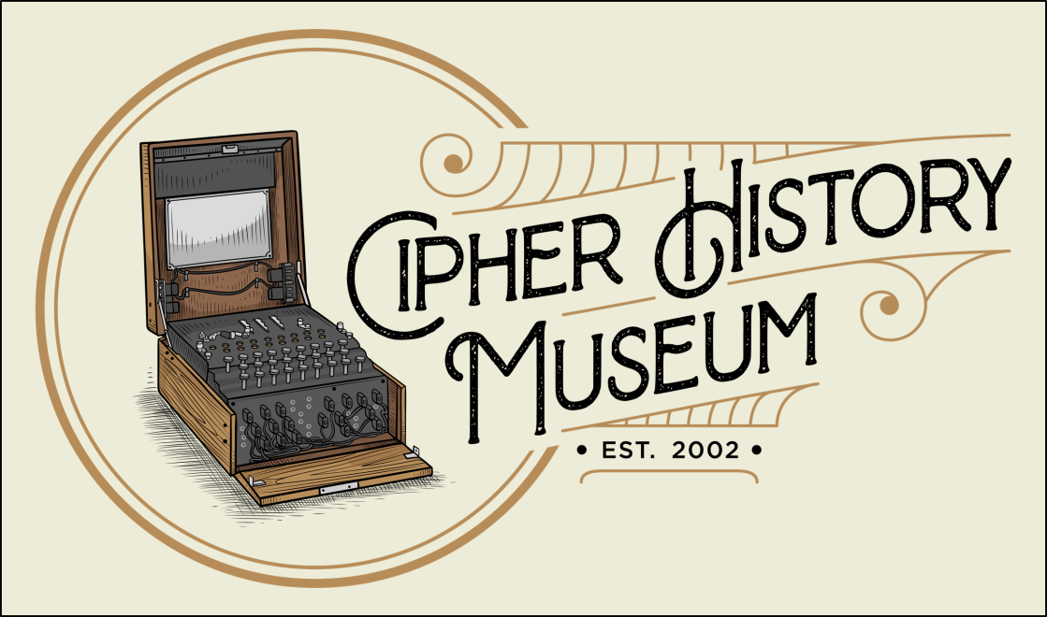
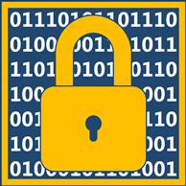
Cryptology: the Secret Battlefield of the Civil War
June 27, 2020
Copyright © 2022
CC Attribution 4.0 International
Ralph Simpson
Ralph@CipherHistory.com
All images and cipher devices in this presentation are from the collection of CipherHistory.com, unless otherwise noted

Slide 2
Cryptology in the Civil War
Not much is written about cryptology in the Civil War
No new crypto technology
Beginning of crypto warfare
Birth of US Signal Corps
Battles were won and lost based on crypto or cryptanalysis
Lessons learned
Lessons not learned, mistakes repeated in WW1
Why should we study Civil War crypto?
Cryptology: the Secret Battlefield of the Civil War
Copyright © 2020 CipherHistory.com
2

Slide 3
Civil War Crypto Landscape
Most widely used crypto:
Vigenère cipher
Transposition and substitution
Code books
Dictionary and other books as code book
Steganography (messages hidden in pocket watches, cigars, invisible ink, Cardano grille, etc.)
Crypto was 400+ years old and worked in the days of couriers on horseback, but was now seriously compromised by the new technology of telegraphy
Cryptology: the Secret Battlefield of the Civil War
Copyright © 2020 CipherHistory.com
3

Slide 4
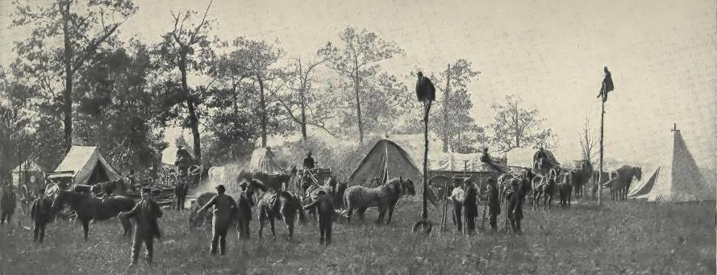
New Message Technology in Civil War
Union Military Telegraph Construction Corps
April, 1864
Civil War - first major war to use telegraphy, revolutionized warfare
Generals have more control over battlefield strategy
Messages received immediately over long distances
Union sent 6.5 million messages over 15,000 miles wires
Wigwag signal flags invented – digital aerial telegraphy
For the first time, many messages were intercepted by the enemy
Cryptology: the Secret Battlefield of the Civil War
Copyright © 2020 CipherHistory.com
4

Slide 5
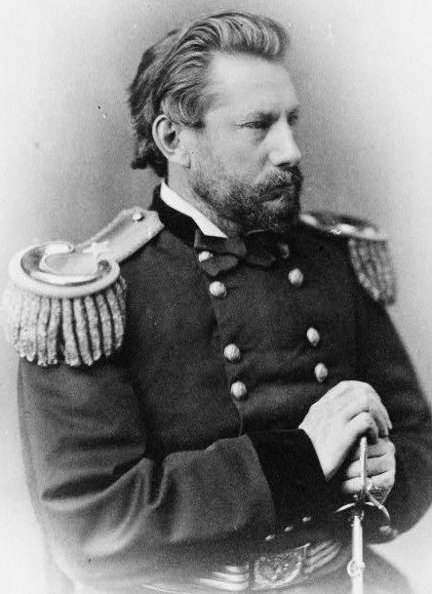
Birth of the US Signal Corps
Albert J. Myers paid for medical school by working as a telegrapher
Doctoral thesis - sign language for deaf
Joined US Army in 1854 as surgeon
Invented “wigwag” digital aerial signaling
Wigwag used single flag as 1 or 2
Lt. Col. Robert E. Lee headed the committee approving wigwag and Myers
Myers was first Chief Signal Officer and headed new Signal Corps in 1860
Second in command for Signal Corps was Lt. Edward Alexander, from Georgia
Gen. Albert J. Myers, US Signal Corps
Cryptology: the Secret Battlefield of the Civil War
Copyright © 2020 CipherHistory.com
5

Slide 6
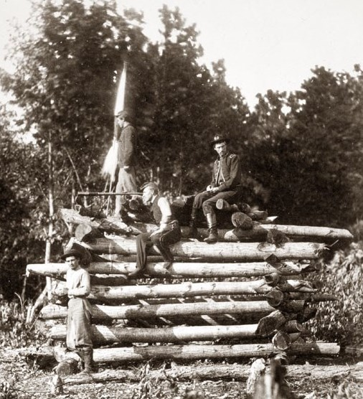
Wigwag
Single flag waved left or right for 1 or 2, “wig or wag”
Four digits represents all letters
Simple signaling, visible for up to 15 miles
Lanterns used at night
Digital system allowed for encrypting signal
Union wigwag platform near Antietam, Sept. 1862
Cryptology: the Secret Battlefield of the Civil War
Copyright © 2020 CipherHistory.com
6

Slide 7
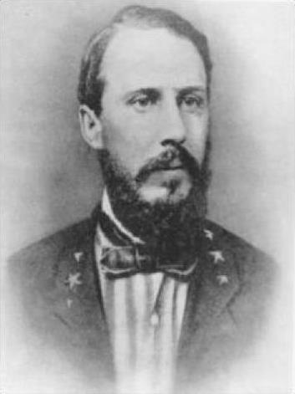
Birth of the Confederate Signal Corps
Lt. Alexander was assistant to Myers, joined South for Civil War
Became Capt. and Chief Signals Officer for South in June 1861
Direct competitor to his old boss
Alexander quickly trained South in the wigwag system invented by Myers
Also used spies in Washington DC and personally went in hot air balloons to find enemy positions
Climbed poles to tap into telegraph messages
Promoted to Lt. Col. by end of 1861, General in Feb. 1863
Capt. Edward Alexander, Chief Signals Officer, Confederate Signal Corps
Cryptology: the Secret Battlefield of the Civil War
Copyright © 2020 CipherHistory.com
7

Slide 8
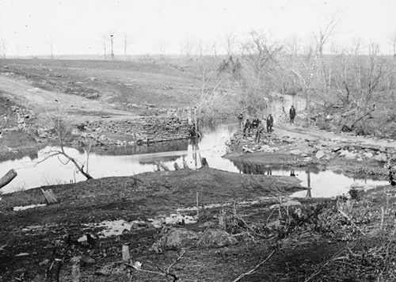
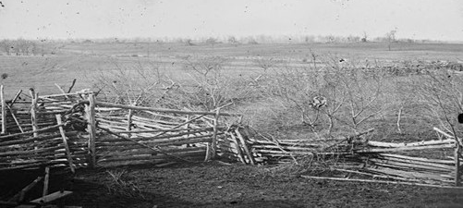
First use of Wigwag by South
Confederate Wigwag signals used in first land battle, First Battle of Bull Run, July 21, 1861
North outnumbered South, 35,000 to 20,000
Wigwag warned of Union flanking move, turning Union rout to Confederate victory
Wigwag changed outcome of first battle
North immediately started wigwag signaling
Bull Run Battlefield
Cryptology: the Secret Battlefield of the Civil War
Copyright © 2020 CipherHistory.com
8

Slide 9
Signal Corps – North vs South
The South had a quicker start, at First Battle of Bull Run
Myers was embroiled in politics with US Military Telegraphers Corps, headed by Anson Stager, co-founder of Western Union
US MTC was civilian organization, reporting to Sec. of War
Myers relieved of duty in Nov. 1863, reinstated after war
By the end of the war, the Union Signal Corps had 3,000 men, the South had half that number
Abraham Lincoln made extensive use of telegraph, changing generals often
Jefferson Davis left war strategy to Robert E. Lee
Both Myers and Alexander would attain the rank of General
Cryptology: the Secret Battlefield of the Civil War
Copyright © 2020 CipherHistory.com
9

Slide 10
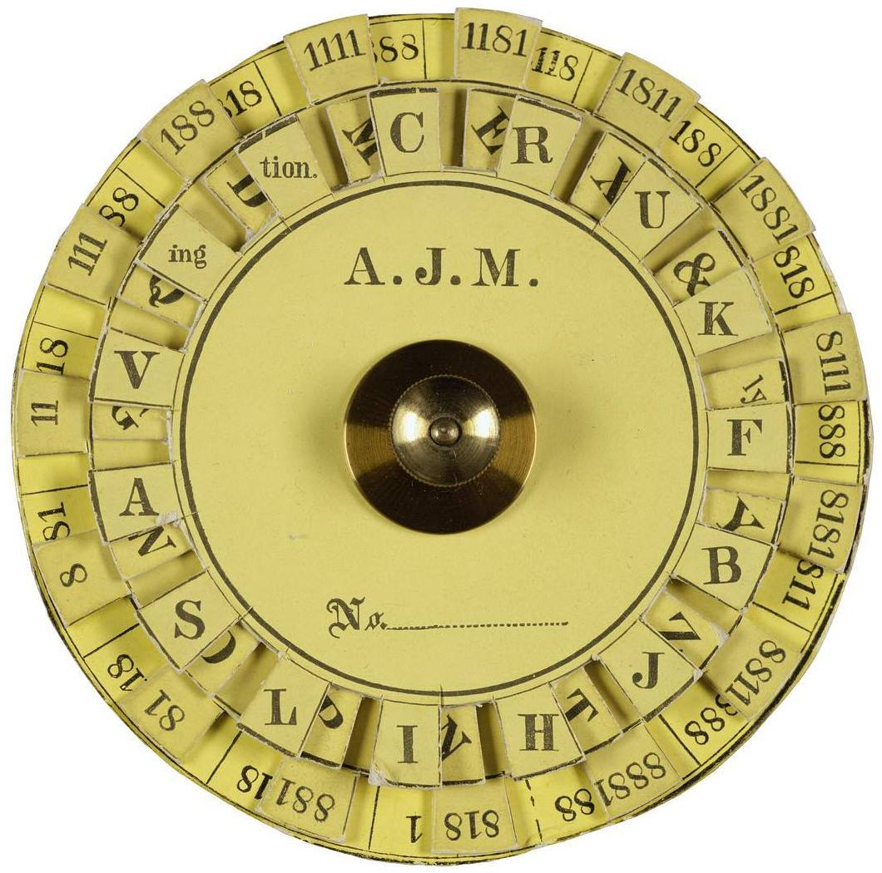
Union Vigenère Cipher
“A.J.M.” is Albert J. Myers
Vigenère disk directly encodes wigwag signals
“8” and “1” used because they can be read in any orientation
“2” not used because it could be confused if partly obscured
4 bit code gives 30 characters
Wigwag was relatively effective and secure
Union Cipher Disk
Vigenère disk was also used for telegraphy and courier messages
Cryptology: the Secret Battlefield of the Civil War
Copyright © 2020 CipherHistory.com
10

Slide 11
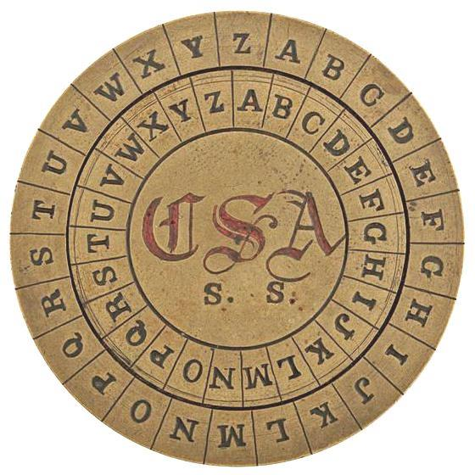
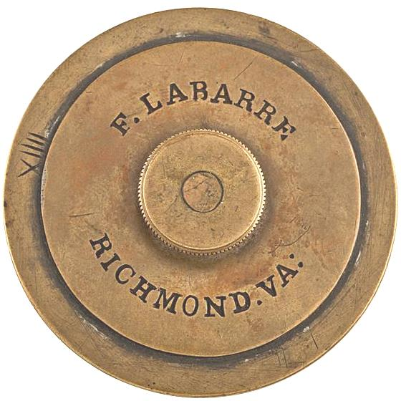
Confederate Vigenère Cipher
“CSA S.S.” means Confederate States of America, Secret Service
57mm or 2.25in. diameter, designed by Francis LeBarre in 1862
Only 5 known to exist:
One in Smithsonian
Two in Museum of the Confederacy in Richmond, VA
Two in private hands
This one, serial # XIIII, sold in 2014 for $18,000 (one that got away!)
Cryptology: the Secret Battlefield of the Civil War
Copyright © 2020 CipherHistory.com
11

Slide 12
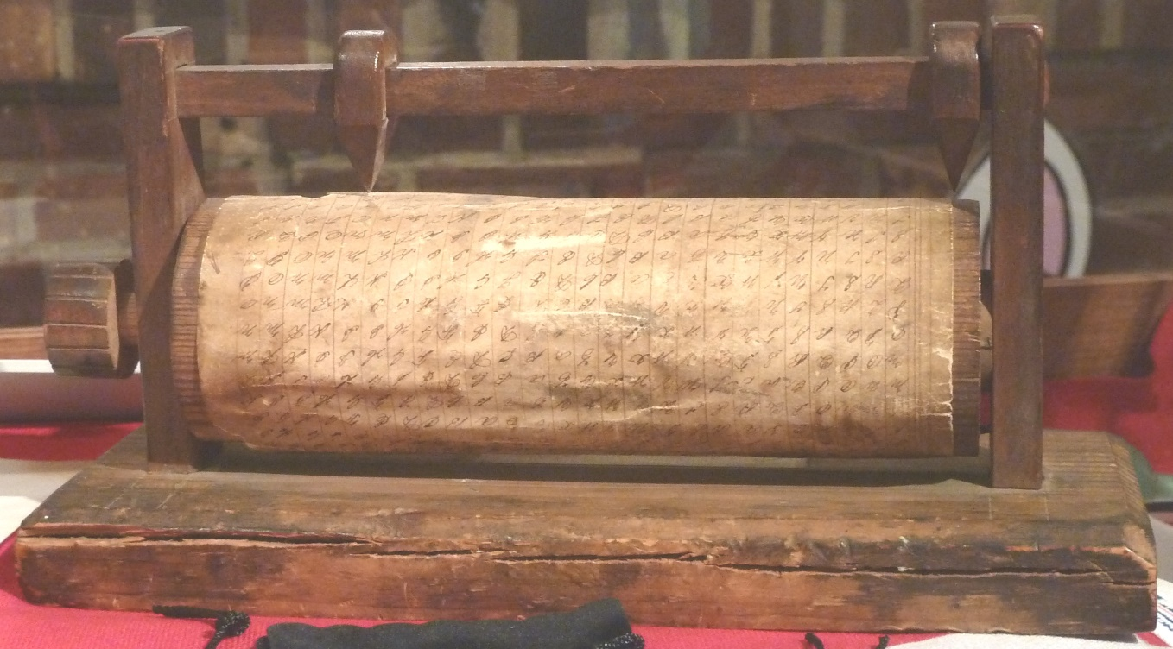
Confederate Vigenère Cipher
Confederate cipher wheel at NCM
“Fred Flintstone” cipher wheel
Only one known to exist, in National Cryptologic Museum
Vigenère table with 2 pointers to find intersection point
Appears to be a solution in search of a problem
Highlights the lack of knowledge of cryptology
Cryptology: the Secret Battlefield of the Civil War
Copyright © 2020 CipherHistory.com
12

Slide 13
Civil War Codebreaking
Both sides of the Civil War intercepted messages and broke enemy codes
Union was more consistent and secure
South only used 4 keywords throughout the war, and changed them only after proof of compromise
Complete Victory
Manchester Bluff
Come Retribution
In God we Trust
First break by North was during Battle of Shiloh in April, 1862; solution published in the New York Herald
Confederates changed keyword to Manchester Bluff
Cryptology: the Secret Battlefield of the Civil War
Copyright © 2020 CipherHistory.com
13

Slide 14
Union Codebreaking
After the war, a Confederate crypto officer on Gen. Joseph Johnston’s staff wrote:
“Col. E [Benjamin S. Ewell] taught me the cipher & the password, or keyword, to read the dispatches. . . The system was only to put the most important words of a message into cipher - & occasionally an unimportant one to mislead - so as to prevent detection. I may of course now mention the keyword then in use. It was “Manchester Bluff.”
During Battle of Vicksburg, Johnston sent message by courier for reinforcements, but cipher was mangled. 12 hours later courier returns to resend message, but it was too late
South lost Vicksburg and Union found cipher messages
July 1863 Confederates changed keyword to “Come Retribution”
In the final weeks of the war, it was changed to “In God we Trust”
Cryptology: the Secret Battlefield of the Civil War
Copyright © 2020 CipherHistory.com
14

Slide 15
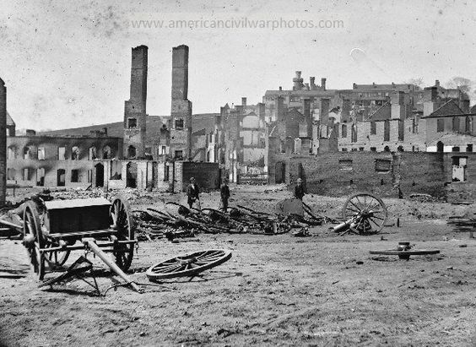
Confederate Codebreaking
Confederates were not as successful as the North, but were known to break some Union Vigenère ciphers
At Battle of Petersburg, Robert E. Lee gave his commanders the encrypted wigwag flag alphabet used by the Union Army
The South still lost Petersburg and Richmond, leading to their surrender on April 9, 1865
Confederate Capital
Richmond, VA
April 1865
Cryptology: the Secret Battlefield of the Civil War
Copyright © 2020 CipherHistory.com
15

Slide 16
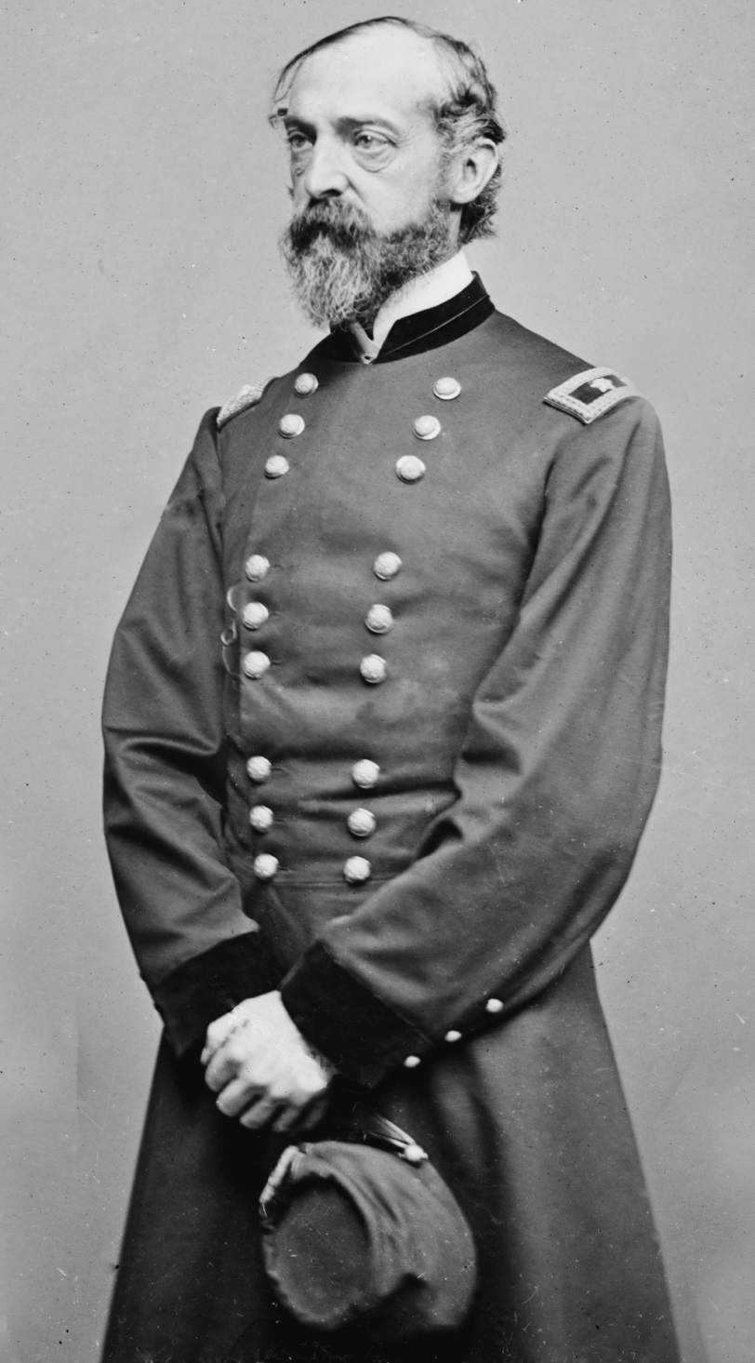
Value of Signal Corps
Most soldiers knew the role of the Signal Corps but did not understand their value
Union General George Meade place great value on the Signal Corps
Meade known for winning the Battle of Gettysburg
When he moved his headquarters location, he delayed the move until the telegraphers were operational at the new location
Aptly, NSA headquarters at Ft. Meade is named for General Meade
Major General George Meade
Cryptology: the Secret Battlefield of the Civil War
Copyright © 2020 CipherHistory.com
16

Slide 17
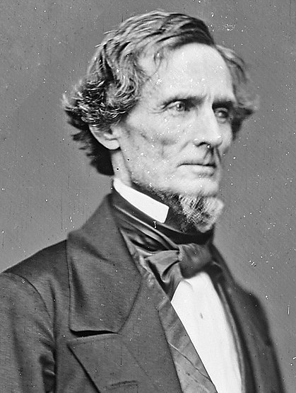
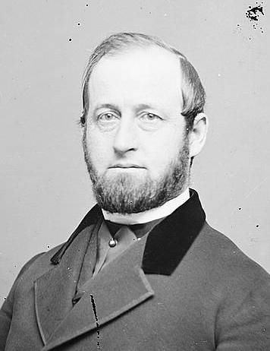
Other Ciphers
Jefferson Davis
President of the
Confederacy
Anson Stager
co-founder, Western Union
Confederate President Jefferson Davis used a dictionary as his code book, not a very strong cipher
Anson Stager took over from Albert Myers as Chief Signals Officer and mainly used transposition ciphers
Despite this being a weak cipher, it was not broken
Intercepted messages were published in newspapers with rewards offered, but they were never decoded
Cryptology: the Secret Battlefield of the Civil War
Copyright © 2020 CipherHistory.com
17

Slide 18
Lessons Learned… or Not!
New invention of telegraphy transformed battlefield strategy
Information, collaboration, intervention in war by government leaders
Current cipher technology was 400 years old and inadequate when many messages are intercepted
What happened in WW1?
New invention of radio and telephone transformed war strategy to include air force, navy, and army at all levels
Information, collaboration, intervention in war by government leaders
Cipher technology was the same as in the Civil War, but now with more known methods of cryptanalysis
Cryptology: the Secret Battlefield of the Civil War
Copyright © 2020 CipherHistory.com
18

Slide 19
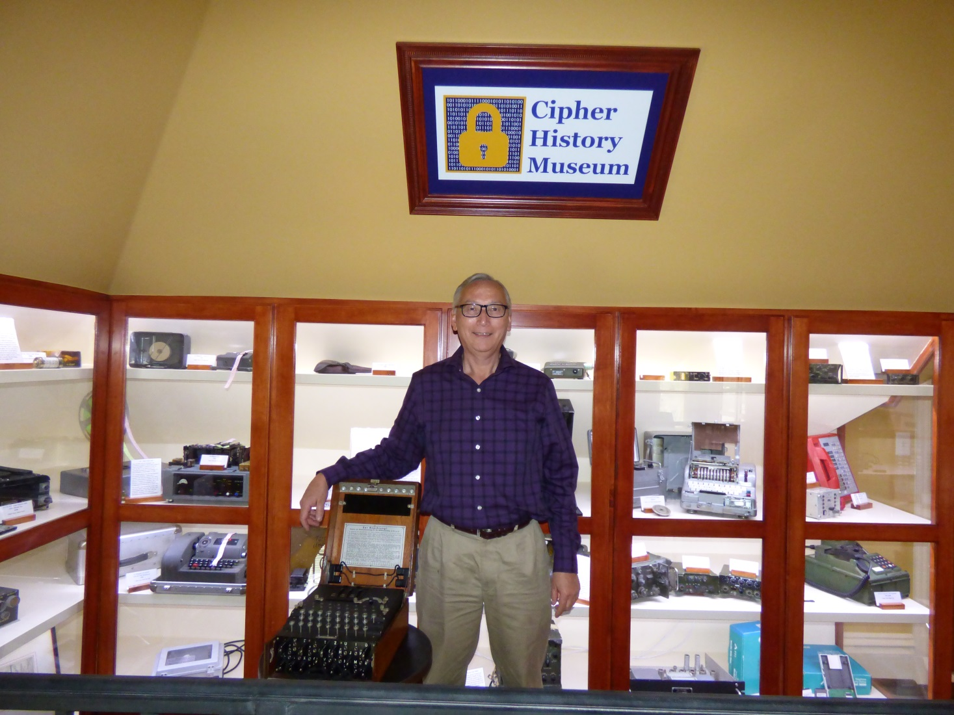
Download this Presentation
Slides: CipherHistory.com/slides/civilwar.pptx
Article: CipherHistory.com/civilwar.html
Cryptology: the Secret Battlefield of the Civil War
Copyright © 2020 CipherHistory.com
19

