Slide 1
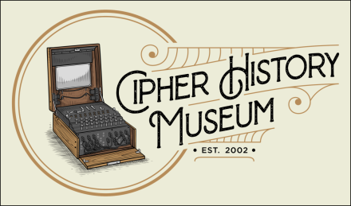
Crypto Wars
Mare Island Historic Park Foundation
St. Peter’s Chapel
August 13, 2023
Copyright © 2023
CC Attribution 4.0 International
Ralph Simpson
Ralph@CipherHistory.com
All images and cipher devices in this presentation are from the collection of CipherHistory.com, unless otherwise noted
Notes:
Cracking the Enigma: the Secret Battlefield of WW2
WW1 was the first war to use radio, which was an enormous strategic advantage, but every country now had their secret messages broken by the enemy! The weakness of existing manual ciphers highlighted the need for more advanced machine ciphers. The Enigma machine was invented during WW1 and was the first cipher device to use electricity. Radio was directly responsible for the resulting birth of crypto warfare.
The Nazis used the Enigma in WW2 and had the utmost confidence in the secrecy of their messages, despite evidence of enemy codebreaking. The story of Allied codebreaking during WW2 is a story of innovation, intrigue, and deception. The success of cracking the Enigma was kept secret for 41 years, until 1974, despite tens of thousands of people working on the effort in the UK and US. This secrecy is especially incredible for us living in the age of the internet, WikiLeaks and Edward Snowden. Over 35,000 Enigma machines were manufactured, but only 380 exist today.
Ralph Simpson Bio
Ralph Simpson worked in the computer industry for 32 years, working for IBM and Cisco Systems. He started as a systems engineer for large mainframe computerss and held a variety of technical and management roles, including authoring an IBM Technical Manual on redundant systems. He retired as Senior Director for Service Strategy at Cisco Systems, with responsibility for 2,500 engineers.
Ralph is now retired and volunteers at History San Jose and the Computer History Museum. He wrote a book on cipher history called, Crypto Wars: 2000 Years of Cipher Evolution. He is also an avid collector of cipher machines, which you can see on his website, CipherHistory.com. Ralph lives in San Jose in a restored Victorian house, which is home to his Cipher History Museum and a very understanding wife.

Slide 2
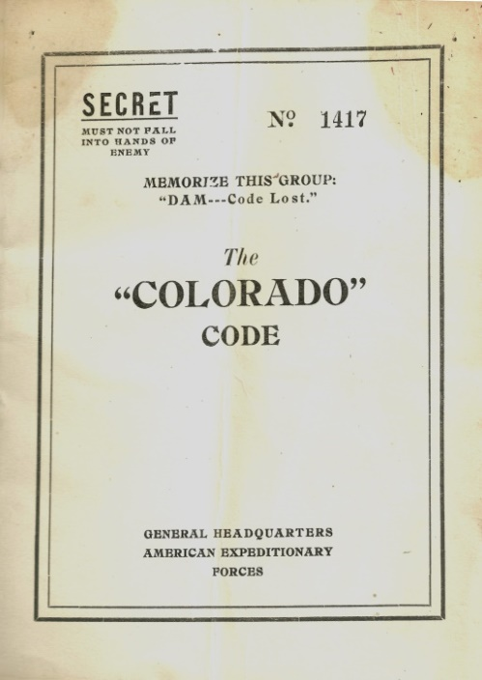
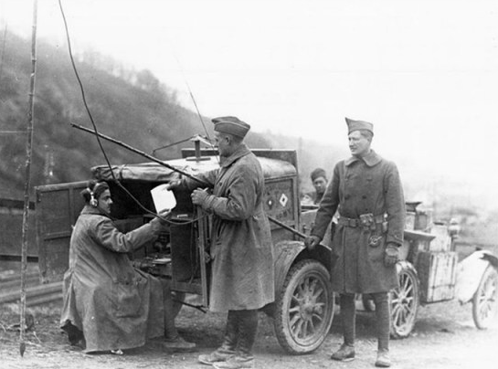
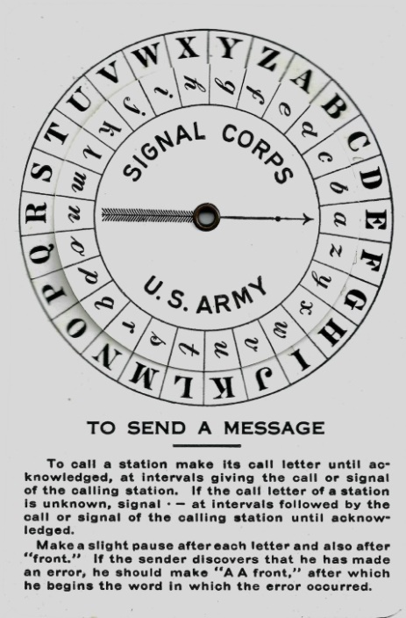
WW1 - first time radio was used in war
WW1 US Army portable radio station in Germany
US Army
Code Book
1918
US Army Vigenère Disk
1912
Photo credit: US Army
Radio radically transformed battlefield strategy, but the enemy can now intercept all messages
Cipher technology was not up to the task
Ciphers were manual, error-prone, 450 years old… and all were broken!
Copyright © 2023 ( CC BY 4.0 ) CipherHistory.com

Slide 3
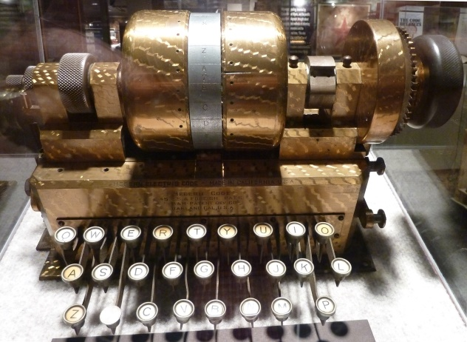
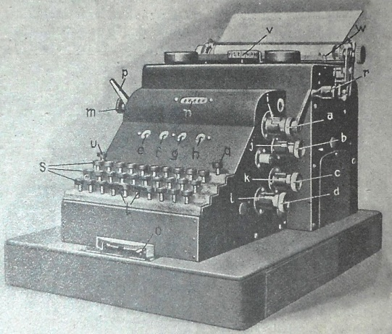
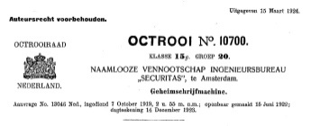
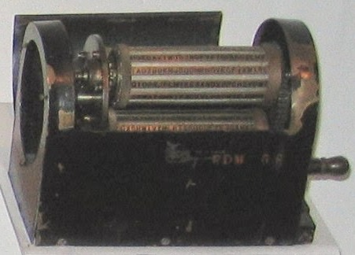

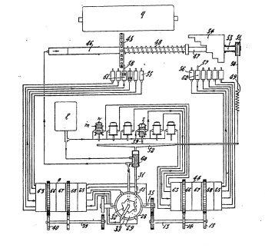
Birth of crypto warfare
Explosion of new cipher technology during WW1:
One-time teletype tape
Cipher wheel
Strip cipher
Burst encoder
4 electro-mechanical rotor machines:
Edward Hebern
USA
1917
Arthur Scherbius
Germany
1918
Hugo Koch
Holland
1919
Arvid Damm
Sweden
1919
Photo credit: Ralph Simpson,
device at NCM. Ft. Meade, MD
Photo credit: 1923 book, Technit, neue
Apparate, Maschinen, Bauwerte
Photo credit: Bureau voor
Industriele Eigendom
Photo credit: Austin Mills,
device in NCM, Ft. Meade, MD
Copyright © 2023 ( CC BY 4.0 ) CipherHistory.com

Slide 4
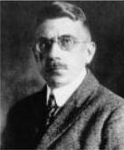
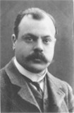
Enigma invention - the classic story
Arthur Scherbius
Germany
(1878-1929)
Hugo Koch
Holland
(1870-1928)
Photo credit: Scherbius family
Photo credit:
Koch family
Scherbius / Koch collaborated on Enigma, filed separate patents
German Navy began testing Scherbius Enigma in 1926
In 1927, Scherbius “curiously” bought the rights to Koch’s patent, paid 600 Dutch guilders (~$350)
“Curious” because Scherbius owned the identical German patent
Koch died in 1928; Scherbius in 1929 in a horse carriage accident
Neither knew the role their invention would have in history
Copyright © 2023 ( CC BY 4.0 ) CipherHistory.com

Slide 5
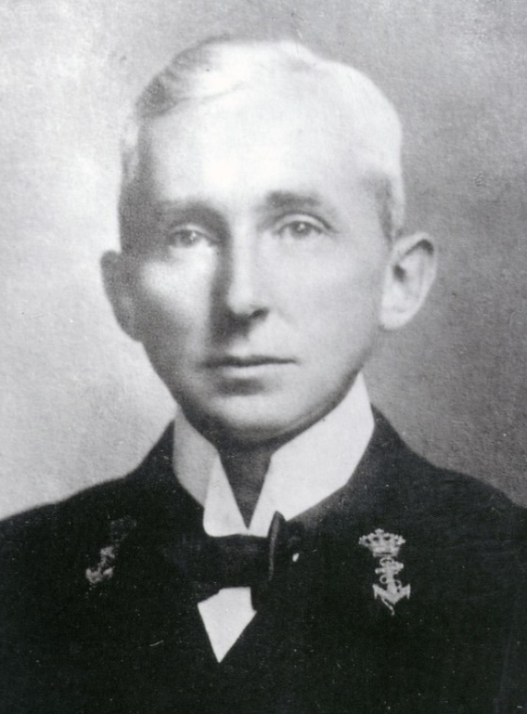
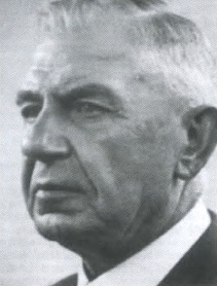
History rewritten in 2003
Theo van Hengel
(1875-1939)
Rudolf P.C. Spengler
(1875-1955)
2003 bombshell: two Dutch naval officers invented the rotor cipher in 1915
Patent attorney hired, but Dutch Navy suppressed patent during WW1
Nov. 1919, Dutch Navy allowed naval officers patent, but Koch filed his patent 3 weeks earlier
Photo credit: Instituut voor Maritieme Historie, Den Haag
Photo credit: Spengler family
Naval officers filed lawsuit against Koch, but lost…
They didn’t know their patent attorney was Koch’s brother-in-law!
Judge was ex-Navy Minister who suppressed the patent in WW1!
Now van Hengel and Spengler are recognized as the true inventors of the rotor cipher and the Enigma machine
Copyright © 2023 ( CC BY 4.0 ) CipherHistory.com

Slide 6
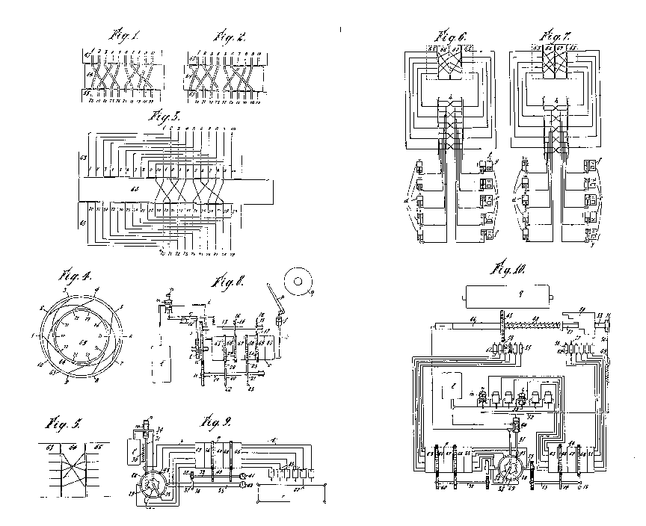
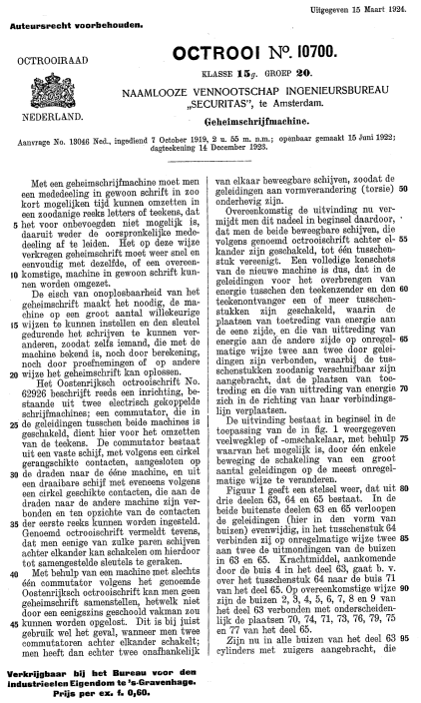
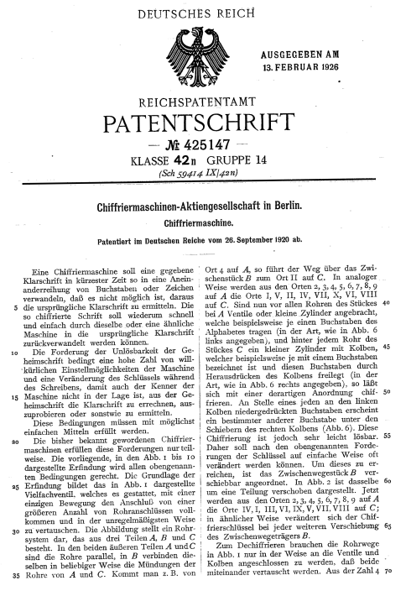
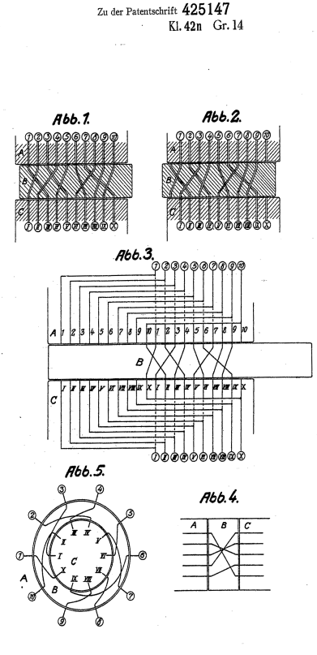
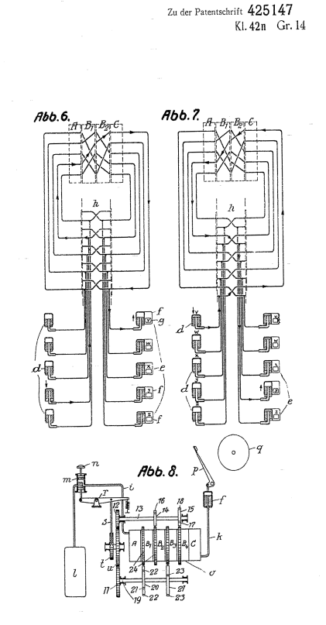
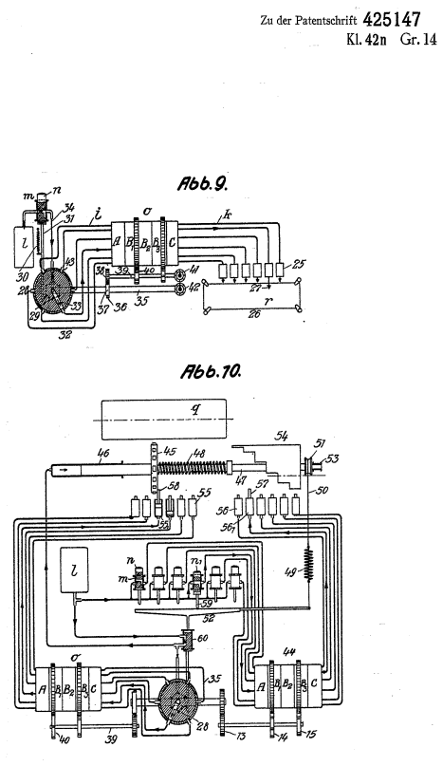
Dutch and German patents are exact copies
Dutch patent NL10700
filed 10/7/1919
Dutch patent never built
German patent filed before Dutch patent was public
Scherbius bought Dutch patent on 1/28/1927
Photo credit: Bureau voor Industriele Eigendom
German patent
DE425147
filed 9/26/1920
Copyright © 2023 ( CC BY 4.0 ) CipherHistory.com

Slide 7

Birth of crypto warfare
Explosion of new cipher technology during WW1:
One-time teletype tape
Cipher wheel
Strip cipher
Burst encoder
Now 3 electro-mechanical rotor machines:
Updated by 2003 revelations
Theo van Hengel
Rudolf P.C. Spengler
Holland
1915
Edward Hebern
USA
1917
Arvid Damm
Sweden
1919
Photo credit: Bureau voor
Industriele Eigendom
Photo credit: Ralph Simpson,
device in NCM. Ft. Meade, MD
Photo credit: Austin Mills,
device in NCM, Ft. Meade, MD
Copyright © 2023 ( CC BY 4.0 ) CipherHistory.com

Slide 8
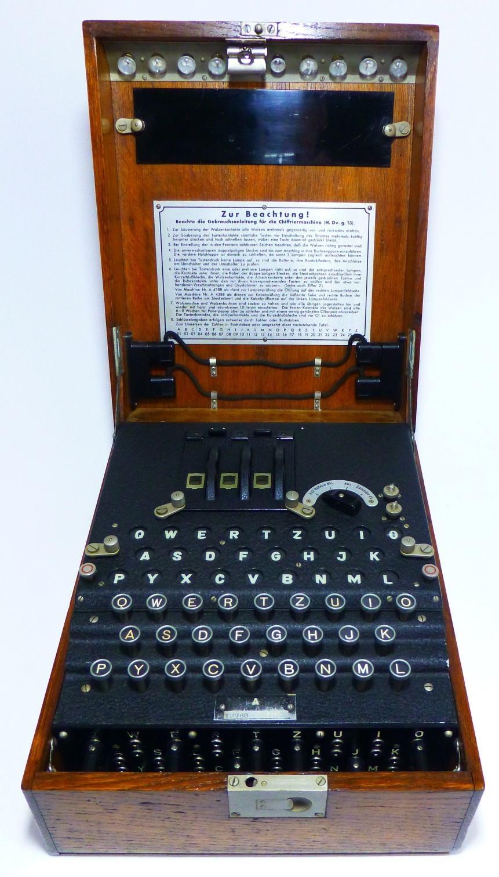
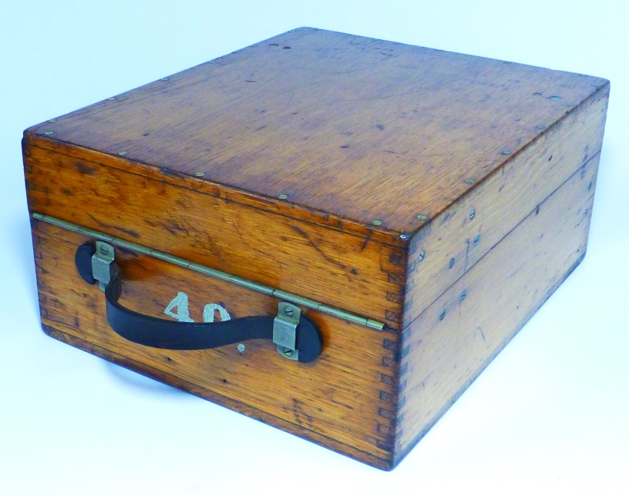
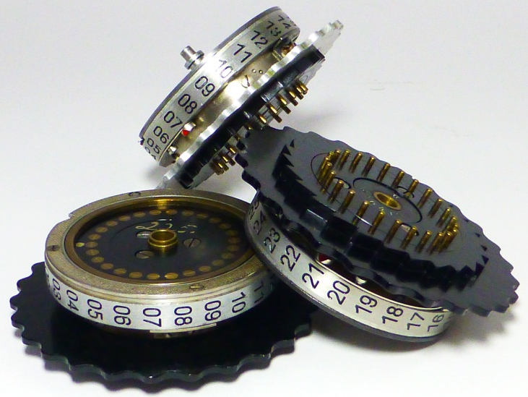
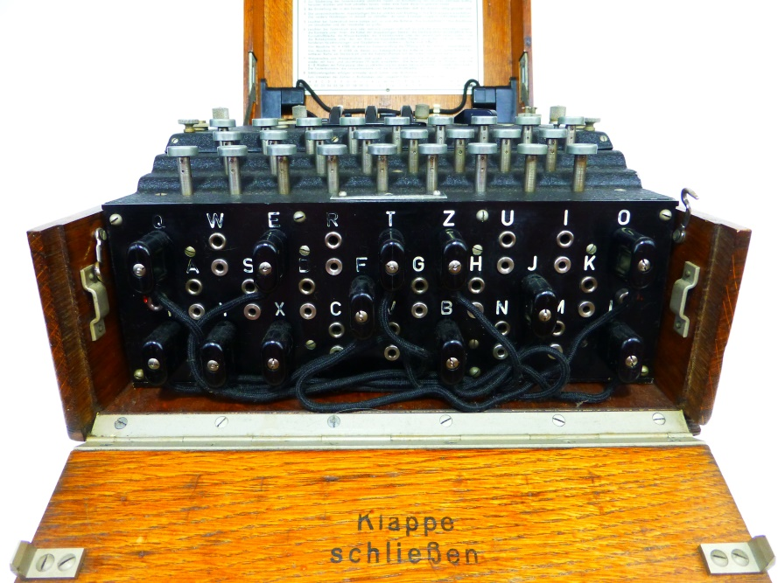
Enigma machine
Enigma means
puzzle or mystery
in German & most
European languages
klappe
schließen
=
close flap
the
your
Copyright © 2023 ( CC BY 4.0 ) CipherHistory.com

Slide 9
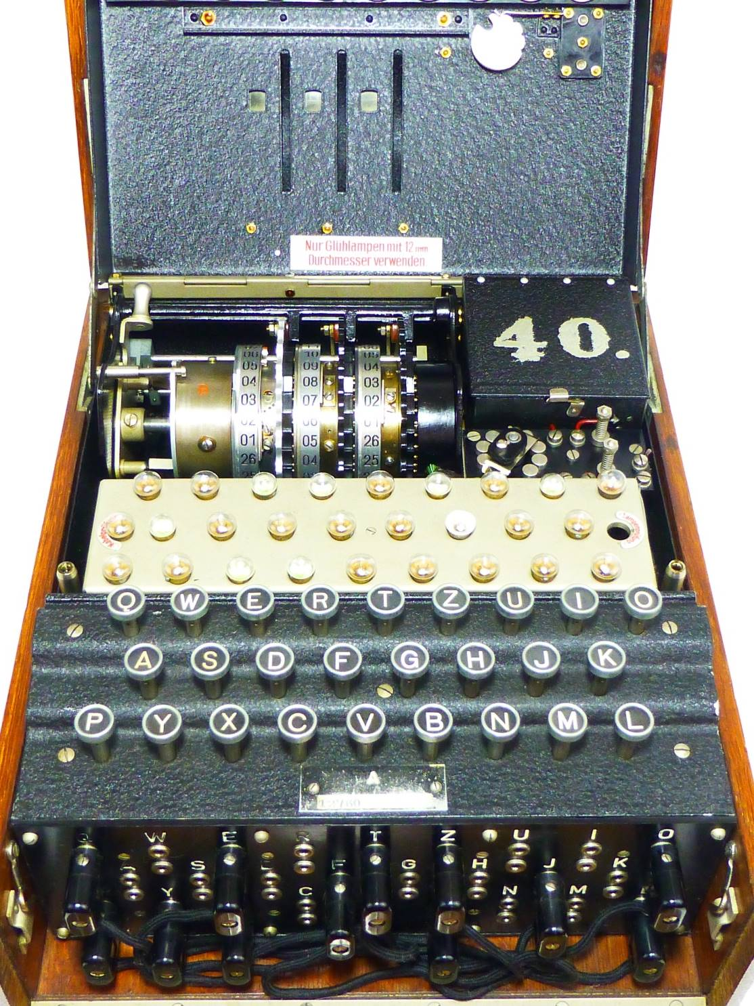
Enigma machine - under the covers
Typewriter style cipher machine, with light bulbs instead of printer
Electro-mechanical rotors was the key innovation
Rotors turn odometer style, so every letter in a message uses a different algorithm
Reflector gives reciprocal encryption / decryption
German military added plugboard
Copyright © 2023 ( CC BY 4.0 ) CipherHistory.com

Slide 10
Enigma wiring - animated!
example: “A” enciphers / deciphers to “H”
Left
Rotor
Middle
Rotor
Right
Rotor
Entry
Drum
Reflector
6
B
2
Rotors
rotate
Current goes through rotors twice
F
B
F
J
J
M
M
X
P
X
O
P
N
O
N
-
Q
W
E
R
T
Z
U
I
O
-
BATTERY
Light Panel
A
S
H
D
F
G
H
J
K
P
Y
X
C
V
B
N
M
L
+
+
1
“A” key pressed
3
Electrical circuit closed
4
Q
W
E
R
T
Z
U
I
O
Electricity flows
Keyboard
A
S
D
F
G
J
K
A
H
P
Y
X
C
5
V
B
N
M
L
Q
E
Plugboard swaps letters 0, 1 or 2 times
W
R
T
Z
U
I
O
O
A
S
D
F
G
H
J
K
O
Plugboard
N
P
Y
X
C
V
B
M
L
M
M
Copyright © 2023 ( CC BY 4.0 ) CipherHistory.com
& EnigmaMuseum.com

Slide 11
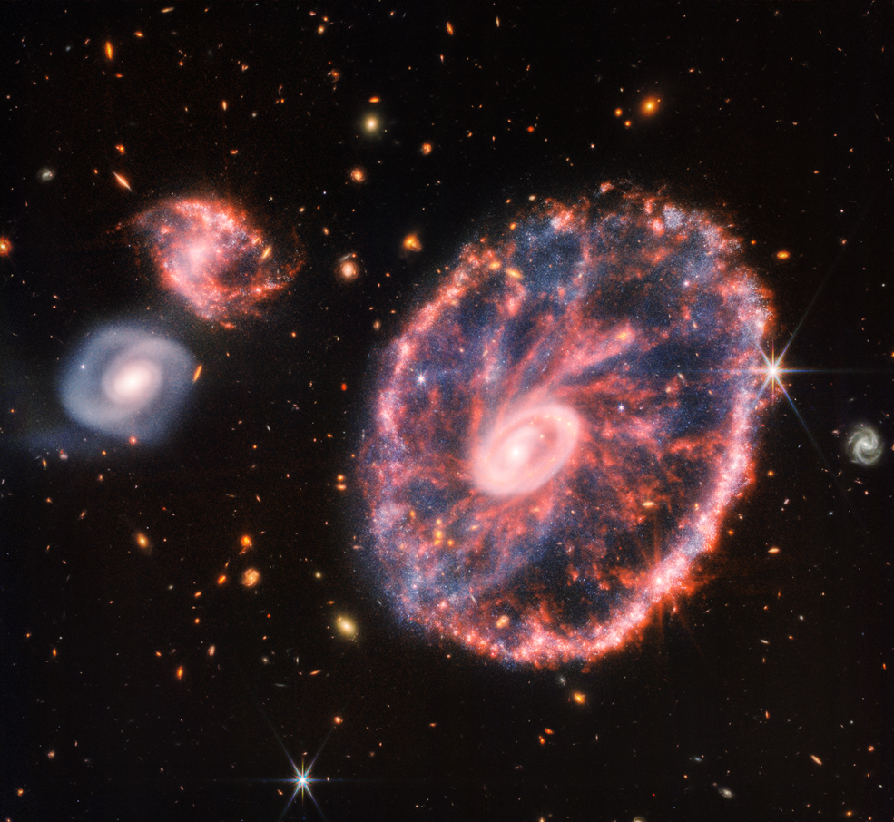
Cryptographic strength of Enigma
Webb Space Telescope view of
cartwheel and spiral galaxies
Theoretical maximum # of Enigma settings is 3 X 10¹¹⁴ ( # atoms in universe = 10⁸⁰ )
If an enemy captures the Enigma, the # settings is still astronomical - 10²²
10²² is equal to a 75 bit key, far better than the 56 bit DES standard, used until 2001
A 75 bit key means:
Photo credit: NASA, ESA, CSA, STScI
If 100,000 Enigma operators could each check
one key setting every second, 24X7…
Takes twice the age of the universe to break the code!
Copyright © 2023 ( CC BY 4.0 ) CipherHistory.com
Notes:
Plugboard gives 47 bits of key space compared to the 29 bits for the rest of the machine. So the German military addition of the plugboard added tremendous strength compared to the commercial Enigma.
Despite the large key space of 47 bits, by itself the plugboard is quite easy to break, just like a NY Times cryptogram. But when added to the rotors, the plugboard settings become randomized, making the total keyspace unbreakable by brute force during WW2. The solution provided by Marian Rejewski was to separate the plugboard and the rotors, and solving for the rotors only. Once the rotors are solved, the plugboard is manually and easily broken, just like that NY Times cryptogram.

Slide 12
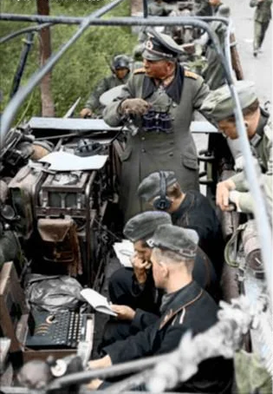
Enigma Weaknesses
Greatest vulnerability was lax operator procedures
Reflector was reciprocal, so no letter encoded to itself
Rotors had regular, odometer movement
Ironically, brute strength of the Enigma gave Germans too much confidence in its security
Panzer General Heinz Guderian on communications truck with Enigma (May/June 1940)
Photo credit: Deutsches Bundesarchiv, colored by Lopatin V.
Copyright © 2023 ( CC BY 4.0 ) CipherHistory.com

Slide 13
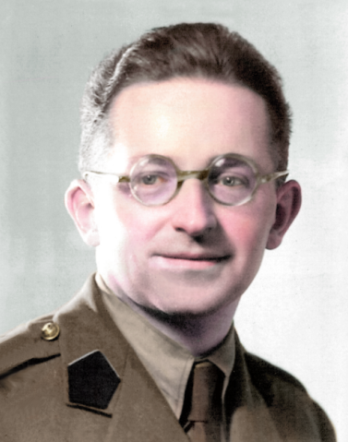
Poland was first to break Enigma
Marian Rejewski (1905-1980),
in UK c.1943/44
In 1932, German spy Hans-Thilo Schmidt sold Enigma keys to Allies
Marian Rejewski used mathematics to recreate & break Enigma, in Dec. 1932
Breakthrough was breaking of rotors and plugboard separately, so now…
100,000 operators can break Enigma in 2 hours vs “twice age of universe”!
Poles made “Bomba,” 6 Enigmas in series, to quickly break daily key (Bomba = Eureka in Polish)
Photo credit: Public domain, unknown photographer
Polish codebreaking success kept secret for 7 years
Poles finally disclosed Enigma secrets to UK and France just 5 weeks before Germany invaded Poland on Sept. 1, 1939
Copyright © 2023 ( CC BY 4.0 ) CipherHistory.com

Slide 14
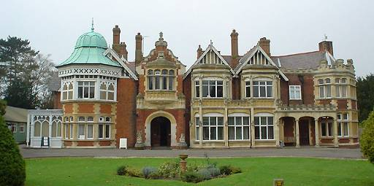
British effort in breaking the Enigma
Bletchley Park Mansion
Photo credit: Standardissuemagazine.com
In 1939, UK began a major decoding effort at Bletchley Park, employing 11,000
Effort led by Alan Turing, who built the Bombe: 36 Enigmas in series to find possible rotor settings
After the Bombe found rotor settings, plugboard cables were solved manually
Copyright © 2023 ( CC BY 4.0 ) CipherHistory.com

Slide 15

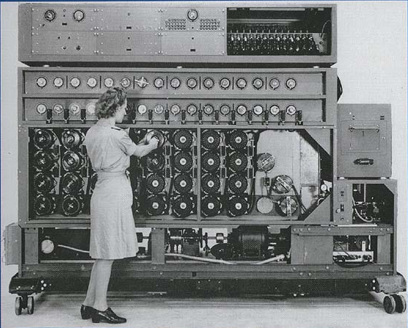
Bombe - the beginning of computing
Alan Turing
(1912-1954)
“Father of
Computing”
US Bombe
Photo credit: Godrey Argent Studio, via The Royal Society
Photo credit: NCM, Ft. Meade, “Solving the Enigma”
Poles named their electro-mechanical codebreaker “Bomba,” British used “Bombe” in honor of Polish contribution
British exploited cribs vs Poles exploit of double message key
211 UK Bombes were built, most were destroyed after WW2
US employed NCR to build a faster version of the Bombe to decode the 4-rotor naval Enigma - 121 were built
Copyright © 2023 ( CC BY 4.0 ) CipherHistory.com
Notes:
The British bombe operated at a speed of 50 rpm, later improved to 120 rpm.
The US bombe operated at 1725 rpm.
It took about 20 min. to test all the combinations of a 3 rotor setting for the British Bombe.
It took about 20 min. to test all the combinations of a 4 rotor setting for the US Bombe.
The US Bombe could test a 3 rotor setting in 50 seconds.

Slide 16
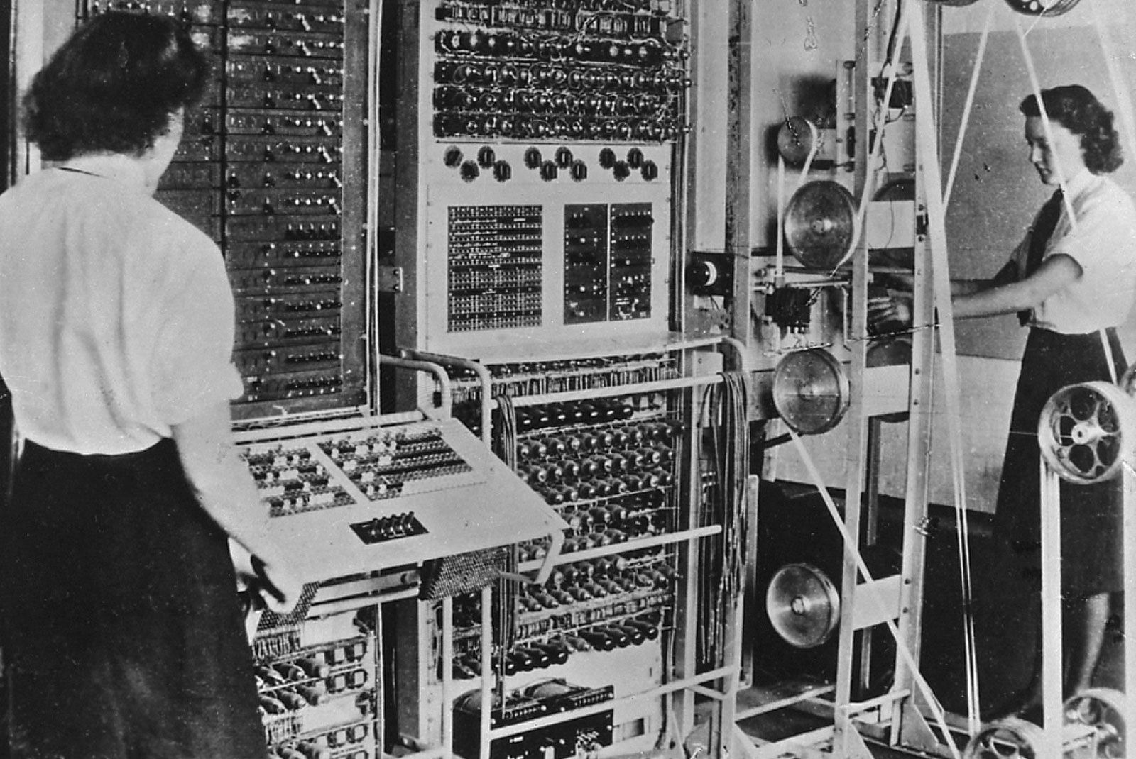
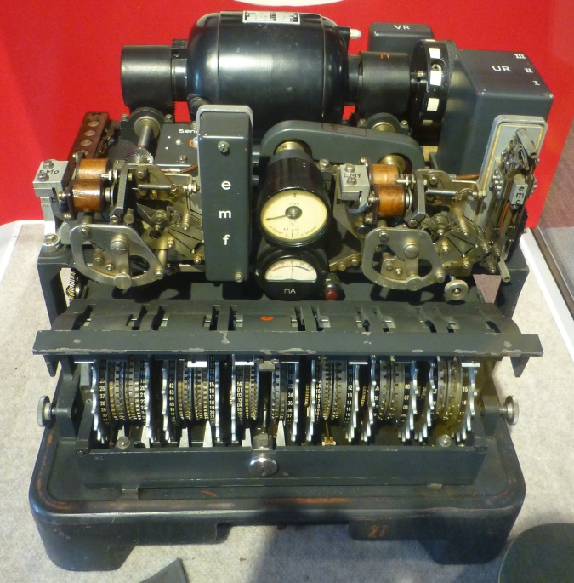
Colossus computer
Lorenz SZ-42 cipher
Enigma
story
Photo credit: Ralph Simpson,
device at NCM, Ft. Meade, MD
Photo credit: UK National Archives
Colossus world’s first electronic, programmable, digital computer
Uses 2400 vacuum and thyratron tubes
Colossus breaks Lorenz teletype cipher, not Enigma
Lorenz cipher used for high level messages
Copyright © 2023 ( CC BY 4.0 ) CipherHistory.com
Notes:
The British bombe operated at a speed of 50 rpm, later improved to 120 rpm.
The US bombe operated at 1725 rpm.
It took about 20 min. to test all the combinations of a 3 rotor setting for the British Bombe.
It took about 20 min. to test all the combinations of a 4 rotor setting for the US Bombe.
The US Bombe could test a 3 rotor setting in 50 seconds.

Slide 17
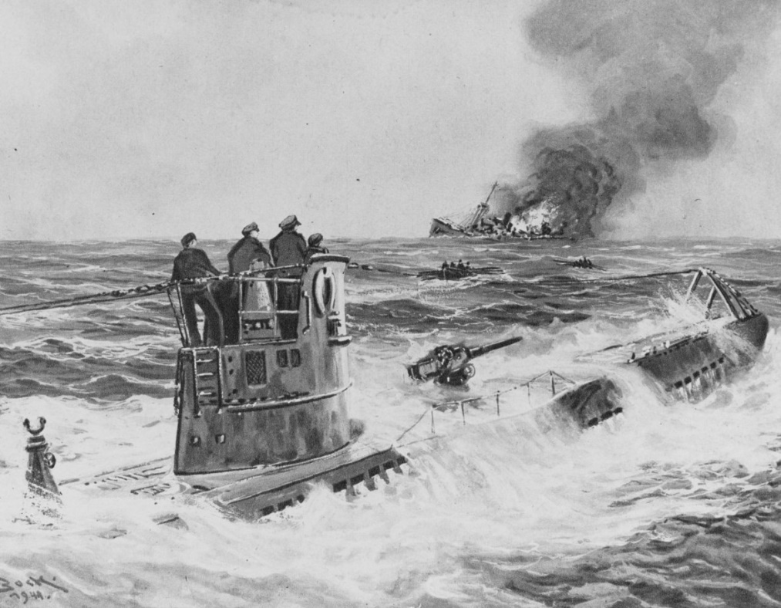
U-boat peril
Before the US entered the war, U-boats sank 60 ships / month
U-boats roamed freely, then formed “wolfpacks” to sink convoys efficiently
Nazis expected a UK blockade to result in a quick surrender
Naval Enigma was initially the same as the Army, but later a 4-rotor version was used with more rigorous procedures
Naval Enigma messages were secure until May 1941
“ The only thing that ever really frightened me during the war was the U-boat peril.”
- Winston Churchill
U-boat sinks an English freighter, from a German book published during WWII
Photo credit: Naval History and Heritage Command
Copyright © 2023 ( CC BY 4.0 ) CipherHistory.com

Slide 18
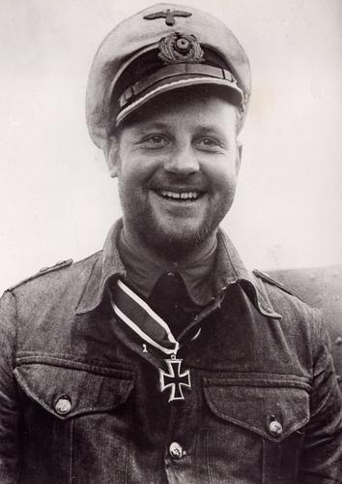
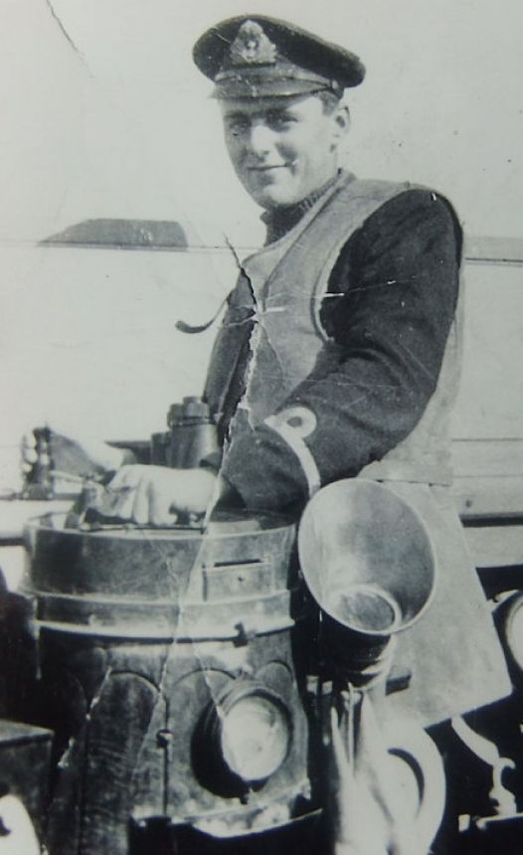
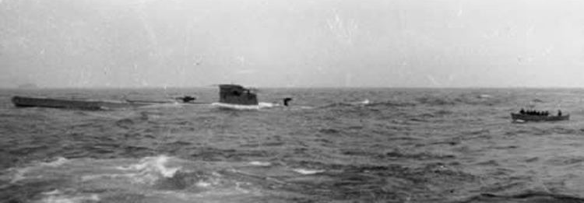
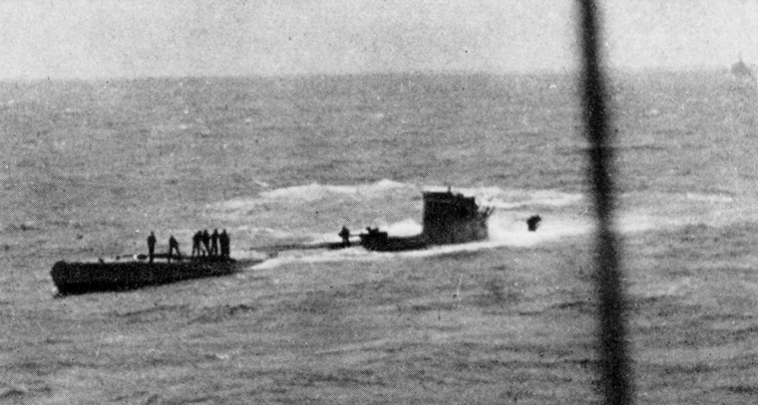
Capture of U-110
U-110 Captain Fritz-Julius Lemp
First code books captured from a U-boat was on May 9, 1941
Captain died trying to scuttle U-110
Germans didn’t know 3 months of codes were stolen, by Lt. Balme
5 ships, from 1 Enigma message, were sunk on June 3 & 4, 1941
U-110 capture was the turning point in the Battle of the Atlantic
Lt. David Balme on deck of HMS Bulldog
Photo credit: reibert.info
Photo credit: forces.net
Balme leads boarding party to captured U-110
UK sailors on deck of U-110
Photo credit: uboatarchive.net
Photo credit: uboatarchive.net
Copyright © 2023 ( CC BY 4.0 ) CipherHistory.com

Slide 19
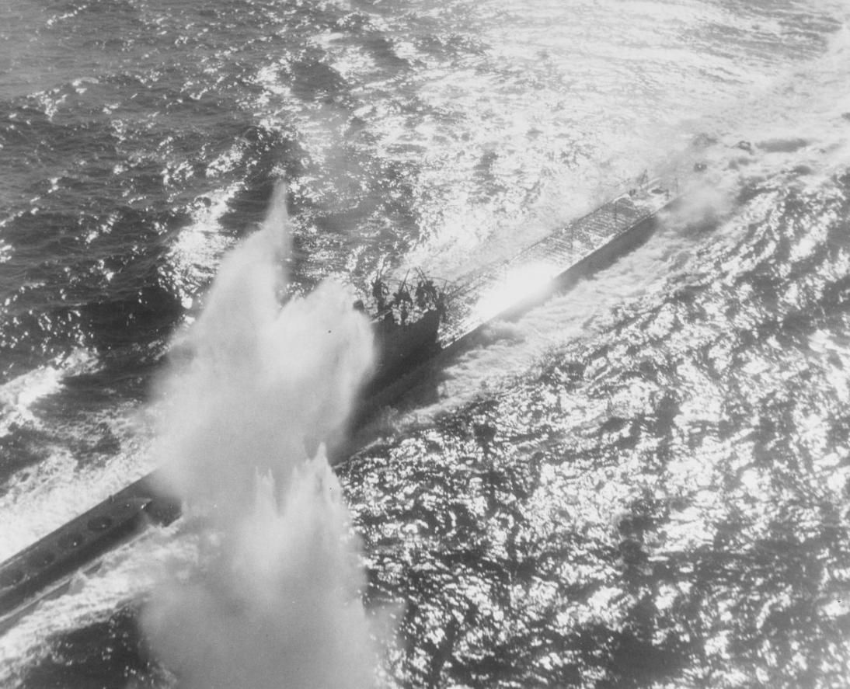
Battle of the Atlantic
After breaking Naval Enigma, the British continuously re-routed convoys to avoid U-boats
Unarmed weather trawlers carried Enigma, a recurring target for more code books
British targeted supply ships and mother U-boats
Early U-boat success turned to failure, 725 of
US bombing of U-117 – Aug. 1943
Photo credit: US National Archives
1155 U-boats and 82% of 35,000 sailors never returned from sea
Some estimate breaking the Enigma shortened WW2 by 2 years
Copyright © 2023 ( CC BY 4.0 ) CipherHistory.com

Slide 20
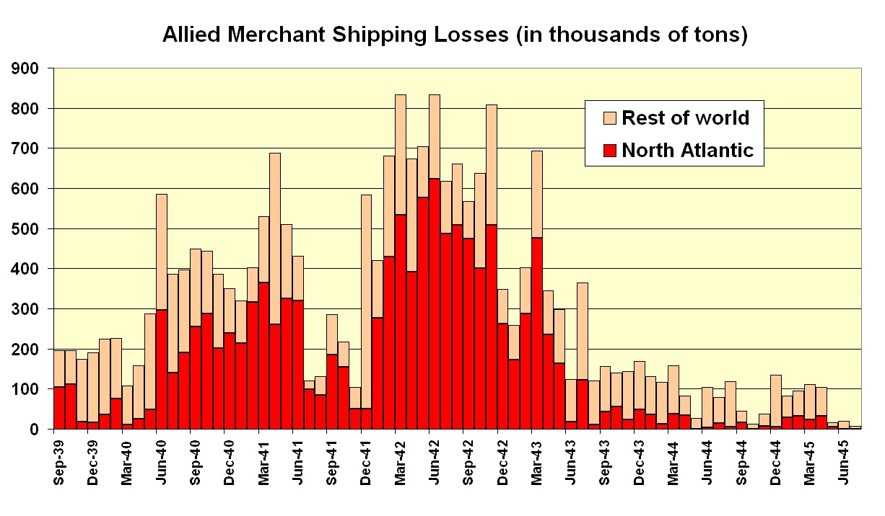
Allied shipping losses vs codebreaking
Tons (000s)
Allied Shipping Losses in WW2
900
800
700
600
500
400
300
200
100
0
1st break in 4-rotor Enigma
Rest of World
North Atlantic
4-rotor Enigma
U-110 & other
captures
U-Boats
exit Atlantic
US Bombe deployed
Sep-39
Dec-39
Mar-40
Jun-40
Sep-40
Dec-40
Mar-41
Jun-41
Sep-41
Dec-41
Mar-42
Jun-42
Sep-42
Dec-42
Mar-43
Jun-43
Sep-43
Dec-43
Mar-44
Jun-44
Sep-44
Dec-44
Mar-45
Jun-45
Copyright © Dr. Mark Baldwin, DrEnigma.org

Slide 21
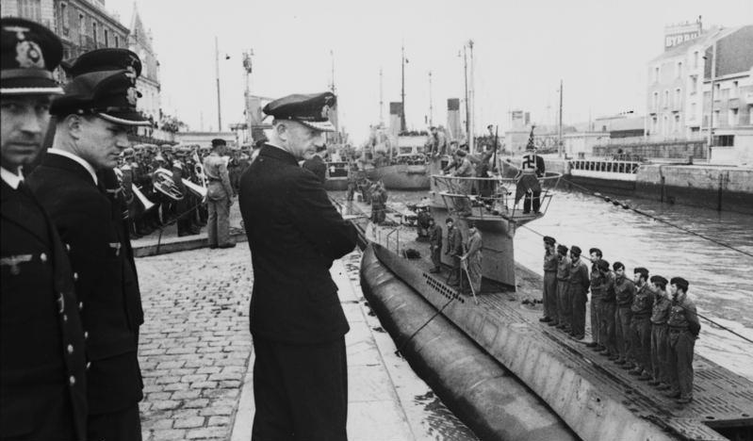
Did Germans know Enigma was broken?
Allies only exploited Enigma messages after deception of traditional sources: (spotter planes, spies, etc.)
But, Allied codebreaking should have been suspected:
5 ships, from one Enigma message, all sunk in 2 days!
Admiral Dönitz inspects U-boat
at Saint-Nazaire, France
Photo credit: Bundesarchiv
Supply convoy for Gen. Rommel in Africa found and sunk, despite continuous cloud cover from Naples to Africa
Was 4-rotor Enigma designed to counter UK codebreaking?
No, more likely security from other Nazi military or spies
Confirmed in interview with Admiral Dönitz in 1974
Copyright © 2023 ( CC BY 4.0 ) CipherHistory.com

Slide 22

Enigma after WW2
Codebreaking success was kept secret for 41 years, until 1974, despite thousands who knew the secret in the US and UK
US and UK encouraged use of Enigma by other countries, including Allies, reading their secret messages for 3 decades
About 35,000 Enigmas were manufactured
Today, about 380 Enigma machines are known to exist, half in museums, half in private collections
David Hatch, NSA Historian, tells story of US Navy missile test, sinking “pallet loads” of Enigma machines
(pallet = 150 Enigmas = 2 tons)
Photo credit: US Navy release
Copyright © 2023 ( CC BY 4.0 ) CipherHistory.com

Slide 23
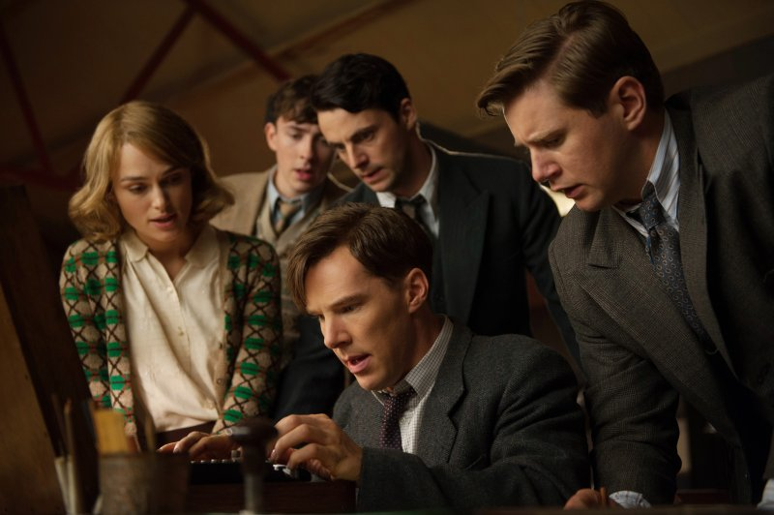
Enigma prices
Benedict Cumberbatch operates Enigma
from movie, “The Imitation Game”
Enigma prices doubled after release of movie, “The Imitation Game” on Christmas, 2014
In June 2017, a professor of cryptology found a “typewriter” in a Romanian flea market
Photo credit: StudioCanal
He knew it was an Enigma and bought it for 100 Euros
Immediately sold on Romanian auction site for 45,000 Euros
Sold 4 months later in US by Rau Antiques for $245,000
Rarity plus interest generate record prices at auction:
$441K for a 3-rotor Enigma at Sothebys on 4/30/21
$860K for a 4-rotor Enigma at Sothebys on 12/17/19
Copyright © 2023 ( CC BY 4.0 ) CipherHistory.com

Slide 24
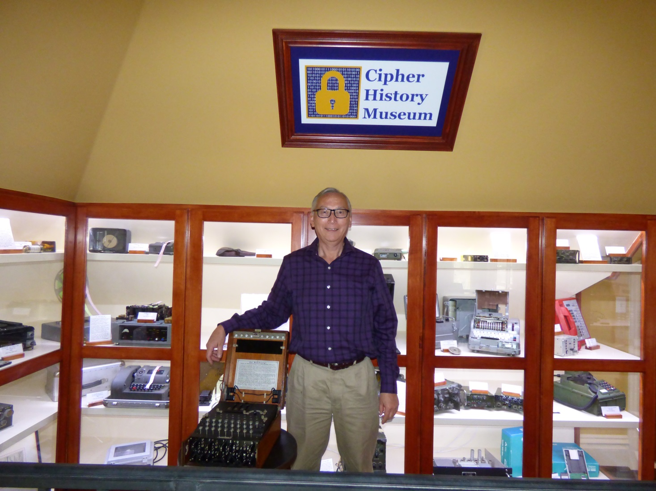
Download this presentation
CipherHistory.com/cryptowars.pptx
Cipher History Museum
Copyright © 2023 ( CC BY 4.0 ) CipherHistory.com

Slide 25
Addendum
The following pages show the mathematics of the Enigma key space, both theoretically and as implemented by the Nazis
Copyright © 2023 ( CC BY 4.0 ) CipherHistory.com

Slide 26
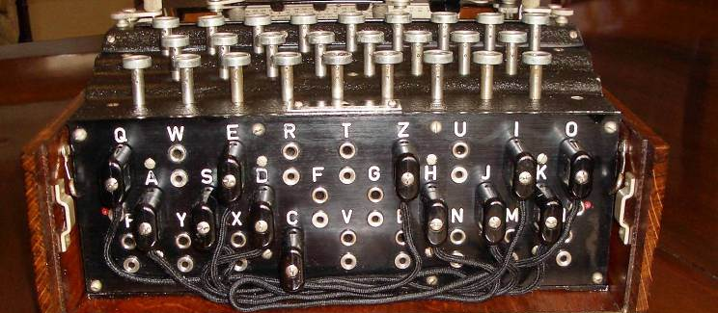
Plugboard settings
The German military addition of the plugboard added more key space than the rotors
The # of possible plugboard settings is a function of 3 variables:
# plugboard cables, p, can be from 0 to 13
# of groupings of possible plugged letters (2p letters out of 26) = 26! / ((2p!) X (26-2p)!)
# interconnections of letters within each group of plugged letters chosen from #2 = (2p-1) X (2p-3) X (2p-5) X …X 1
The 3 items above are calculated on the next slide
Copyright © 2022 ( CC BY 4.0 ) CipherHistory.com

Slide 27
Plugboard settings
1. # plugboard cables | 2. # groupings of plugged letters | 3. # interconnections for each set of plugged letters | Total # possible settings
 | 26! / ((2p!) X (26-2p)!) | (2p-1) X (2p-3) X (2p-5) X…X 1 | (column 2) X (column 3)
0 | 1 | 1 | 1
1 | 325 | 1 | 325
2 | 14,950 | 3 | 44,850
3 | 230,230 | 15 | 3,453,450
4 | 1,562,275 | 105 | 164,038,875
5 | 5,311,735 | 945 | 5,019,589,575
6 | 9,657,700 | 10,395 | 100,391,791,500
7 | 9,657,700 | 135,135 | 1,305,093,289,500
8 | 5,311,735 | 2,027,025 | 10,767,019,638,375
9 | 1,562,275 | 34,459,425 | 53,835,098,191,875
10 | 230,230 | 654,729,075 | 150,738,274,937,250
11 | 14,950 | 13,749,310,575 | 205,552,193,096,250
12 | 325 | 316,234,143,225 | 102,776,096,548,125
13 | 1 | 7,905,853,580,625 | 7,905,853,580,625
Total |  |  | 532,985,208,200,576
Copyright © 2022 ( CC BY 4.0 ) CipherHistory.com

Slide 28
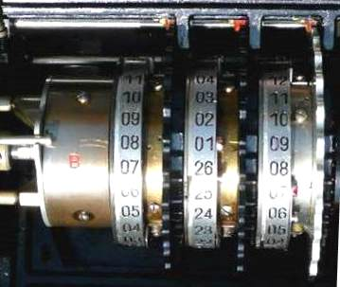
Rotor settings
The internal wiring of each rotor could be arranged in 26! different combinations. Since only 3 rotors are used, the number of combinations when selecting 3 unique rotors out of 26! is:
26! X (26!-1) X (26!-2) =
65,592,937,459,144,468,
297,405,473,480,371,753,615,896,841,298,988,710,328,553,
805,190,043,271,168,000,000
Each of the 3 rotors could be set to any letter:
26 X 26 X 26 = 17,576
The rotors advance like an odometer, the setting to enable this is a notch set to any letter of the alphabet:
26 X 26 = 676 (Note: notch on left-most rotor has no effect)
Copyright © 2022 ( CC BY 4.0 ) CipherHistory.com

Slide 29
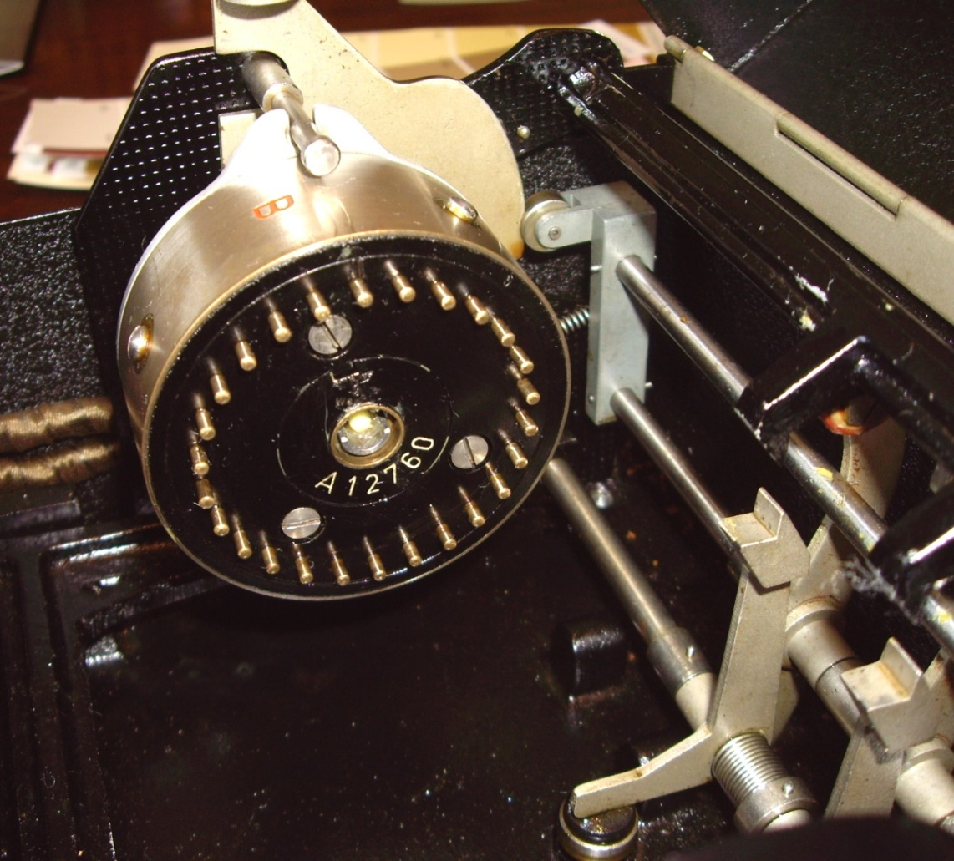
Reflector settings
The reflector scrambles the letters in pairs so it could encrypt or decrypt with the same setting
The letter “A” could be switched to any of the 25 remaining letters, the next letter could be switched to any of the 23 remaining letters, and so on
Notice this result is the same as using 13 plugboard cables,
since all letters are paired (see chart on page 23)
25 X 23 X 21 X … X 1 = 7,905,853,580,625
Copyright © 2022 ( CC BY 4.0 ) CipherHistory.com

Slide 30
Total theoretical number of settings
The total theoretical number of Enigma settings is thus the product of the 5 items on the previous 3 slides, or…
3,283,883,513,796,974,198,700,882,069,882,752,878, 379,955,261,095,623,685,444,055,315,226,006,433,615, 627,409,666,933,182,371,154,802,769,920,000,000,000
Or 3.28 X 10¹¹⁴
This number is far greater than the total number of atoms in the observable universe (10⁸⁰)
Webb Space Telescope view of
cartwheel and spiral galaxies
Photo credit: NASA,
ESA, CSA, STScI
Copyright © 2022 ( CC BY 4.0 ) CipherHistory.com

Slide 31
Theory vs. practice
The theoretical number of Enigma settings was not achieved in practice by the Germans, the number of settings the Allied Forces encountered for the standard 3-rotor Enigma:
10 plugboard cables were always used, reducing errors and the possible combinations to 150,738,274,937,250
Only 5 fixed rotors were issued out of 26! possibilities. Since the wiring was known, selecting 3 out of 5 is 5 X 4 X 3 = 60
The initial settings of the rotors and the positions of the notches remain the same at 17,576 and 676
Reflector setting was known and remained unchanged = 1
The product of the above numbers is: 107,458,687,327,250,619,360,000 or 1.07 X 10²³
1.07 X 10²³ is equivalent to a 76 bit key, better than 56 bit DES, the first PC standard in use until 2001
Copyright © 2022 ( CC BY 4.0 ) CipherHistory.com

Slide 32
Enigma codebreaking example
Germans considered the Enigma to be unbreakable
Before computers, a brute force attack was impossible:
To test 10²³ key settings:
Each U-boat, Air Force, and Army unit had separate keys, which changed daily!
The British Bombe did not perform brute force attacks but searched for possible cribs to decode the rotors only
The plugboard, which gave more key space than the rotors, was manually, and easily, decoded
If 100,000 Enigma operators could each check
one key setting every second, 24X7…
It would take twice the age of the universe to break the code!
Copyright © 2022 ( CC BY 4.0 ) CipherHistory.com

