Slide 1


Why Key Space Matters
Featuring 35 Historic Cipher Machines
Ralph Simpson
Proprietor & Curator
February 19, 2023
Ralph Simpson
Ralph@CipherHistory.com
Copyright © 2023
CC Attribution 4.0 International
Notes:
Ralph Simpson Bio
Ralph Simpson worked in the computer industry for 32 years, working for IBM and Cisco Systems. He started as a systems engineer for large mainframe computers and held a variety of technical and management roles, including authoring an IBM Technical Manual on redundant systems. He retired as Senior Director for Service Strategy at Cisco Systems, with responsibility for 2,500 engineers.
Ralph is now retired and volunteers at History San Jose and the Computer History Museum. He wrote a book on cipher history called, Crypto Wars: 2000 Years of Cipher Evolution. He is also an avid collector of cipher machines, which you can see on his website, CipherHistory.com. Ralph lives in San Jose in a restored Victorian house, which is home to his Cipher History Museum and a very understanding wife.

Slide 2
35 Historic Ciphers... and 4 Modern Ones
Year
Cipher
Year
Cipher
600 BCE
50 BCE
1466
1586
1854
1860s
1912
1912
1916
1918
1922
1924
1926
1930
1931
1932
1937
1939
Monoalphabetic
Caesar
Vigenère (repeating key)
Vigenère (autokey)
Playfair
Wheatstone Cryptograph
Lugagne Transpositeur
M-94 Cylinder Cipher
M-138A Strip Cipher
ADFGX / ADFGVX
Hebern 5-Rotor
Kryha
Enigma Swiss K
Lugagne Le Sphinx
Abwehr Enigma G
Enigma I
SIGABA
Japanese Purple
1939
1941
1941
1942
1942
1942
1943
1947
1952
1952
1950s
1953
1955/7
1956
1976
1977
1992
2001
Japanese JN-25 Codebook
Lorenz SZ-40/42
SG-41 “Hitler Mill”
M-209 Pin & Lug
Enigma M4
T-52d Geheimschreiber
Typex Mark 22
NEMA
Hagelin C-52 / CX-52
KL-7
Transvertex HC-9
VIC Pencil & Paper
Hagelin CD-55 / CD-57
Fialka
DES (56 bit)
RSA-4096
AT&T 3600E Clipper Chip
AES-256
Copyright © 2023 ( CC BY 4.0 ) CipherHistory.com
Notes:
So, why does key space matter? An understanding of key space unlocks a deeper understanding of how a cipher machine works. The key space of a cipher machine even gives an insight into the mind of the inventor, codebreaker, and user. Knowing the tradeoffs between ease-of-use, cryptologic strength, manufacturing complexity, user errors, etc. tells us why specific decisions were made in the design and use of the cipher machine.
To attain this level of understanding of each cipher machine, the theoretical "Maximum key space" will be compared to the "Practical key space". The practical key space is the final cryptosystem as viewed and attacked by the enemy cryptanalyst. The ability to compare, contrast, and analyze the differences between the maximum key space and the practical key space provides a new way to study the relative effectiveness of the machines in theoretical and real-life situations.
Each historic cipher machine will be deconstructed to show the contribution to the key space of each component. The calculation of the practical key space will assume the codebreaker has the enemy cipher machine and knows exactly how it was used, including any self-imposed and situational limitations. The only unknown is the key itself.
There are several surprises in this list, not only in terms of the size of the key space, but also in terms of why some decisions were made in the design or usage of the cipher machines. Some of the decisions show a surprising lack of cryptologic knowledge or appreciation for the skills of the enemy cryptanalysts.
Why Key Space Matters
Key space is an important but elusive concept in cryptology. It primarily relates to the number of settings that need to be tested to break a cipher system by brute force. While this is a reasonable measure of cryptologic strength for the latest cryptologic systems like AES and RSA, it is less reliable but still important for historic cipher systems.
Key space is an elusive concept because wildly different key spaces are often reported for the same device. Each of these various key spaces could be valid, but may have been based on different assumptions which are not always explicitly stated. This presentation will clearly state the assumptions and apply them precisely to each device.
But the size of a key space can be a misleading measure of cryptologic strength, particularly for historic cipher devices, because techniques have been developed to speed and enhance codebreaking without the need to use brute force.

Slide 3
What is a Key vs. Key Space?
Key is the set of information needed to apply to a cryptosystem in order to encrypt or decrypt a message
Modern keys are passwords, pin #s, fingerprints, etc.
Historic keys are usually machine settings; such as rotor settings, plugboard connections, etc.
Key Space is the sum of all possible keys of a cryptosystem which are valid and unique

Slide 4
Why Key Space Matters
Caution!
​Key space allows easy comparisons of cryptologic strength between cipher systems
But…
It only measures effort for brute force attacks,
and most historic ciphers can be broken by other means
But, key space matters because it is a pathway to:
Unlock the mystery of how a cipher machine works
Understand the cryptologic tradeoffs in design & use
Enter the mind of the inventor, codebreaker, and user

Slide 5
A Short Note about Scientific Notation
Cryptology commonly uses absurdly large numbers, some of the largest encountered in the natural world
Scientific Notation:
Shorthand for large numbers
Easy way to compare order of magnitude differences
Example: 10²⁶ is…
- 10 times larger than 10²⁵
- 1 million times larger than 10²⁰
Historic precedents for describing key space in cryptology:
Historic devices use base 10 or powers of 10, ie. 10^{X}
Modern encryption use base 2 or # bits, ie. 2^{X}

Slide 6
Assumptions about Key Spaces
These assumptions are from the NSA pamphlet,
“The Cryptographic Mathematics of Enigma”
Maximum key space:
The base machine is captured and known to the enemy
(per Kerckhoffs’s Principle)
Field replaceable parts (ex. rotors, reflectors) are unknown
“Message setting” is included in key space
Practical key space:
Same as above, plus…
Field replaceable parts are also known
User imposed limitations are known and exploited
Notes:
To use the Enigma machine as an example, the Maximum Key Space is:
If the enemy captures an Enigma, then the base machine would reveal the wiring of the entry disk, which is not changeable in the field.
Rotor and reflector wirings can be changed, so they are assumed to be unknown.
Notch location can be changed, so it is unknown.
The Practical Key Space is:
The enemy has the reflector, so it adds no cryptologic strength.
All 5 available rotors are captured, so wiring and notch location is known.
Also known are user imposed limitations, such as, always using 10 plugboard cables, no rotor allowed in same position on subsequent day, no 3 rotor combination repeated within same month.
Consecutive Stecker Knock Out was not included because it was only used by a few networks
Even though a single message can be broken without knowing the message setting, other messages using the same internal setting cannot be broken. So, the NSA assumes that the message setting (the rotor start position) must be known so all the daily messages can be broken.
NSA document, “The Cryptographic Mathematics of Enigma”: https://www.nsa.gov/portals/75/documents/about/cryptologic-heritage/historical-figures-publications/publications/wwii/CryptoMathEnigma_Miller.pdf

Slide 7
Monoalphabetic Cipher Key Space
A | B | C | D | E | F | G | H | I | J | K | L | M | N | O | P | Q | R | S | T | U | V | W | X | Y | Z
p | c | r | l | j | s | g | u | a | v | b | f | x | y | i | m | w | d | h | t | e | o | k | z | n | q
Monoalphabetic Cipher:
a substitution cipher where any letter can encrypt to any other letter, key space = 26!
Maximum & Practical key space
4.03 x 10²⁶
A | B | C | D | E | F | G | H | I | J | K | L | M | N | O | P | Q | R | S | T | U | V | W | X | Y | Z
d | e | f | g | h | i | j | k | l | m | n | o | p | q | r | s | t | u | v | w | x | y | z | a | b | c
Caesar Cipher:
the simplest monoalphabetic cipher, shift of alphabet from 1 to 25 positions
Maximum & Practical key space
25

Slide 8
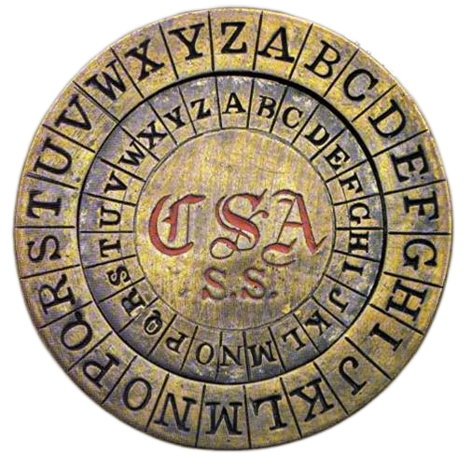
Vigenère Disk Example Key Spaces
Repeating keyword
key space = 26^{(keyword length)}
Example: keyword is
“Manchester Bluff” - 26¹⁵
Maximum & Practical key space
1.68 x 10²¹
Autokey or book cipher*
key space = 26^{(message length)}
Example: message is
314 characters - 26³¹⁴
Maximum & Practical key space
2.00 x 10⁴⁴⁴
Photo credit: Stafford Museum, Stafford, VA
* Autokey, invented by Vigenère, or a book
cipher means key is as long as the message

Slide 9
Playfair Key Space
M | A | N | C | H
E | S | T | R | B
L | U | F | D | G
I/J | K | O | P | Q
V | W | X | Y | Z
E | S | T | R | B
L | U | F | D | G
I/J | K | O | P | Q
V | W | X | Y | Z
M | A | N | C | H
Playfair 5x5 matrix = 25!
(But for each matrix, shifting rows
or columns 1-5 places are equivalent)
25! / (5x5) = 24!
H | M | A | N | C
B | E | S | T | R
G | L | U | F | D
Q | i/J | K | O | P
Z | V | W | X | Y
Maximum & Practical key space
6.20 x 10²³

Slide 10
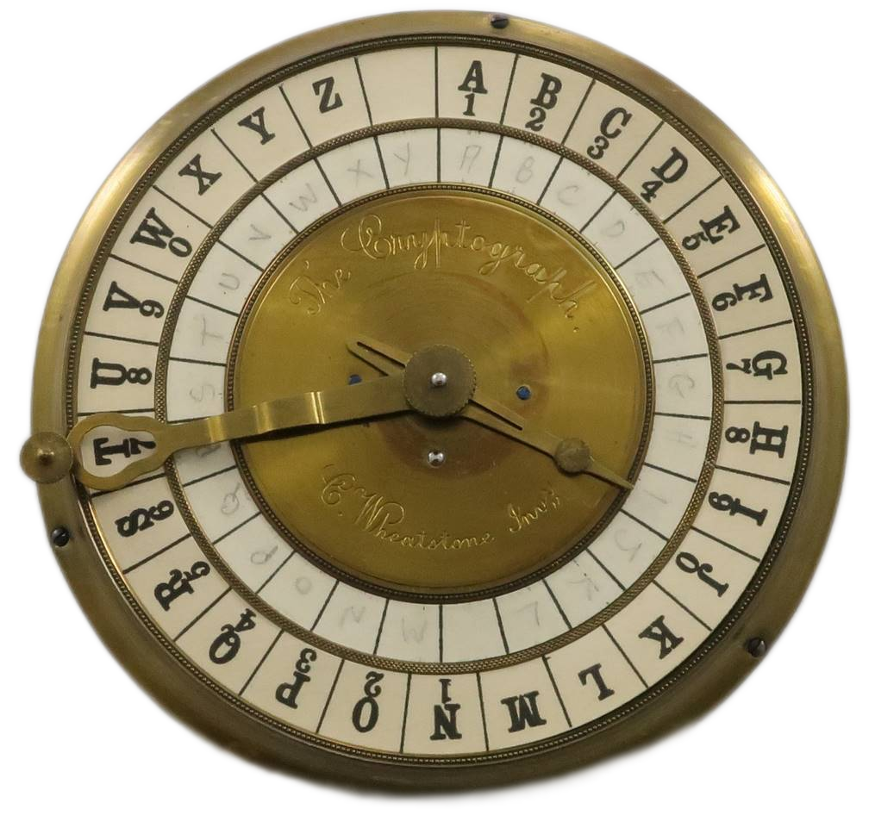
Wheatstone Cryptograph Key Space
Inner disk alphabet
is the key = 26!
Maximum & Practical key space
4.03 x 10²⁶
Photo credit: Ralph Simpson, CipherHistory.com

Slide 11
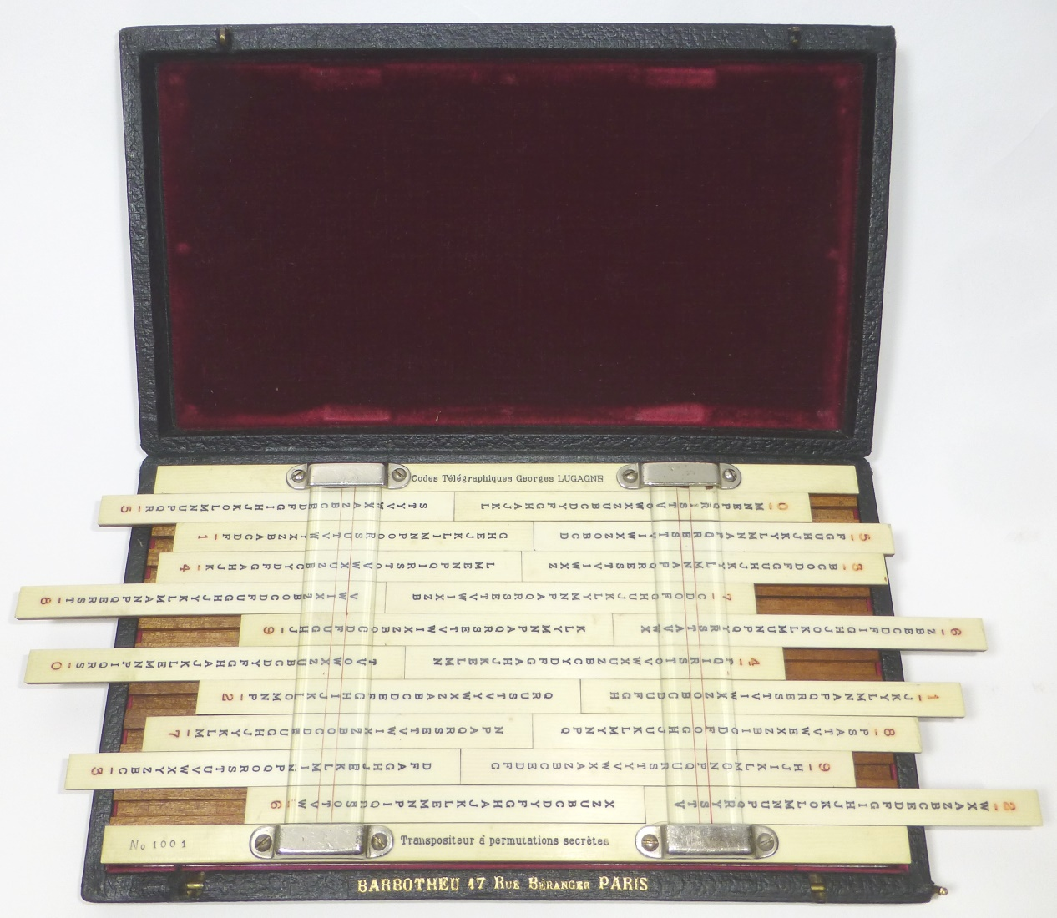
Lugagne Transpositeur Maximum Key Space
Offset fixed: 1
10 pairs alphabet strips:
20 strips: (26!)²⁰ =
1.30x10⁵³²
Order: 1
Maximum key space
1.30 x 10⁵³²
Photo credit: Ralph Simpson, CipherHistory.com

Slide 12
Lugagne Transpositeur Practical Key Space
Offset fixed: 1
10 pairs alphabet strips:
20 strips: 1²⁰
Order: (10!)² =
1.32x10¹³
Practical key space
1.32 x 10¹³
Photo credit: Ralph Simpson, CipherHistory.com

Slide 13
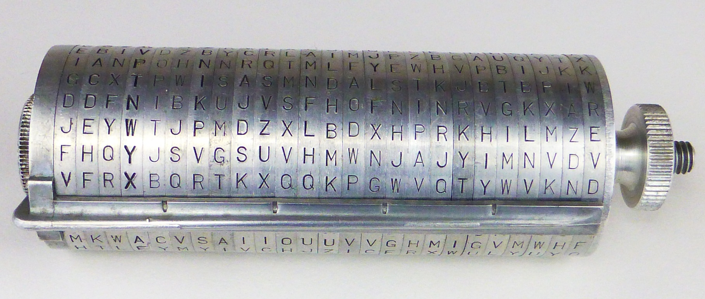
M-94 Maximum Key Space
Photo credit: Ralph Simpson, CipherHistory.com
Row offset:
= 25
Disk order on spindle: = 1
Mixed alphabet on disk:
(26!)²⁵ = 1.38x10⁶⁶⁵
Maximum key space
3.45 x 10⁶⁶⁶
Notes:
All reporting I could find reports cylinder cipher key space without the row offset included. This begins with Thomas Jefferson, who claimed his 36 Wheel Cypher had a key space of 36!. This makes little difference, but should be included for accuracy.

Slide 14
M-94 Practical Key Space
Photo credit: Ralph Simpson, CipherHistory.com
Row offset:
= 25
Disk order on spindle: = 25!
Mixed alphabet
on disk: = 1²⁵
The key space for the cylinder cipher has been incorrectly reported as (#disks)! since its invention by Thomas Jefferson, which ignores the row offset
Practical key space
3.88 x 10²⁶

Slide 15
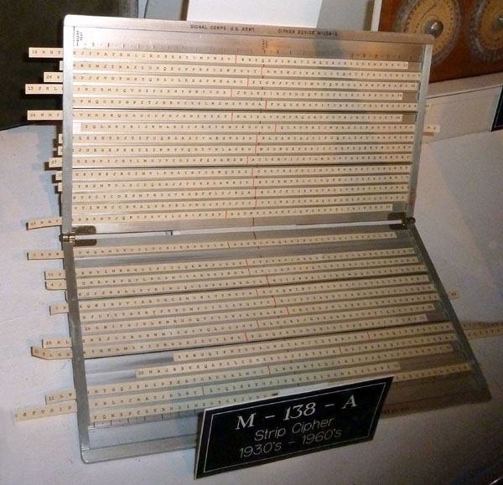
M-138A Maximum Key Space
30 Strips:
30 mixed strips:
(26!)³⁰ = 1.47x10⁷⁹⁸
Order: 1
Offset: 25
Maximum key space
3.69 x 10⁷⁹⁹
Photo credit: Ralph Simpson, device at NCM. Ft. Meade, MD
Notes:
The M-138A actually had 100 alphabet strips, each with a different mixed alphabet. Since the alphabet on all 30 strips used for the calculation are unknown, having more than 30 strips does not add any key space.

Slide 16
M-138A Practical Key Space
30 Strips from 100:
30 mixed strips: 1
C(100,30) = 2.94x10²⁵
Order: 30!
Offset: 25
Practical key space
1.95 x 10⁵⁹
Photo credit: Ralph Simpson, device at NCM. Ft. Meade, MD
Notes:
C(100,30) X (order of 30!) is the same as P(100,30), but I wanted to specifically highlight the two contributors to key space being the selection of 30 alphabetic strips from a group of 100, and then the order of those strips in the device.

Slide 17
ADFGX Cipher Key Space
 | A | D | F | G | X
A | G | H | Q | F | L
D | Z | K | T | X | M
F | O | W | S | A | C
G | I | D | N | P | U
X | E | V | B | Y | R
8 | 12 | 2 | 10 | 9 | 1 | 15 | 7 | 16 | 6 | 14 | 5 | 3 | 13 | 4 | 11
D | X | D | F | A | G | A | D | D | G | F | F | X | A | A | X
A | F | X | D | D | F | G | G | X | F | G | A | D | D | X | D
F | X | F | G | G | D | X | A | A | X | A | D | G | G | F | X
A | D | A | G | A | X | D | X | A | F | X | G | F
5x5 Substitution table:
= 25! = 1.55x10²⁵
Transposition 16-23 columns:
∑ n! = 2.70x10²²
23
n=16
1 | 2 | 3 | 4 | 5 | 6 | 7 | 8 | 9 | 10 | 11 | 12 | 13 | 14 | 15 | 16
G | D | X | A | F | G | D | D | A | F | X | X | A | F | A | D
F | X | D | X | A | F | G | A | D | D | D | F | D | G | G | X
D | F | G | F | D | X | A | F | G | G | X | X | G | A | X | A
X | A | F |  | G | F | X | A | A | G |  | D |  | X | D | A
Maximum & Practical key space
4.19 x 10⁴⁷
Notes:
Examples of ADFGX messages used by the Germans in WW1 included transpositions between 16 and 23 columns, so that was used as the possible range for the transposition calculation,

Slide 18
ADFGVX Cipher Key Space
 | A | D | F | G | V | X
A | G | 3 | Q | F | 6 | L
D | Z | K | 0 | X | M | T
F | O | 9 | J | A | C | 1
G | I | D | 8 | 5 | U | 4
V | E | V | B | Y | R | H
X | 4 | N | 7 | W | 2 | P
8 | 12 | 2 | 10 | 9 | 1 | 15 | 7 | 16 | 6 | 14 | 5 | 3 | 13 | 4 | 11
D | X | V | F | V | G | A | D | D | G | V | 3 | X | A | A | 2
A | F | X | V | 1 | 6 | G | G | X | 7 | G | A | D | D | X | D
9 | D | V | G | G | V | X | A | A | 2 | A | D | 4 | V | F | X
I | D | 8 | 5 | A | 4 | D | F | V | V | X | G | F
6x6 Substitution table:
= 36! = 3.72x10⁴¹
Transposition 16-23 columns:
∑ n! = 2.70x10²²
23
n=16
1 | 2 | 3 | 4 | 5 | 6 | 7 | 8 | 9 | 10 | 11 | 12 | 13 | 14 | 15 | 16
G | V | X | A | 3 | G | D | D | V | F | 2 | X | A | V | A | D
6 | X | D | X | A | 7 | G | A | 1 | V | D | F | D | G | G | X
V | V | 4 | F | D | 2 | A | 9 | G | G | X | D | V | A | X | A
4 | 8 | F |  | G | V | F | I | A | 5 |  | D |  | X | D | V
Maximum & Practical key space
1.01 x 10⁶⁴
Notes:
This cipher was broken on the day it was first deployed by the Germans in early June, 1918 and continued to be broken until the end of WW1. It was broken by French Army Lt. Georges Painvin, who also broke the earlier ADFGX cipher.

Slide 19
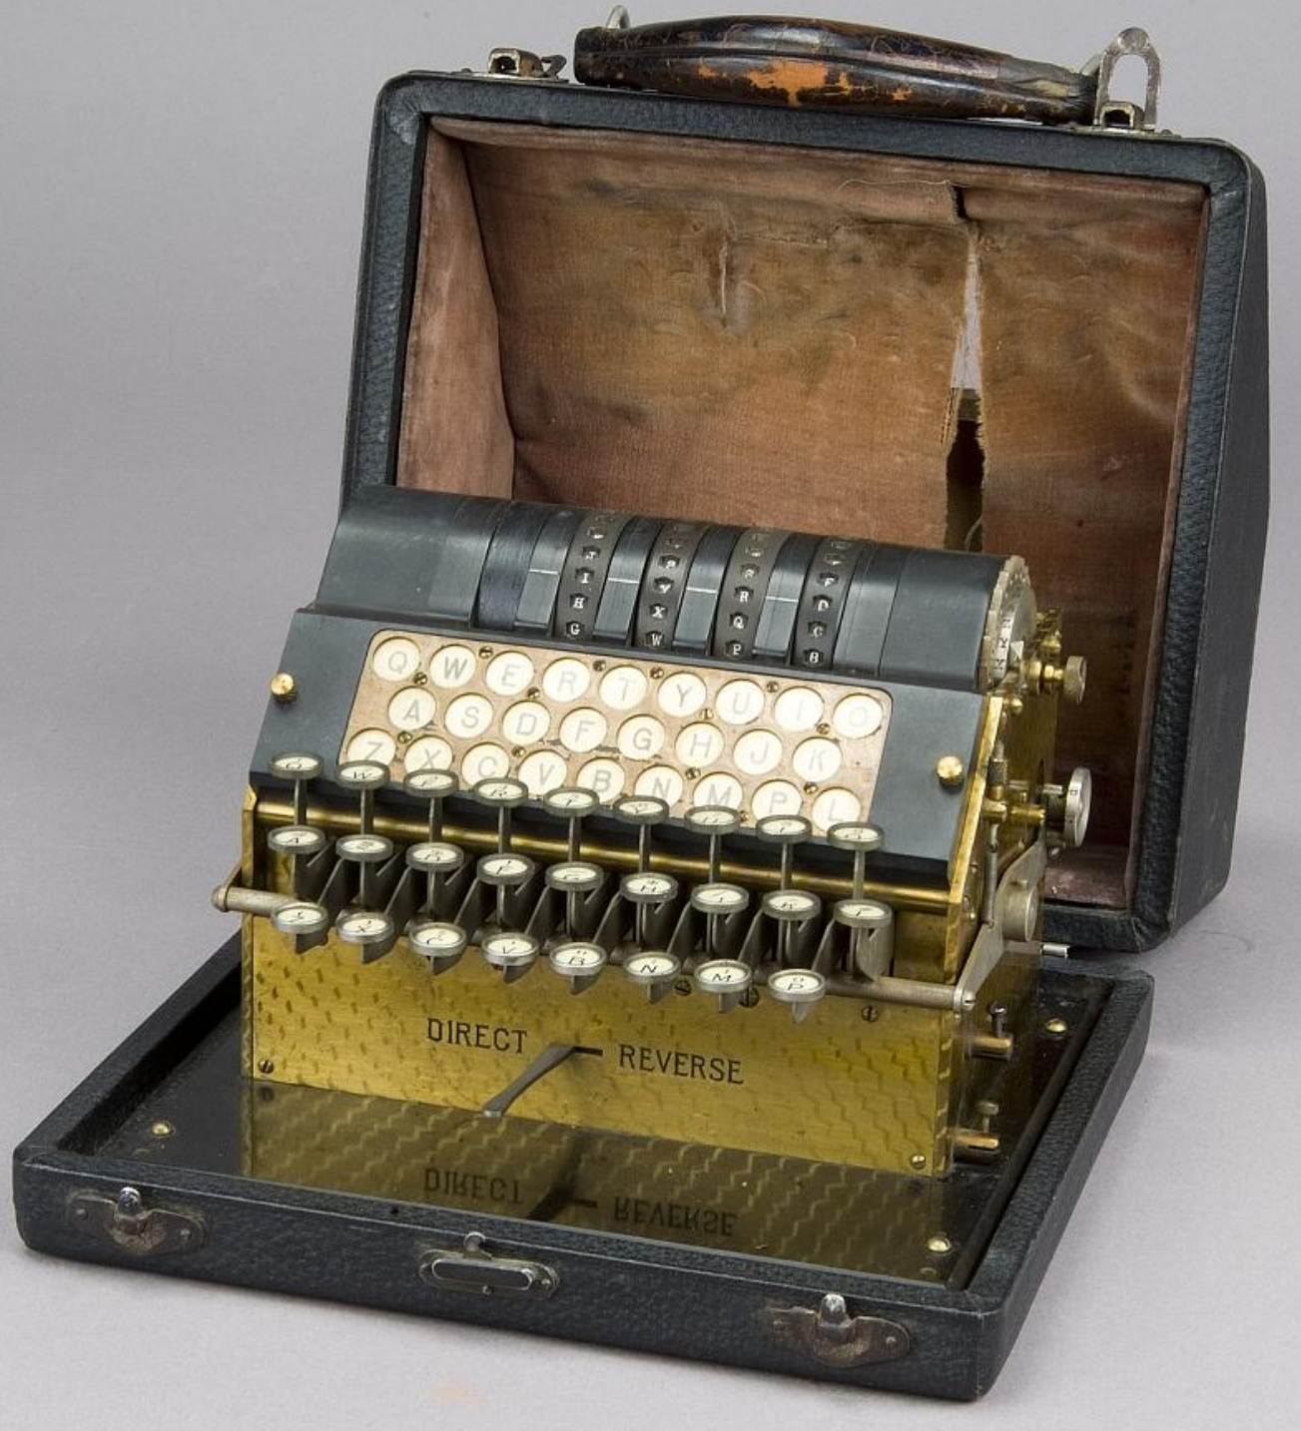
Hebern Maximum Key Space
5 Rotors:
Wiring: (26!)⁵ =
1.07x10¹³³
Order: 1
Side: 1
Start position: 26⁵
Maximum key space
1.27 x 10¹⁴⁰
Photo credit: Smithsonian National Museum of American History, Washington, DC
Notes:
Note that when using all possible wirings of the 5 rotors, a single message can be broken without knowing the start position.
The NSA document that calculates of the Enigma key space (see slide #6 notes) includes the rotor start position because that is needed to break any other messages sent with that same rotor order, which usually remains the same for each day.
The rotor start position is the message key, which would change with each message. So, rather than break the rotor wiring again, only the starting position of the rotors need to be determined for every messages sent with that rotor wiring configuration, so solving this once means all messages can be broken for that day.

Slide 20
Hebern Practical Key Space
5 Rotors:
Wiring: 1⁵
Order: 5x4x3x2x1
= 120
Side: 2⁵
Start position: 26⁵
Practical key space
4.56 x 10¹⁰
Photo credit: Smithsonian National Museum of American History, Washington, DC

Slide 21
Key Spaces of Historic Cipher Machines
Year
Cipher
Maximum Key Space
Practical Key Space
600 BCE
50 BCE
1466
1586
1854
1860s
1912
1912
1916
1918
1918
1922
Monoalphabetic
Caesar
Vigenère (15 char. repeating key)
Vigenère (314 char. autokey)
Playfair
Wheatstone Cryptograph
Lugagne Transpositeur
M-94 Cylinder Cipher
M-138A Strip Cipher
ADFGX
ADFGVX
Hebern 5-Rotor
4.03x10²⁶
2.50x10¹
1.68x10²¹
2.00x10⁴⁴⁴
6.20x10²³
4.03x10²⁶
1.30x10⁵³²
3.45x10⁶⁶⁶
3.69x10⁷⁹⁹
4.19x10⁴⁷
1.01x10⁶⁴
1.27x10¹⁴⁰
2⁸⁸
2⁵
2⁷¹
2¹⁴⁷⁶
2⁷⁹
2⁸⁸
2¹⁷⁶⁸
2²²¹⁴
2²⁶⁵⁶
2¹⁵⁸
2²¹³
2⁴⁶⁶
4.03x10²⁶
2.50x10¹
1.68x10²¹
2.00x10⁴⁴⁴
6.20x10²³
4.03x10²⁶
1.32x10¹³
3.88x10²⁶
1.95x10⁵⁹
4.19x10⁴⁷
1.01x10⁶⁴
4.56x10¹⁰
2⁸⁸
2⁵
2⁷¹
2¹⁴⁷⁶
2⁷⁹
2⁸⁸
2⁴⁴
2⁸⁸
2¹⁹⁷
2¹⁵⁸
2²¹³
2³⁵

Slide 22
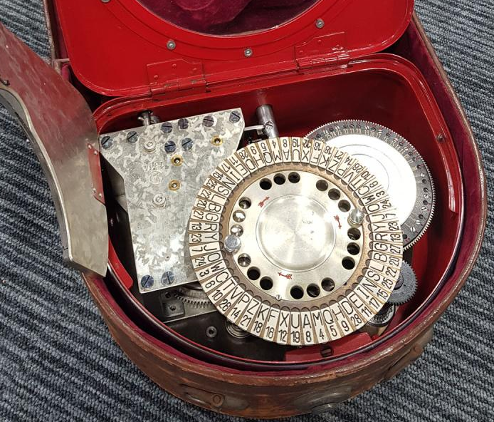
Kryha Maximum Key Space
Historical Deduction
Georg Hamel calculated the Kryha key space as 4.57x10⁵⁰ and claimed only immortals could break it. William Friedman and others broke Khrya in 2 hours and 41 minutes…
17 Segment wheel:
# patterns: 26¹⁷
Start position: 17
therefore, Friedman is immortal!
Cipher rotor:
Mixed alphabet: 26!
Start position: 26
(26¹⁷ x 26!) x (26 x 17) =
(4.57x10⁵⁰) x (26 x 17)
(26¹⁷ x 26!) x (26 x 17) =
(4.57x10⁵⁰) x (26 x 17)
Maximum key space
2.02 x 10⁵³
Photo credit: Invaluable Auctions
Notes:
Later Kryha devices had more than 17 segment wheels, or multiple wheels. This particular early model is shown because this was the model Georg Hamel used to calculate key space.
Hamel’s calculation is correct, but does not include the starting positions of the 2 disk, which would be required knowledge to be able to break other messages sent with the same disk configuration. In other words, the starting positions of the two disks is sent as part of the “message key”.

Slide 23
Kryha Practical Key Space
Pin wheel (0-16 pins):
# wheels: 1
Start position: 17
Cipher rotor:
Mixed alphabet: 26!
Start position: 26
Practical key space
1.78 x 10²⁹
Photo credit: Invaluable Auctions

Slide 24
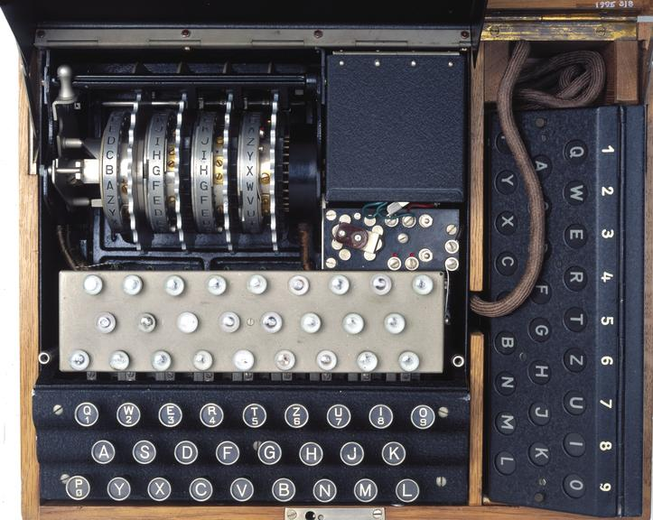
Swiss K Enigma Maximum Key Space
Reflector:
Wiring: 7.91x10¹²
Start position: 26
3 Rotors:
Wiring: (26!)³
Order: 1
Ring setting: 26²
Start position: 26³
Photo credit: The Military Museums, Calgary, Alberta, Canada
Maximum key space
1.60 x 10¹⁰¹
Notes:
Reflector looks like a 4th rotor, but the wiring is paired reciprocally. This means if A encodes to X, then X encodes to A. This reduces the key space, but allows encoding and decoding to operate identically without any change of machine settings, such as a code/decode switch as is used on the Hagelin pin&lug devices.
The difference in key space is reciprocal reflector = 7.91 x 10¹² vs non-reciprocal reflector = 26! = 4.03 x 10²⁶. This is a factor of 100,000,000,000,000 or 100 trillion times greater.

Slide 25
Swiss K Enigma Practical Key Space
Reflector:
Wiring: 1
Start position: 26
3 Rotors:
Wiring: 1³
Order: 3x2x1= 6
Ring setting: 26²
Start position: 26³
Photo credit: The Military Museums, Calgary, Alberta, Canada
Practical key space
1.85 x 10⁹

Slide 26
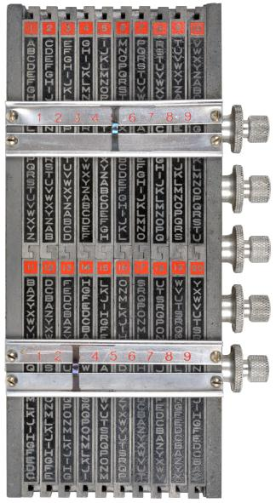
Lugagne Le Sphinx Maximum Key Space
20 interchangeable alphabet strips:
20 strips: (26!)²⁰ =
1.30x10⁵³²
Order: 1
Offset fixed: 1
Maximum key space
1.30 x 10⁵³²
Same key space as Transpositeur cipher
Photo credit: CryptoMuseum.com
Notes:
Cryptographically, the only difference in this Lugagne device from the first version, 18 years earlier, is the alphabet strips are now interchangeable from top and bottom. This means the Maximum key space remains the same as the earlier model, but the Practical key space improves significantly, from 10¹³ to 10²⁴.

Slide 27
Lugagne Le Sphinx Practical Key Space
20 interchangeable alphabet strips:
20 strips: (1)²⁰
Order: 20! =
2.43x10²⁴
Offset fixed: 1
Practical key space
2.43 x 10²⁴
Photo credit: CryptoMuseum.com

Slide 28
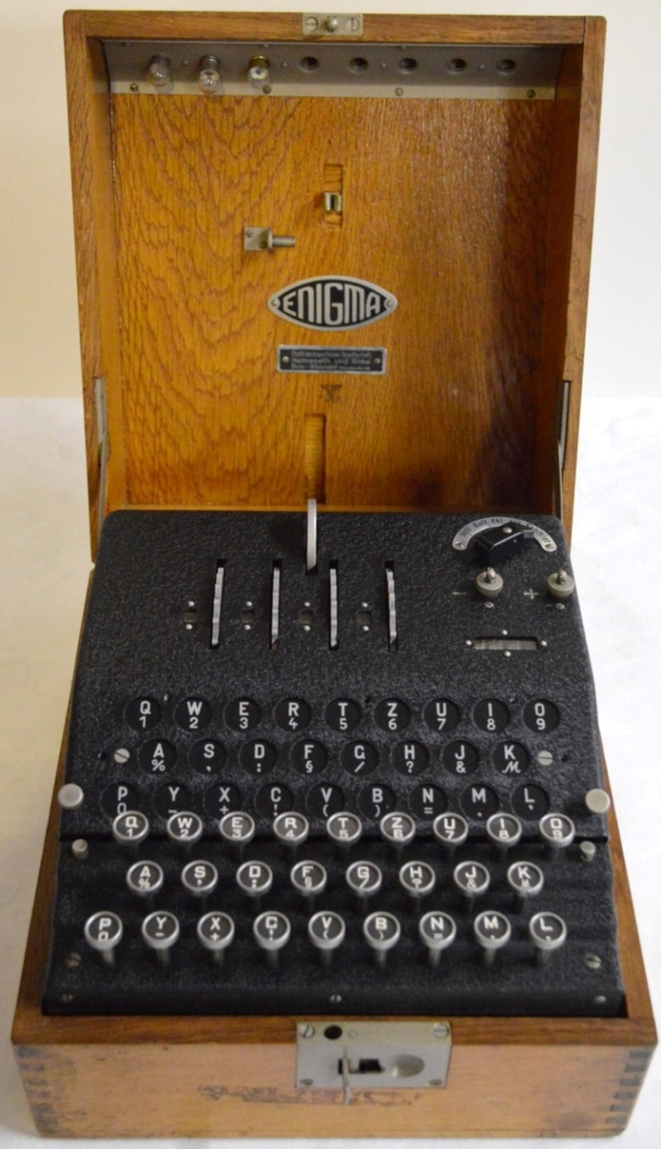
Abwehr Enigma G Maximum Key Space
Reflector:
Wiring: 7.91x10¹²
Start position: 26
3 Rotors:
Wiring: (26!)³
Order: 1
Notches: (2²⁶)³
Ring setting: 1³
Start position: 26³
Maximum key space
7.17 x 10¹²¹
Photo credit: Bletchley Park Trust
Notes:
Note the Maximum key space is greater than the standard 3 rotor, plugboard Enigma of 10¹¹⁴. The Practical key space will be considerably lower. The big difference is the unknown number of notches on the rotors, which add no key space after the rotors are known.

Slide 29
Abwehr Enigma G Practical Key Space
Reflector:
Wiring: 1
Start position: 26
3 Rotors:
Wiring: 1³
Order: 3x2x1 = 6
Notches: 1³
Ring setting: 26³
Start position: 26³
Practical key space
4.82 x 10¹⁰
Photo credit: Bletchley Park Trust

Slide 30
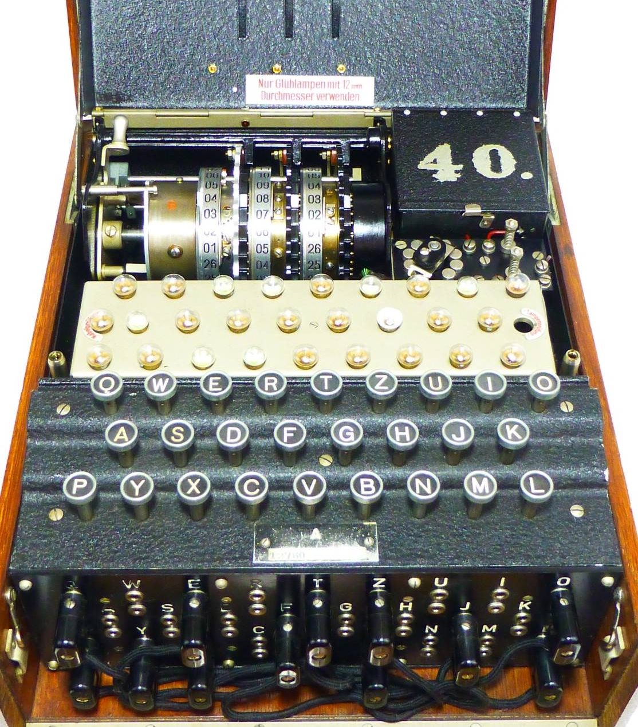
Enigma I Maximum Key Space
3 Rotors:
Wiring: (26!)³
Order: 1
Ring setting: 26²
Start position: 26³
Reflector:
(2p-1)(2p-3)…(1) = 7.91x10¹²
Plugboard 0-13 plugs:
∑ C(26,2p)x(2p-1)(2p-3)…(1) =
5.33x10¹⁴
13
p=0
Maximum key space
3.28 x 10¹¹⁴
Photo credit: Ralph Simpson, CipherHistory.com
Notes:
Plugboard setting:
Since any number of plugs from p=0 to p=13 can be used, the formula is:
The reflector and plugboard are both reciprocal, and the reflector swaps all letters, so it uses the same formula as above with p=13.
This calculation is the same as the NSA document, “The Cryptographic Mathematics of Enigma” by Dr. Ray Miller.
All possible wirings are used for the 3 rotors, so a single message can be decrypted without knowing the start position. To decrypt all the messages using the same daily setting, then the start position must be known.
The entry disk is not considered in the key space because it is hardwired to the plugboard and cannot be re-wired in the field.
∑ C(26,2p)x(2p-1)(2p-3)…(1) = (26!/(26-2p)!(2p)!) x ((2p)!/(p!)(2^{p})
= 26! / ((26-2p)!(2p)!)(p!)(2^{p})
= 5.33x10¹⁴
p=0
13

Slide 31
Enigma I Practical Key Space
3 Rotors from 5
Wiring: 1³
Order:
Ring setting: 26²
Start position: 26³
avg. 24
5x4x3 = 60
Reflector: 1
In mid-1940, Germany changed 2 procedures:
NO ROTOR IN SAME POSITION from previous day, rotor settings reduce from 60 to 32 daily
NO 3-ROTOR COMBINATION REUSED in same month; settings reduce from 60 to 30, or 50%
1&2 above: (32+16)/2=24 avg. rotor orders
Plugboard - 10 cables:
1.51x10¹⁴
Practical key space
1.07 x 10²³
4.31 x 10²²
Photo credit: Ralph Simpson, CipherHistory.com
Notes:
No rotor in same position from previous day, if rotor order I,II,III was used on one day, then the next day the following rotor configurations would not be allowed:
All combinations with rotor I in first position:
= 4x3 combinations = 12
[All combinations with rotor II in second position] – [combinations with rotor I in first position or rotor III in third position (already counted above)]:
= 4x3 combinations – (I,II, IV or V) – (IV or V,II,III) = 12 – 2 – 2 = 8
[All combinations with rotor III in third position] – [combinations with rotor I in first position or rotor II in second position]:
= 4x3 combinations – (I, IV or V, III) – (IV or V, II, III) = 12 – 2 – 2 = 8
Total = 12 + 8 + 8 = 28 rotor combinations would not be allowed
Total rotor combinations allowed = (5x4x3) – 28 = 32
No 3 rotor combination allowed in the same month. Each 3 rotor combination has odds 5x4x3 = 60, so over a typical 30 day month, the odds of any combination reduces from 60 down to 30 over the month.
Combining the two items above means 32 possible 3 rotor positions on the first day of the month reduces to 32 X (30/60) = 16 possible rotor positions on the last day of a 30 day month, so on average, there are (32 + 16) / 2 = 24 possible 3 rotor positions to check.
Note that the plugboard could have been made non-reciprocal, but a key space of 10¹⁴ was considered sufficient. The non-reciprocal plugboard was tested but viewed as too complex and error-prone for the operators for the improvement in key space to 10²⁴. Because the plugboard was separated from the rotors cryptographically by Marian Rejewski, this difference became a moot point since both reciprocal and non-reciprocal plugboards could be easily broken after the rotors were deteremined.
CSKO Odds - Consecutive stecker knock out rule: adjacent letters of the alphabet are not steckered (ex. B could not be steckered to A or C). This was used by the Luftwaffe, but was not used for the Army or Navy, so was excluded from the key space calculation.

Slide 32
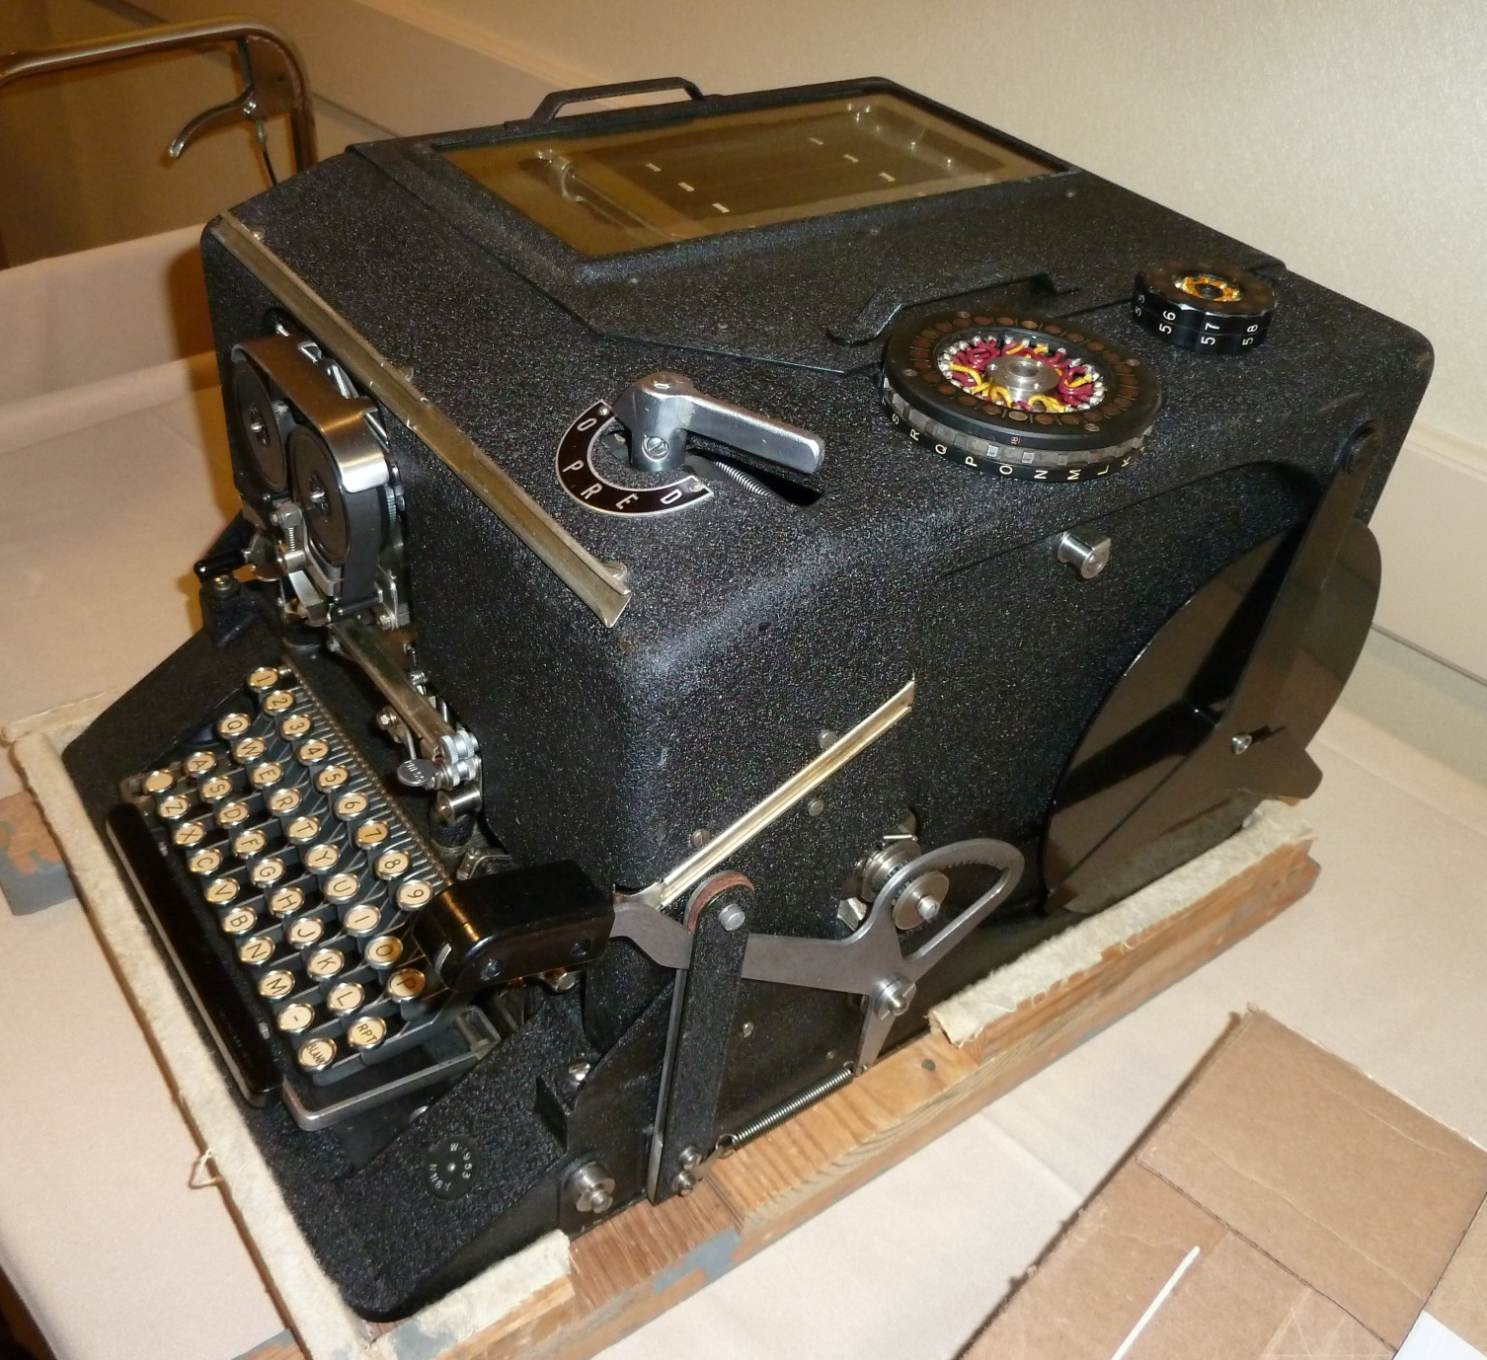
SIGABA Maximum Key Space
5 Index rotors:
Wiring: (10!)⁵
Order: 1⁵
Side: 1⁵
Start position: 10⁵
Index rotor logic:
10! / 2⁵ = 1.13x10⁵
10 Cipher /
control rotors
Wiring: (26!)¹⁰
Order: 1
Side: 1
Start position: 26¹⁰
Maximum key space
1.82 x 10²⁸⁵
Photo credit: Ralph Simpson, device at NCM. Ft. Meade, MD

Slide 33
SIGABA Practical Key Space
5 Index rotors:
Wiring: 1⁵
Order: 5!
Side: 1⁵
Start position: 10⁵
Index rotor logic:
10! / 2⁵ = 1.13x10⁵
10 Cipher /
control rotors
Wiring: 1¹⁰
Order: 10!
Side: 2¹⁰
Start position: 26¹⁰
Practical key space
5.95 x 10²⁸
Photo credit: Ralph Simpson, device at NCM. Ft. Meade, MD

Slide 34
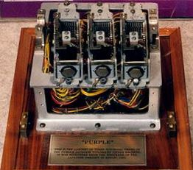
Japanese Purple Cipher Maximum Key Space
Input plugboard:
Non-reciprocal: 26!
20 consonants
6 vowels
Three - 20s
stepping
switches:
One - 6s
stepping
switch:
Wiring: 1³
Order: 3x2x1 = 6
(fast, med., slow)
Start position: 25³
Wiring: 1
Order: 1
Start position:
= 25
Photo credit: Ralph Simpson, device at NCM. Ft. Meade, MD
(26!)(6x25³)(25)(26!) =
Output
plugboard:
Maximum key space
3.81 x 10⁵⁹
20 consonants
6 vowels
Non-reciprocal: 26!

Slide 35
Japanese Purple Cipher Practical Key Space
Input plugboard:
Non-reciprocal: 26!
20 consonants
6 vowels
Three - 20s
stepping
switches:
One - 6s
stepping
switch:
Wiring: 1³
Order: 3x2x1 = 6
(fast, med., slow)
Start position: 25³
Wiring: 1
Order: 1
Start position:
= 25
User restriction: Initally 120 start positions were used, by 5/1/1942, 240 were used
Photo credit: Ralph Simpson, device at NCM. Ft. Meade, MD
= 240
(26!)(6x240)(25)(1) =
User restriction: Input and output plugboards are set identically; 2nd plugboard: 1
Output
plugboard:
Practical key space
1.45 x 10³¹
20 consonants
6 vowels
Non-reciprocal: 26!
1
Notes:
The Japanese wired the output plugboard identically to the input, even though they are independent. Apparently, the Japanese felt this was simpler and less error-prone for the user and the cryptologic strength of the plugboard is not as great as the key space implies. The US replica of Purple used one plugboard with wiring to go through it twice.
The decision to use 120 and later 240 start positions for the 20s stepping switches was made in order to reduce the number of messages sent in depth. The Japanese would disguise this practice by using additives. (see “Purple Revealed.” Freeman, Sullivan, Weierud. “Cryptologia” January, 2003, (Vol.26: No.1), p.18.

Slide 36
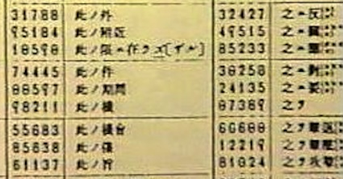
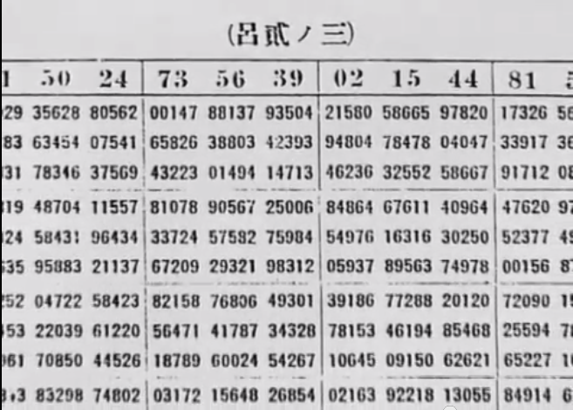
Japanese Naval Code JN-25 Maximum Key Space
five-digit codes: = 10⁵
five-digit additives: = 10⁵
Photo credit: StationHypo.com
Example:
(100 word message) x
10⁵ x 10⁵ = 10¹²
Maximum key space
1.00 x 10¹²
Photo credit: Odacir Blanco via Wikimedia Commons

Slide 37
Japanese Naval Code JN-25 Practical Key Space
27,500 five-digit codes
30,000 five-digit additives
Photo credit: StationHypo.com
Example:
(100 word message) x
27,500 x 30,000
Practical key space
8.25 x 10¹⁰
Photo credit: Odacir Blanco via Wikimedia Commons

Slide 38
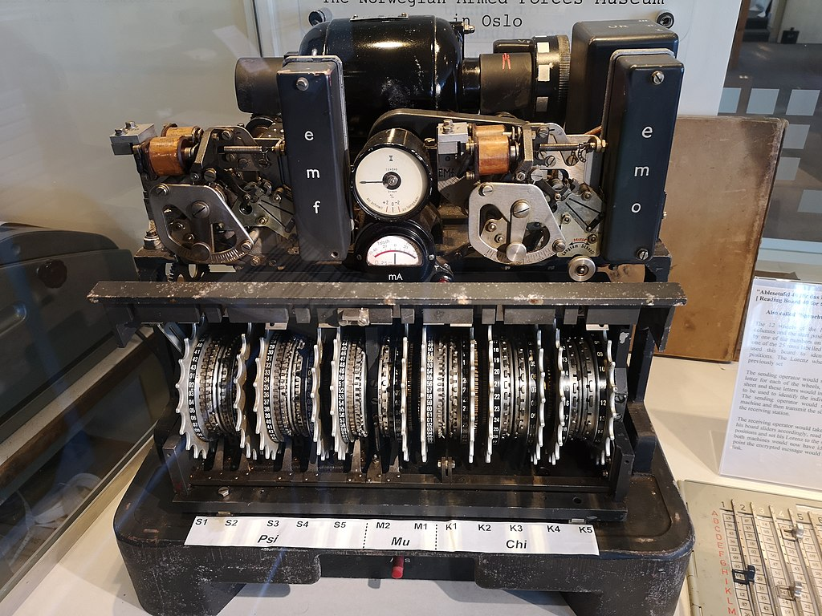
Lorenz SZ- 40/42 Key Space
2 Mu rotors:
5 Chi rotors:
# pins: 37,61
Pin setting: 2⁹⁸
Start position: 37x61=2257
# pins: 41,31,29,26,23
Pin setting: 2¹⁵⁰
Start position:(pins)=2.20x10⁷
5 Psi rotors:
# pins: 43,47,51,53,59
Pin setting: 2²⁵³
Start position: x(pins)=
3.22x10⁸
2⁵⁰¹ x (pins positions) =
2⁵⁰¹ x (1.60x10¹⁹) =
Maximum & Practical key space
1.05 x 10¹⁷⁰
Photo credit: Ted Coles, at The National Museum of Computing on Bletchley Park

Slide 39
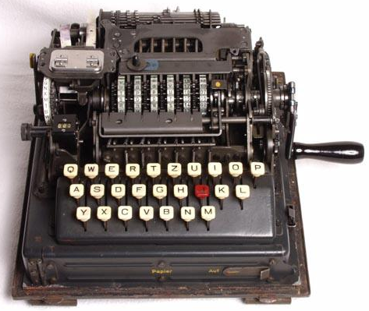
SG-41 “Hitler Mill” Key Space
Lugs:
25 bars: lugs are fixed
= 1
6 Rotors:
# pins: 25,25,23,23,24,24
Pin setting: 2¹⁴⁴
= 2.23x10⁴³
Start position: 25²x23²x24²
= 1.90x10⁸
Maximum & Practical key space
4.24 x 10⁵¹
Photo credit: Klaus Kopacz

Slide 40
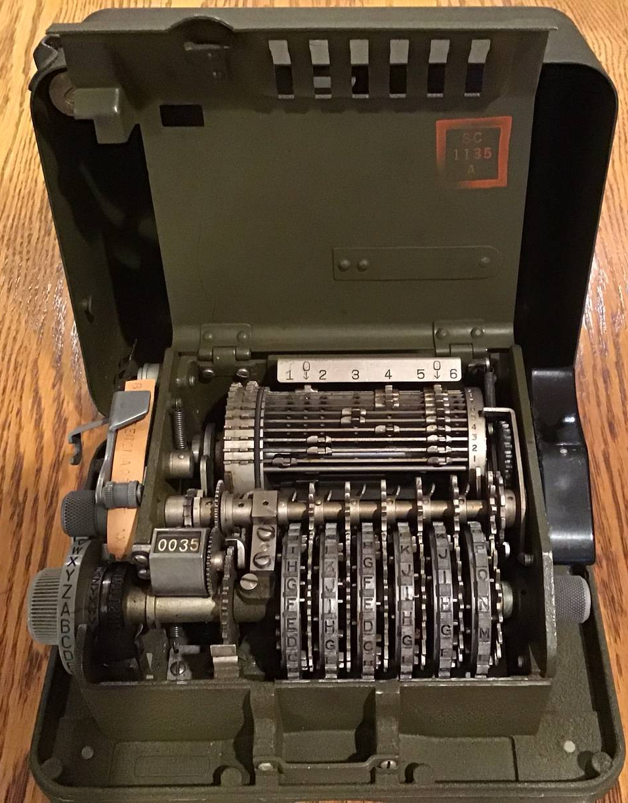
M-209 Maximum Key Space
Lug Settings:
(22 lug settings & 27 bars)
C(n+k-1,k)*= (n+k-1)!/(n-1)!k!
C(48,27) = (48!)/(21! x 27!)
= 2.23x10¹³
6 Rotors
Pin setting: 2¹³¹
= 2.72x10³⁹
Start position:
26x25x23x21x19x17
= 101,405,850
Maximum key space
6.16 x 10⁶⁰
Photo credit: Ralph Simpson, CipherHistory.com
“Stars and Bars” formula
*

Slide 41
M-209 Practical Key Space
Lug Settings:
With US Army Constraints of 1942 = 2.18x10¹¹
6 Rotors
Pin setting: 2¹³¹
= 2.72x10³⁹
Start position:
26x25x23x21x19x17
= 101,405,850
Practical key space
6.02 x 10⁵⁸
Photo credit: Ralph Simpson, CipherHistory.com

Slide 42
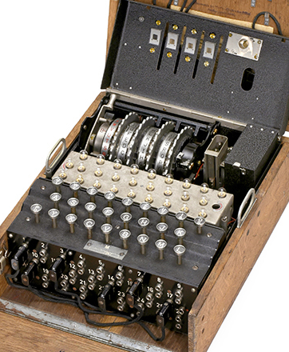
Enigma M4 Maximum Key Space
Thin Rotor:
Reflector:
(2p-1)(2p-3)…1 =
7.91x10¹²
Wiring: 26!
Order: 1
Start position: 26
3 Rotors:
Wiring: (26!)³
Order: 1
Notch (single or dual):
[(26)+(26x25)]² = 26⁴
Start position: 26³
Plugboard 0-13 plugs:
5.33x10¹⁴
Maximum key space
2.33 x 10¹⁴⁵
Photo credit: Invaluable Auctions

Slide 43
Enigma M4 Practical Key Space
1 Thin Rotor of 2:
Reflector:
Fixed: 1
Wiring: 1
Order: 2
Start position: 26
3 Rotors of 8:
Wiring: 1³
Order: 8x7x6 = 336
Notch setting: 26²
Start position: 26³
Plugboard 10 plugs:
1.51x10¹⁴
Practical key space
3.13 x 10²⁵
Photo credit: Invaluable Auctions

Slide 44
Key Spaces of Historic Cipher Machines
Year
Cipher
Maximum Key Space
Practical Key Space
1924
1926
1930
1931
1932
1937
1939
1939
1941
1941
1942
1942
Kryha
Enigma Swiss K
Lugagne Le Sphinx Strip Cipher
Abwehr Enigma G
Enigma I
SIGABA
Japanese Purple
Japanese JN-25 Code (100 words)
Lorenz SZ-40/42
SG-41 “Hitler Mill”
M-209 Pin & Lug
Enigma M4
2.02x10⁵³
1.60x10¹⁰¹
1.30x10⁵³²
7.17x10¹²¹
3.28x10¹¹⁴
1.82x10²⁸⁵
3.81x10⁵⁹
1.00x10¹²
1.05x10¹⁷⁰
4.24x10⁵¹
6.16x10⁶⁰
2.33x10¹⁴⁵
2¹⁷⁷
2³³⁶
2¹⁷⁶⁸
2⁴⁰⁵
2³⁸⁰
2⁹⁴¹
2¹⁹⁸
2⁴⁰
2⁵⁶⁵
2¹⁷¹
2²⁰²
2⁴⁸³
1.78x10²⁹
1.85x10⁹
2.43x10²⁴
4.82x10¹⁰
4.31x10²²
5.95x10²⁸
1.45x10³¹
8.25x10¹⁰
1.05x10¹⁷⁰
4.24x10⁵¹
6.02x10⁵⁸
3.13x10²⁵
2⁹⁷
2³¹
2⁸¹
2³⁵
2⁷⁵
2⁹⁶
2¹⁰⁴
2³⁶
2⁵⁶⁵
2¹⁷¹
2¹⁹⁵
2⁸⁵
Copyright © 2023 ( CC BY 4.0 ) CipherHistory.com

Slide 45
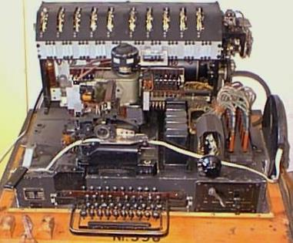
T-52d Geheimschreiber Maximum Key Space
Rotor plugboard switch:
10 rotors: 47,53,59,61,64,
65,67,69,71,73:
10 rotors order: 10! =
3,628,800
Wiring: 2⁶²⁹ = 2.23x10¹⁸⁹
Stepping: 1
Start position: (47x53x59x
61x64x65x67x69x71x73)
= 8.94X10¹⁷
Maximum key space
7.23 x 10²¹³
Photo credit: Reidar Olsen, Norway
Notes:
3 Rotating rotors:
Notch setting can theoretically include notches on any of the 26 letters, or 2^26 for each rotor. Only notches on the 2nd and 3rd rotors from the left affect the rotor movements to the rotors to the left of them, just like the Enigma.
Start position is not needed for solving one message, but the start position is needed to solve the “message key” to solve all messages from a single day (messages using the same internal settings).
2 Static rotors:
Wiring for 2 rotors is only 26! Instead of (26!)^2 because the 2 rotors are stationary, so their wiring can be combined and considered as one rotor.
Entry disk and reflector are hard-wired in the machine, so is known by the enemy.
The entry disk plugboard can be plugged non-reciprocally, so A can be plugged to B and B can be plugged to C. The reflector plugboard is reciprocal, so if A is plugged to B, then B must be plugged to A.

Slide 46
T-52d Geheimschreiber Practical Key Space
Rotor plugboard switch:
Σ rotors: 10!/5! = 30,240
π rotors: 30 (“Pentagon” logic)
10 rotors: 47,53,59,61,64,
65,67,69,71,73:
Wiring: 1
Stepping: 1
Start position: (47x53x59x
61x64x65x67x69x71x73)
= 8.94X10¹⁷
Practical key space
8.11 x 10²³
Photo credit: Reidar Olsen, Norway
Notes:
3 Rotating rotors:
Notch setting can theoretically include notches on any of the 26 letters, or 2^26 for each rotor. Only notches on the 2nd and 3rd rotors from the left affect the rotor movements to the rotors to the left of them, just like the Enigma.
Start position is not needed for solving one message, but the start position is needed to solve the “message key” to solve all messages from a single day (messages using the same internal settings).
2 Static rotors:
Wiring for 2 rotors is only 26! Instead of (26!)^2 because the 2 rotors are stationary, so their wiring can be combined and considered as one rotor.
Entry disk and reflector are hard-wired in the machine, so is known by the enemy.
The entry disk plugboard can be plugged non-reciprocally, so A can be plugged to B and B can be plugged to C. The reflector plugboard is reciprocal, so if A is plugged to B, then B must be plugged to A.

Slide 47
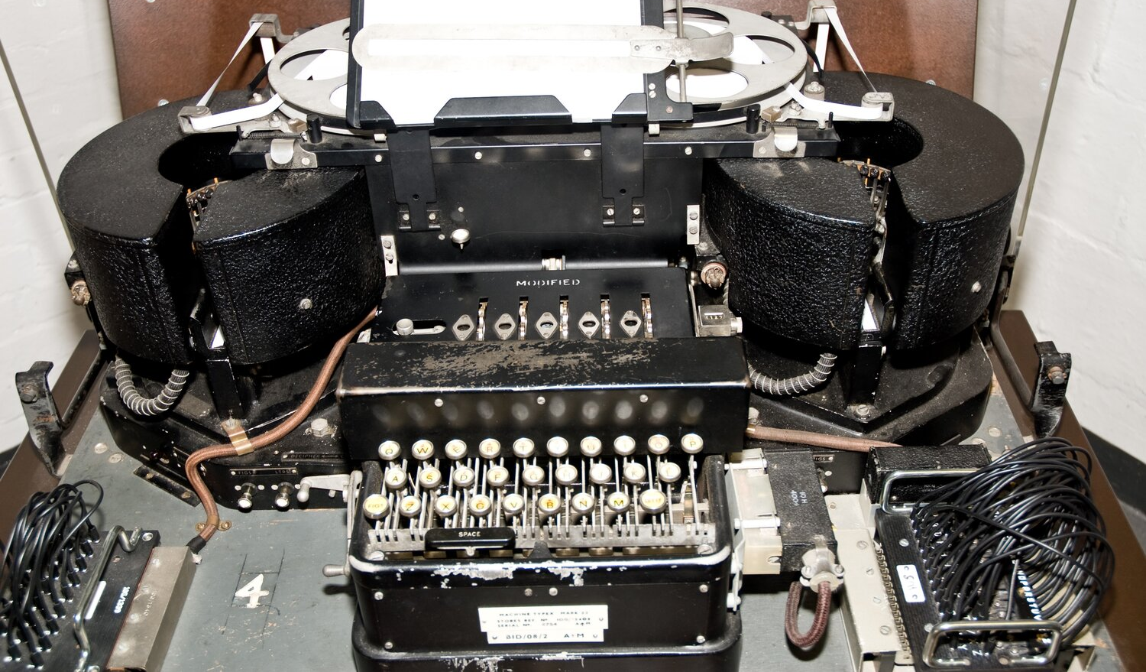
Typex Mark 22 Maximum Key Space
3 Rotating rotors:
2 Static rotors of 8:
Wiring: (26!)³
Order: 1³
Side: 1³
Notch setting: 2²⁶
Start position: 26³
Wiring: (26!)²
Order: 1²
Side: 1²
Notch setting: 1²
Start position: 26²
Entry disk plugboard:
Entry
disk:
Non-reciprocal =
26! = 4.03x10²⁶
fixed: 1
Reflector:
fixed: 1
Reflector plugboard:
Reciprocal =
7.91x10¹²
Maximum key space
1.82 x 10¹⁹⁵
Photo credit: Lawrence Wilkinson
Notes:
3 Rotating rotors:
Notch setting can theoretically include notches on any of the 26 letters, or 2^26 for each rotor. Only notches on the 2nd and 3rd rotors from the left affect the rotor movements to the rotors to the left of them, just like the Enigma.
Start position is not needed for solving one message, but the start position is needed to solve the “message key” to solve all messages from a single day (messages using the same internal settings).
2 Static rotors:
Wiring for 2 rotors is only 26! Instead of (26!)^2 because the 2 rotors are stationary, so their wiring can be combined and considered as one rotor.
Entry disk and reflector are hard-wired in the machine, so is known by the enemy.
The entry disk plugboard can be plugged non-reciprocally, so A can be plugged to B and B can be plugged to C. The reflector plugboard is reciprocal, so if A is plugged to B, then B must be plugged to A.

Slide 48
Typex Mark 22 Practical Key Space
3 Rotating rotors:
2 Static rotors of 8:
Wiring: 1³
Order: 8x7x6 = 336
Side: 2³
Notch setting: 26²
Start position: 26³
Wiring: 1²
Order: 5x4 = 20
Side: 2²
Notch setting: 1²
Start position: 26²
Entry disk plugboard:
Entry
disk:
Non-reciprocal =
26! = 4.03x10²⁶
fixed: 1
Reflector:
fixed: 1
Reflector plugboard:
Reciprocal =
7.91x10¹²
Practical key space
5.51 x 10⁵⁴
Photo credit: Lawrence Wilkinson
Notes:
Total of 5 rotors used out of 8 available. The rotating and static rotors are interchangeable, so the order of 5 from 8 rotors is n!/(n-k)! = 8!/(8-5)! = 8x7x6x5x4=6720, which I divided as 336 for the rotating rotors and 20 for the static rotors. Equivalently, it could be 8x7=56 for the static rotors and 6x5x4=120 for the rotating rotors or any other combination of 8,7,6,5,4.

Slide 49
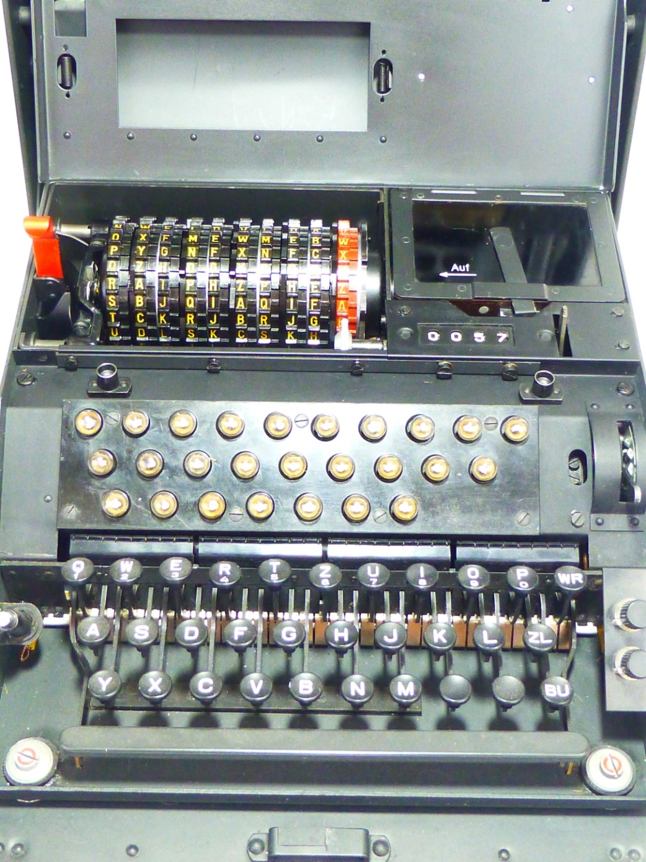
NEMA Maximum Key Space
Reflector:
Stepping adjustment screws: 1⁴
Wiring: 7.91x10¹²
Start position: 26¹
4 Cipher rotors:
Wiring: 26!⁴ = 2.65x10¹⁰⁶
Order: 1
Start position: 26⁴
4 Stepping rotors:
Notches: (2²⁶)⁴ = 2.03x10³¹
Order: 1
Start position: 26⁴
Entry rotor:
Maximum key space
5.99 x 10¹⁶⁴
Wiring: fixed
Start position: 26¹
Photo credit: Ralph Simpson, CipherHistory.com

Slide 50
NEMA Practical Key Space
Reflector:
Stepping adjustment screws: 1⁴
Wiring: 1
Start position: 26¹
4 Cipher rotors:
Wiring: 1⁴
Order: 6x5x4x3 = 360
Start position: 26⁴
4 Stepping rotors:
Notches: 1⁴
Order: 6x5x4x3 = 360
Start position: 26⁴
Entry rotor:
Practical key space
1.83 x 10¹⁹
Wiring: fixed
Start position: 26¹
Photo credit: Ralph Simpson, CipherHistory.com

Slide 51
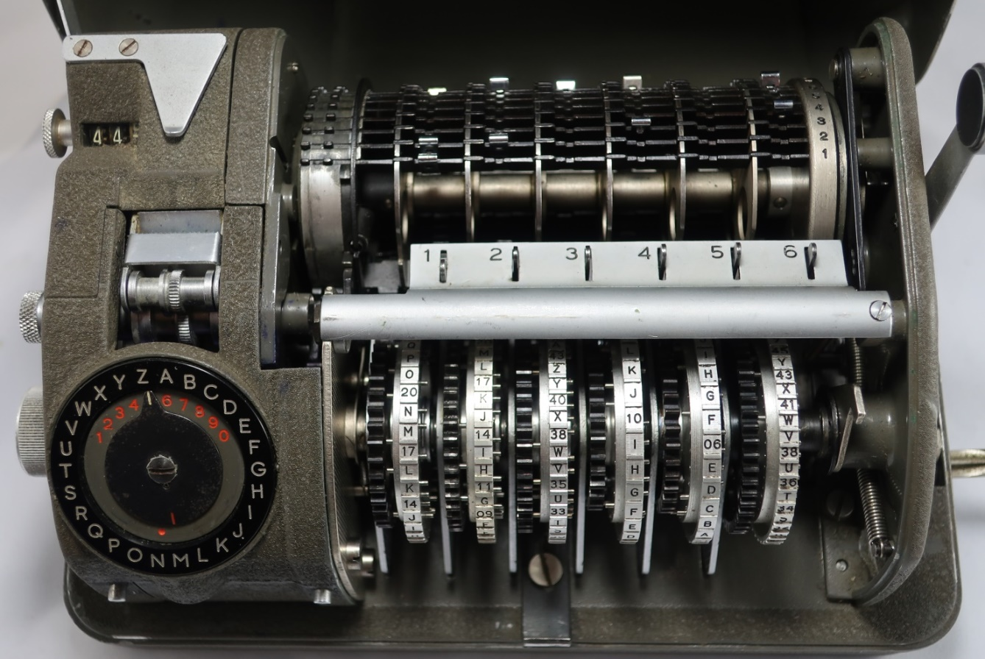
Hagelin C-52 Maximum Key Space
5 Stepping bars:
27 Cipher bars:
5 stepping bars have fixed teeth vs settable lugs, so # settings = 1
n=2⁶ lug settings & k=27 bars
C(n+k-1,k) = (n+k-1)!/(n-1)!k!
C(90,27) = (90!)/(63! x 27!)
= 6.88x10²²
Printer offset:
*
Printer wheel offset: 26
6 Rotors (25,26,29,31,34,37, 38,41,42,43,46,47):
Pin setting: 2³⁸⁺⁴¹⁺⁴²⁺⁴³⁺⁴⁶⁺⁴⁷
= 2²⁵⁷ = 2.32x10⁷⁷
Order: 12!/6! = 665,280
Start position: 38x41x42x
43x46x47 = 6.08x10⁹
Maximum key space
1.68 x 10¹¹⁷
Photo credit: Ralph Simpson, CipherHistory.com
“Stars and Bars” formula
*
Notes:
# lug settings per bar:
₆
∑ C(6,p) = 1+6+15+20+15+6+1 = 64
^{p=0}

Slide 52
Hagelin C-52 Practical Key Space
5 Stepping bars:
27 Cipher bars:
5 stepping bars have fixed teeth vs settable lugs, so # settings = 1
n=2⁶ lug settings & k=27 bars,
but Hagelin user manual recommendations provide only 65,000 lug settings
Printer offset:
Printer wheel offset: 26
6 Rotors (25,26,29,31,34,37, 38,41,42,43,46,47):
Pin setting: 45-55% active
2¹²¹ ⁻ 2⁹⁹ = 2.66x10³⁶
Order: 12!/6! = 665,280
Start position avg: (439/12)⁶ = 2.40x10⁹
Practical key space
7.17 x 10⁵⁷
Photo credit: Ralph Simpson, CipherHistory.com
Notes:
Recommendations from the Hagelin manual, “The effect of computers on the security of Hagelin cryptographer type C-52”, No. R 7002 e, Oct. 1962.
Pin setting 6 Rotors from 25,26,29,31,34,37,38,41,42,43,46,47:
Recommendation: 45-55% pins should be active
Sum ( 25,26,29,31,34,37,38,41,42,43,46,47 ) / 2 = 439/2 = 219.5
219.5 X 45% = 99
219.5 X 55% = 121
2^121 – 2^99 = 2.65x10^36
Rotor start position: [Sum ( 25,26,29,31,34,37,38,41,42,43,46,47 ) / 12]^6
= [439/12]^6
= 2.40x10^9
Lug setting = 65,000

Slide 53
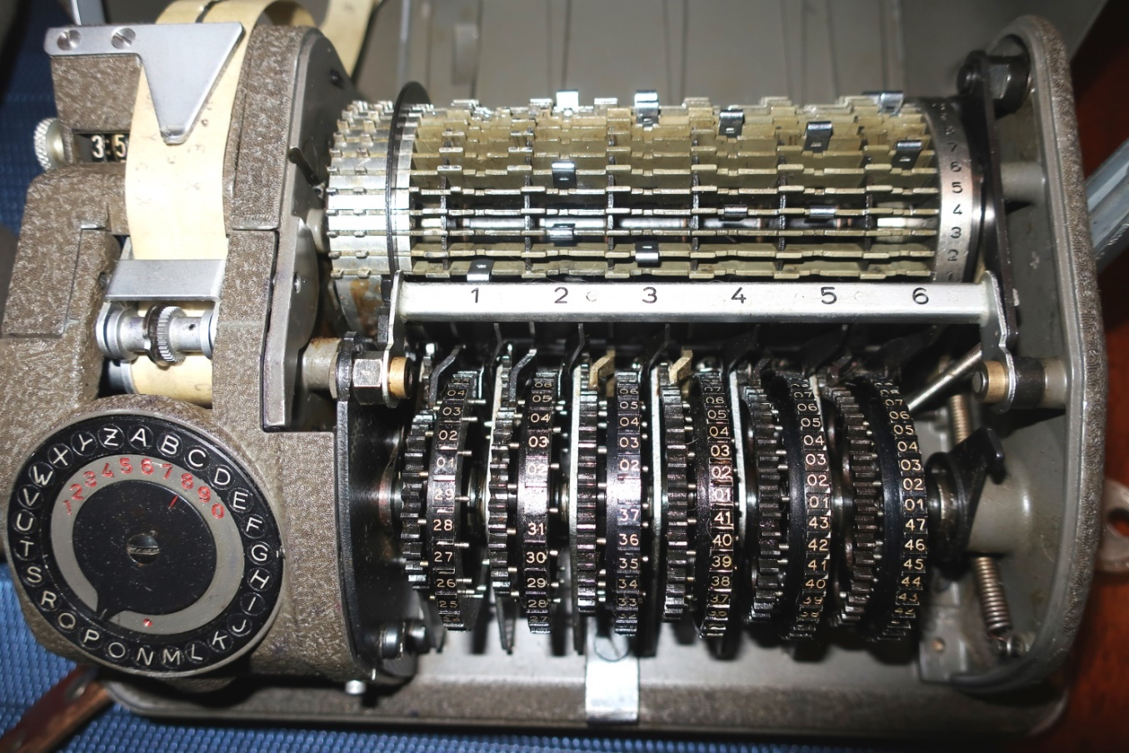
Hagelin CX-52 Maximum Key Space
27 Cipher bars:
5 Stepping bars:
n=2⁶ lug settings & k=27 bars
C(n+k-1,k) = (n+k-1)!/(n-1)!k!
C(90,27) = (90!)/(63! x 27!)
= 6.88x10²²
Printer offset:
Rotor 1 always steps once 5 bars: 0-5 lug positions,
6⁵ = 7,776
*
Printer wheel offset: 26
6 47-pin rotors:
Pin setting: (2⁴⁷)⁶ =
2²⁸² = 7.77x10⁸⁴
Order: 1
Start position: 47⁶ =
1.08x10¹⁰
Maximum key space
1.17 x 10¹²³
Photo credit: Ralph Simpson, CipherHistory.com
“Stars and Bars” formula
*
Notes:
Pins setting:
40-60% active pins = 113-169 pins of 282
₁₆₉
∑ C(282,p) = 282! / (282-p)! X p! =
^{p=113}
113 –
114 –
115 –
5 stepping bar lug combinations
N = 2^5 = 32, k=5
C(36,5) = 36! / 31! X 5! = 376,992

Slide 54
Hagelin CX-52 Practical Key Space
27 Cipher bars:
5 Stepping bars:
n=2⁶ lug settings & k=27 bars, but Hagelin user manual recommendations provide only 65,000 lug settings
Printer offset:
Rotor 1 always steps once 5 bars: 0-5 lug positions,
6⁵ = 7,776
Printer wheel offset: 26
6 47-pin rotors:
Pin setting: 45-55% active
= (.55)(2⁴⁷)⁶ - (.45)(2⁴⁷)⁶
= 7.77x10⁸³
Order: 1
Start position: 47⁶
= 1.08x10¹⁰
Practical key space
1.10 x 10¹⁰⁴
Photo credit: Ralph Simpson, CipherHistory.com

Slide 55
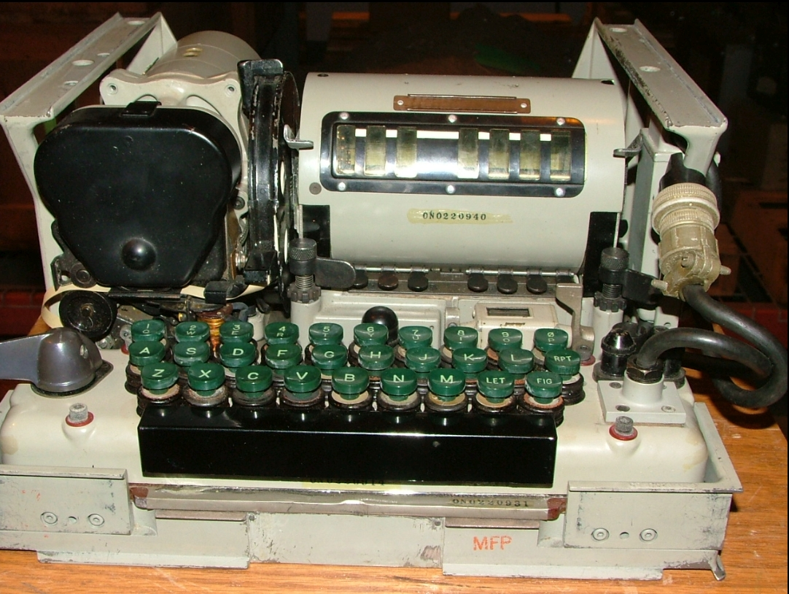
KL-7 Maximum key space
8 Rotors:
Wiring: (36!)⁸
Order: 1
Start position: 36⁸
7 Notch rings:
Notches: (2³⁶)⁷
Order: 1
Start position: 36⁷
Maximum key space
5.87 x 10⁴³¹
Photo credit: Navy-radio.com

Slide 56
KL-7 Practical key space
7 Rotors from 11:
Static rotor:
Wiring: 1⁷
Order: 11!/4!
= 1.66x10⁶
Start position: 36⁷
Wiring: 1
Order: 1
Start position: 1
7 Notch rings from 11:
Notches: 1⁷
Order: 11!/4!
= 1.66x10⁶
Start position: 36⁷
Practical key space
1.70 x 10³⁴
Photo credit: Navy-radio.com

Slide 57
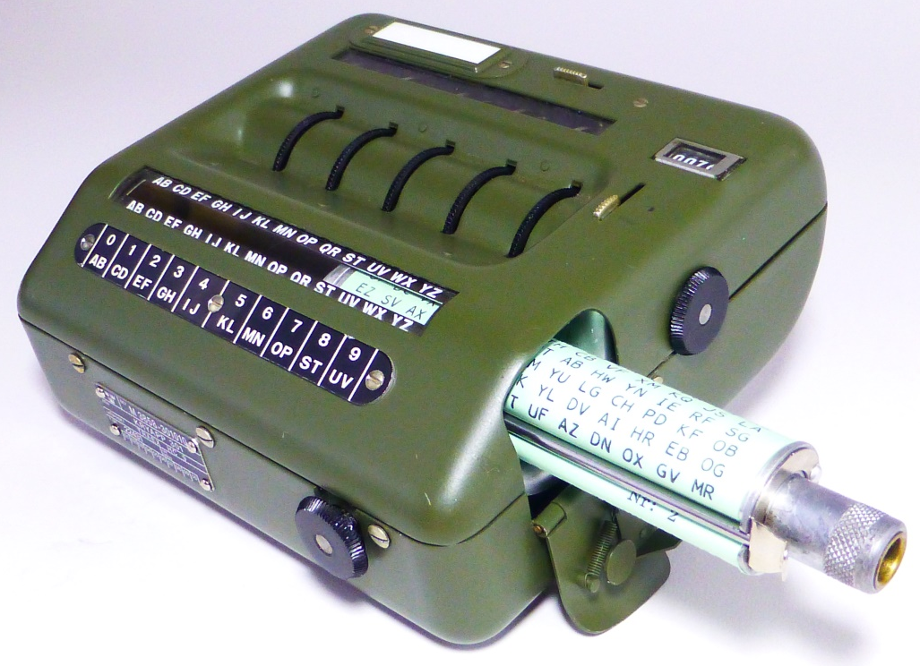
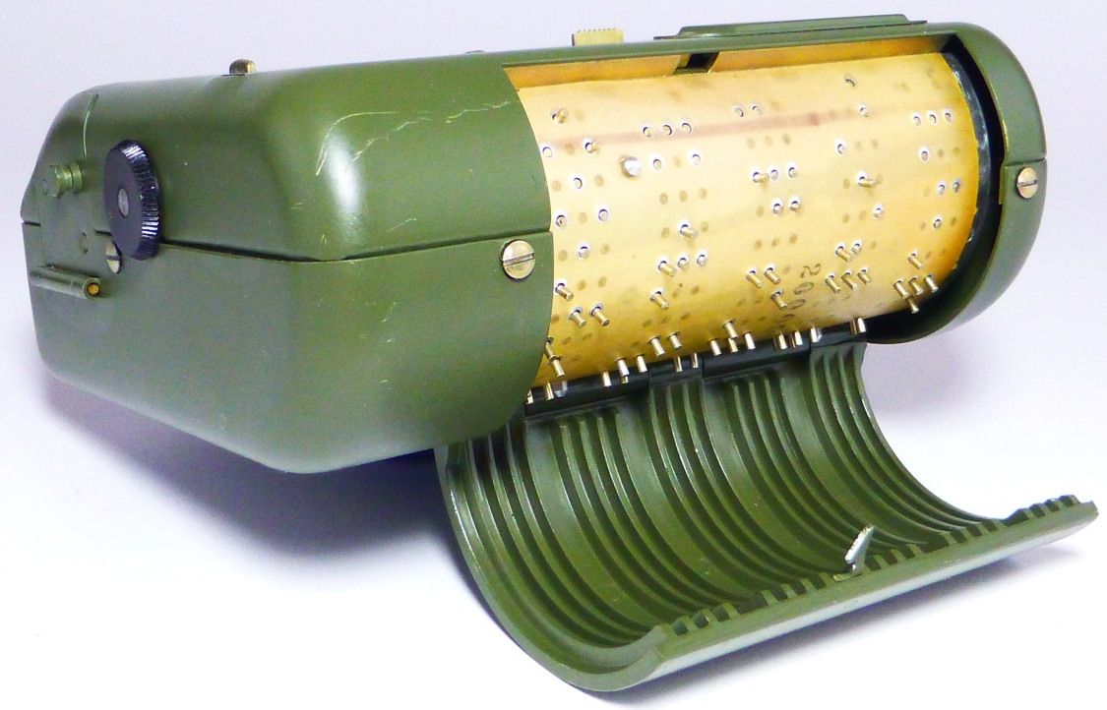
Transvertex HC-9 Maximum Key Space
Photo credit: Ralph Simpson, CipherHistory.com
Rotor start position:
26⁵ = 11,881,376
Pin setting:
(2¹⁶²) / 2 = (5.84x10⁴⁸) / 2 =
2.92x10⁴⁸
16 Alphabets:
(5.33x10¹⁴) x 16 = 8.53x10¹⁵
Maximum key space
2.96 x 10⁷¹
Photo credit: Ralph Simpson, CipherHistory.com

Slide 58
Transvertex HC-9 Practical Key Space
Photo credit: Ralph Simpson, CipherHistory.com
Rotor start position:
26⁵ = 11,881,376
Pin setting:
(2¹⁶²) / 2 = (5.84x10⁴⁸) / 2 =
2.92x10⁴⁸
User restriction: no letter encrypts to itself
16 Alphabets:
(5.33x10¹⁴) x 16 = 8.53x10¹⁵
(7.91x10¹²) x 16 = 1.26x10¹⁴
Practical key space
4.39 x 10⁶⁹
Photo credit: Ralph Simpson, CipherHistory.com

Slide 59
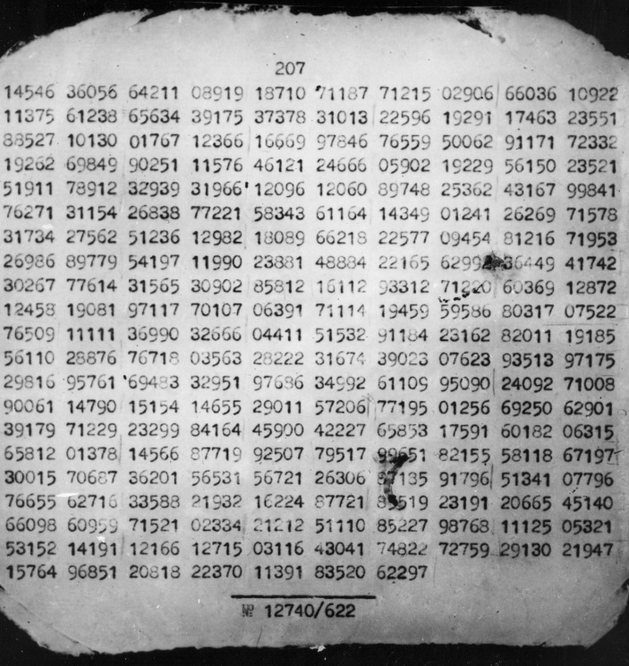
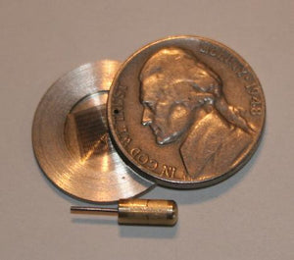
Russian VIC Maximum Key Space
Photo credit: mysteriouswritings.com
Photo credit: FBI.gov
VIC Paper & Pencil cipher key:
Key Space =
10⁵ x 10²⁰ x 10² x (9.09x10¹³)
5 digit random key combined with
secret date = 10⁵
2) 20 character secret phrase converted
to digits = 10²⁰
3) 1 or 2 digit agent code = 10²
10 chars. for straddling checkerboard
(a-z, 2 blanks, . , /) = 9.09x10¹³
Maximum key space
9.09 x 10⁴⁰
Notes:
Item 1) – A random 5 digit number and a secret date truncated to 5 digits seems like it should have a key space of 10¹⁰, but both numbers are combined into a single 5 digit number and the two original numbers are not used in the rest of the algorithm, so the key space is this combined 5 digit number = 10⁵
Item 4) - The maximum key space for this, assuming the enemy knows the algorithm but not the changeable elements, means these 10 characters can be any letter, a-z plus the period, slash, and 2 blanks.
Permutations of 10 items from (a-z, period, slash, two blanks)
= P(30,10) = 30! / (30-10)! = 109,027,350,432,000 (but this includes 2 non-unique blanks)
Permutations of 10 items from (a-z, period, slash, one blank)
= P(29,10) = 29! / (29-10)! = 72,684,900,288,000
Difference (Permutations with 2 blanks)
= 36,342,450,144,000
The Difference # has 2 blanks, but they could be interchanged, so the unique permutations with 2 blanks
= 36,342,450,144,000 / 2
Total = permutations allowing only one blank + permutations requiring two blanks
= 72,684,900,288,000 + (36,342,450,144,000 / 2) = 90,856,125,360,000

Slide 60
Russian VIC Practical Key Space
Photo credit: mysteriouswritings.com
Photo credit: FBI.gov
VIC Paper & Pencil cipher key:
Key Space =
10⁵ x 10²⁰ x 10² x 1
5 digit random key combined with
secret date = 10⁵
2) 20 character secret phrase converted
to digits = 10²⁰
3) 1 or 2 digit agent code = 10²
4) 10 chars. for straddling checkerboard,
(“snegopad” or snowfall, 2 blanks) = 1
Practical key space
1.00 x 10²⁷

Slide 61
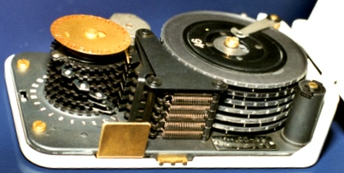
Hagelin CD-55 Maximum Key Space
6 rotors (17,19,21,23,25,26 or
29,31,37,41,43,47) :
TBD
Pin setting:
Order: 1
Stepping: 1 (fixed)
Start position:
Alphabet offset:
Alphabet disk offset: 26
6 Displacement disks:
Each disk has 1-16 steps but ≤32 total:
TBD
Notes:
https://nsarchive.gwu.edu/document/19892-national-security-archive-18-correspondence (page 37)
Maximum displacement steps total = 32 (CD-57 allows up to 40 displacement steps)
17,19,21,23,25,26 or 29,31,37,41,43,47 – CD-55 (same as M-209 or CX-52a)
17,19,21,23,25,26 – C-446, M-209, C-38
29,31,37,41,43,47 – CX-52a
29,31,37,41,42,47 – CX-52b
25,26,34,38,42,46 - CX-52c
25,26,29,31,34,37,38,41,42,43,46,47 – C-52
,31,34,37,38,41,42,43,46,47 – CD-57
Choosing 6 of 12 disks – 12!/6! = 665,280
Pin settings – 2^(29+31+37+41+43+47) = 2^228
Displacement settings – using stars and bars formula:
C(n+k-1, k) = (n+k-1)! / (n-1)!k!
C(15+6-1,6) = 20! / 14! X 6! = 38,760
25,26,29(22 lug settings & 27 bars)
C(n+k-1,k)*= (n+k-1)!/(n-1)!k!
C(48,27) = (48!)/(21! x 27!)
= 2.23x10¹³

Slide 62
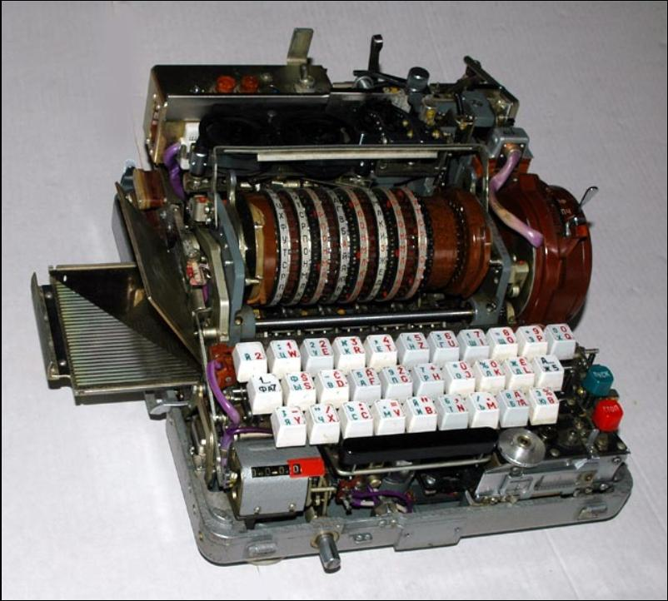
FIALKA Maximum Key Space
Punched card:
30! = 2.65x10³²
10 Rotors:
Start position:
30¹⁰ = 5.90x10¹⁴
Pin setting:
(2³⁰)⁸ = 1.77x10⁷²
10 Wiring mazes:
Wiring: 30!¹⁰ =
1.72x10³²⁴
Order: 1
Side (1 or 2): 1
Rotation: 30¹⁰ =
5.90x10¹⁴
Maximum key space
2.82 x 10⁴⁵⁸
Photo credit: Ralph Simpson, CipherHistory.com

Slide 63
FIALKA Practical Key Space
Punched card:
30! = 2.65x10³²
10 Rotors:
Start position:
30¹⁰ = 5.90x10¹⁴
Pin setting:
10!/2 = 1.81x10⁶
10 Wiring mazes:
Wiring: 1
Order: 10! =
3.63x10⁶
Side: 2¹⁰ = 1024
Rotation: 30¹⁰ =
5.90x10¹⁴
Practical key space
6.24 x 10⁷⁷
Photo credit: Ralph Simpson, CipherHistory.com

Slide 64
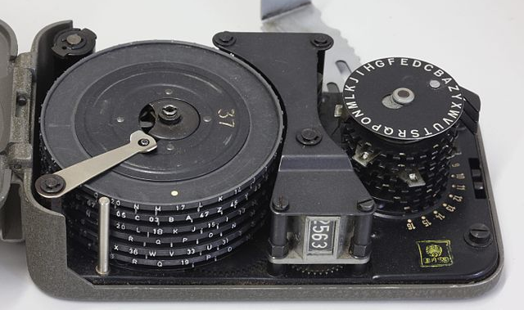
Hagelin CD-57 Maximum Key Space
Photo credit: Rama via Wikimedia Commons
Alphabet offset:
Alphabet disk offset: 26
6 Displacement disks:
Each disk has 1-16 steps but ≤40 total:
(16⁶)[(40) / (6x16)]
= 6.99x10⁶
6 47-pin rotors:
Pin setting: (2⁴⁷)⁶ =
2²⁸² = 7.77x10⁸⁴
Order: 1
Stepping: 1 (fixed)
Start position: 47⁶ = 1.08x10¹⁰
Maximum key space
1.52 x 10¹⁰³
Notes:
Hagelin technical manual, “Pocket Cryptographer Type CD-57, Technical Description, No. 3088 B” says CD-57 is the same cryptologically as the C-52 (not CX-52), but all 6 rotors only move one space at a time and each rotor can only cause the print wheel to advance up to 16 positions, at most, and 40 positions total for all 6 rotors.
Basic keys
Arrangement of stops on displacement disk:
6 disks with lug settings = 1-16 each means 6 to 96 total steps are possible, but only 40 allowed
So 6-40 steps out of (6-96) possible steps are allowed = 40/96
Number of lug settings for displacement disks = 16⁶ x (40/96) = 6,990,507 settings
Choice of key wheels, assume 12 standard wheels: 25,26,29,31,34,37,38,41,42,43,46,47:
Order of the 6 wheels from 12 = 12!/6! = 665,280
Stepping = 1 because all rotors always step one position
Arrangement of pins: Ʃ 25,26,29,31,34,37,38,41,42,43,46,47 = 439 total pins, so 2^{439/2} = 2^{219.5}
Recommendation: 1) 40-60% active pins: 60%(219.5) = 132 to 40%(219.5) = 88, so 2¹³² - 2⁸⁸ = 5.44x10³⁹
2) no more than 5 active/inactive in a row: reduction of 2 out of 64 settings for each pin
position = [(64-2)/64]^219.5 valid pin settings = 9.07x10^-4
result = 1) x 2) = 5.12x10³⁶
- Position of alphabet ring = 26
Initial keys
- Start position of key wheels = Ʃ 25,26,29,31,34,37,38,41,42,43,46,47 = (439/12)⁶ = 2.40x10⁹

Slide 65
Hagelin CD-57 Practical Key Space
Photo credit: Rama via Wikimedia Commons
Alphabet offset:
Alphabet disk offset: 26
6 Displacement disks:
Each disk has 1-16 steps but ≤40 total:
(16⁶)[(40) / (6x16)]
= 6.99x10⁶
6 Rotors (25,26,29,31,34,37,38,41,42,43,46,47):
Pins: 1) 40-60% active = 2^{(439/2)(.6)} – 2^{(439/2)(.4)}
= 2¹³² - 2⁸⁸ = 5.44x10³⁹
2) <6 active/inactive pins in row,
[(2⁶ - 2) / 2⁶]^{439/2} = 9.41x10⁻⁴
= 1) x 2) = 5.12x10³⁶
Order: 12!/6! = 665,280
Stepping: 1 (fixed)
Start position: (439/12)⁶ = 2.40x10⁹
Practical key space
1.49 x 10⁶⁰
Notes:
Hagelin technical manual, “Pocket Cryptographer Type CD-57, Technical Description, No. 3088 B” says CD-57 is the same cryptologically as the C-52 (not CX-52), but all 6 rotors only move one space at a time and each rotor can only cause the print wheel to advance up to 16 positions, at most, and 40 positions total for all 6 rotors.
Basic keys
Arrangement of stops on displacement disk:
6 disks with lug settings = 1-16 each means 6 to 96 total steps are possible, but only 40 allowed
So 6-40 steps out of (6-96) possible steps are allowed = 40/96
Number of lug settings for displacement disks = 16⁶ x (40/96) = 6,990,507 settings
Choice of key wheels, assume 12 standard wheels: 25,26,29,31,34,37,38,41,42,43,46,47:
Order of the 6 wheels from 12 = 12!/6! = 665,280
Stepping = 1 because all rotors always step one position
Arrangement of pins: Ʃ 25,26,29,31,34,37,38,41,42,43,46,47 = 439 total pins, so 2^{439/2} = 2^{219.5}
Recommendation: 1) 40-60% active pins: 60%(219.5) = 132 to 40%(219.5) = 88, so 2¹³² - 2⁸⁸ = 5.44x10³⁹
2) no more than 5 active/inactive in a row: reduction of 2 out of 64 settings for each pin
position = [(64-2)/64]^219.5 valid pin settings = 9.07x10^-4
result = 1) x 2) = 5.12x10³⁶
- Position of alphabet ring = 26
Initial keys
- Start position of key wheels = Ʃ 25,26,29,31,34,37,38,41,42,43,46,47 = (439/12)⁶ = 2.40x10⁹

Slide 66
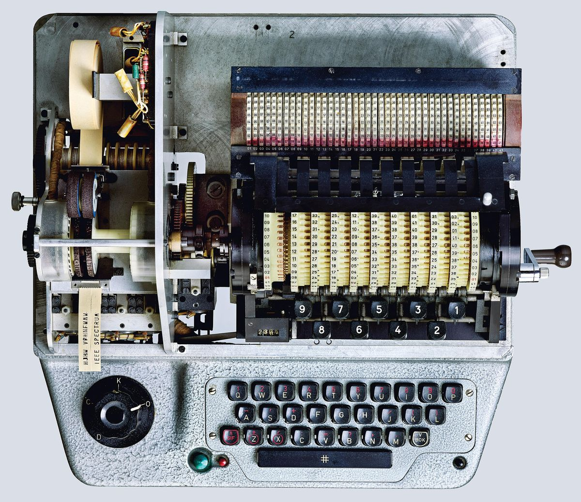
Hagelin HX-63 Maximum Key Space
Rotary stepping switch:
Photo credit: Peter Adams
Starting position: 41⁴¹
Alphabet offset:
Alphabet disk offset: 26
Reflector:
Non-reciprocal:
41!
9 Rotors of 12:
Entry Rotor:
Wiring: (41!)⁹
Order: 12! / (12-9)!
= 79,833,600
Notches:
Starting position: 41⁹
Wiring: 1
Maximum key space
1.49 x 10⁶⁰⁰
Notes:
Hagelin technical manual, “Pocket Cryptographer Type CD-57, Technical Description, No. 3088 B” says CD-57 is the same cryptologically as the C-52 (not CX-52), but all 6 rotors only move one space at a time and each rotor can only cause the print wheel to advance up to 16 positions, at most, and 40 positions total for all 6 rotors.
Basic keys
Arrangement of stops on displacement disk:
6 disks with lug settings = 1-16 each means 6 to 96 total steps are possible, but only 40 allowed
So 6-40 steps out of (6-96) possible steps are allowed = 40/96
Number of lug settings for displacement disks = 16⁶ x (40/96) = 6,990,507 settings
Choice of key wheels, assume 12 standard wheels: 25,26,29,31,34,37,38,41,42,43,46,47:
Order of the 6 wheels from 12 = 12!/6! = 665,280
Stepping = 1 because all rotors always step one position
Arrangement of pins: Ʃ 25,26,29,31,34,37,38,41,42,43,46,47 = 439 total pins, so 2^{439/2} = 2^{219.5}
Recommendation: 1) 40-60% active pins: 60%(219.5) = 132 to 40%(219.5) = 88, so 2¹³² - 2⁸⁸ = 5.44x10³⁹
2) no more than 5 active/inactive in a row: reduction of 2 out of 64 settings for each pin
position = [(64-2)/64]^219.5 valid pin settings = 9.07x10^-4
result = 1) x 2) = 5.12x10³⁶
- Position of alphabet ring = 26
Initial keys
- Start position of key wheels = Ʃ 25,26,29,31,34,37,38,41,42,43,46,47 = (439/12)⁶ = 2.40x10⁹

Slide 67
RSA-4096 Key Space
Key = product of 2 primes, (pxq), where 2^{2047.5} < p < q < 2²⁰⁴⁸
Key space = total number of unique prime pairs: p and q
2⁰
2²⁰⁴⁷
2^{2047.5}
2²⁰⁴⁸
Calculation of key space = (# primes)² / 2
(note1: divide by 2 because pxq = qxp)
(note2: (# primes ≤ n) = π(n) ≈ n / ln(n) )
= [ π(2²⁰⁴⁸) - π(2^{2047.5} ) ]² / 2
= [ (2²⁰⁴⁸ / ln(2²⁰⁴⁸) ) - (2^{2047.5} / ln(2^{2047.5} ) ) ]² / 2
= [ 2.27654x10⁶¹³ - 1.61015x10⁶¹³ ]² / 2
= 2.22x10¹²²⁵ ≡ 2^{4070.51}
Maximum & Practical key space
2.22 x 10¹²²⁵

Slide 68
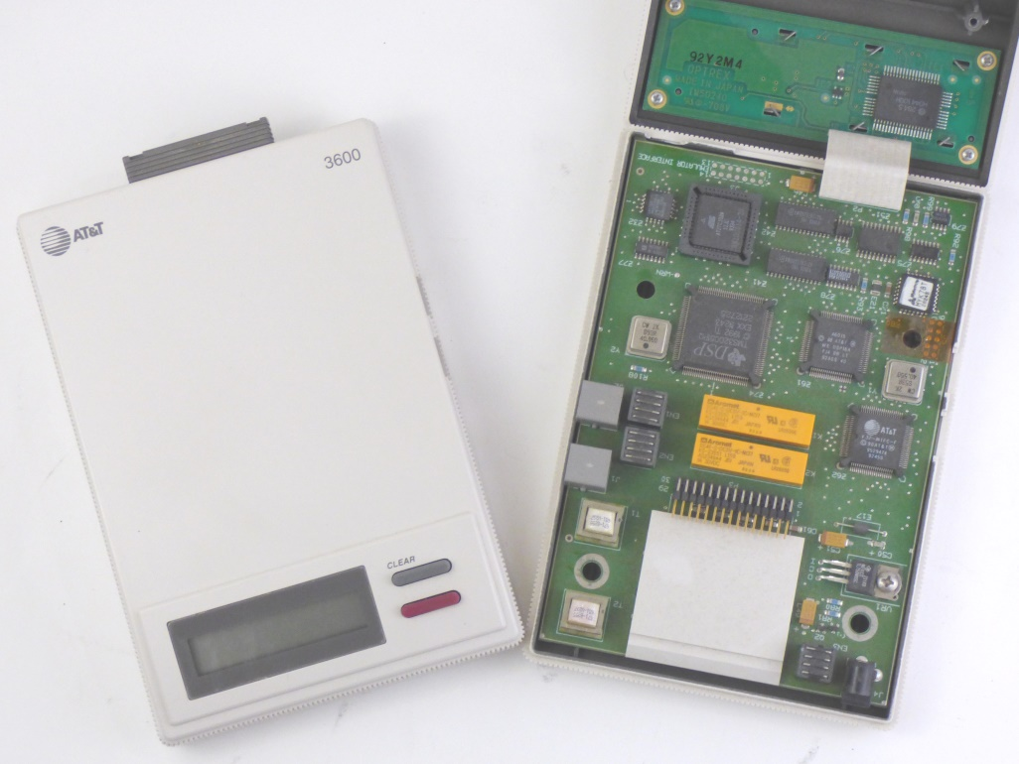
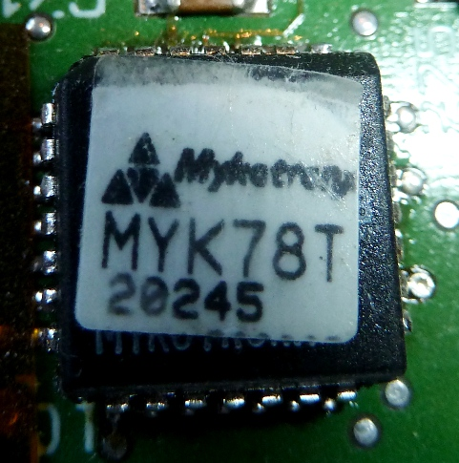
AT&T TSD 3600-E “Clipper Chip” Key Space
Photo credit: Ralph Simpson, CipherHistory.com
Photo credit: Ralph Simpson, CipherHistory.com
Clipper Chip designed with advertised front door access
Clipper Chip has proprietary NSA Skipjack encryption program
Skipjack similar to DES, but with an 80 bit key: key space = 2⁸⁰
Maximum & Practical key space
1.21 x 10²⁴

Slide 69
Key Spaces of Historic Cipher Machines
Year
Cipher
Maximum Key Space
Practical Key Space
1942
1943
1947
1952
1952
1952
1950s
1953
1955
1956
1957
1976
1977
1992
2001
T-52d Geheimschreiber
Typex Mark 22
NEMA
Hagelin C-52
Hagelin CX-52
KL-7
Transvertex HC-9
VIC Paper & Pencil
Hagelin CD-55
Fialka
Hagelin CD-57
DES (56 bit)
RSA-4096
AT&T TSD 3600-E Clipper Chip
AES-256
7.23x10²¹³
1.82x10¹⁹⁵
5.99x10¹⁶⁴
1.68x10¹¹⁷
1.17x10¹²³
5.87x10⁴³¹
2.96x10⁷¹
9.09x10⁴⁰
TBD
2.82x10⁴⁵⁸
1.52x10¹⁰³
7.21x10¹⁶
2.22x10¹²²⁵
1.21x10²⁴
1.16x10⁷⁷
2⁷¹⁰
2⁶⁴⁹
2⁵⁵¹
2³⁸⁹
2⁴⁰⁹
2¹⁴³⁴
2²³⁷
2¹³⁶
2¹⁵²³
2³⁴³
2⁵⁶
2⁴⁰⁷¹
2⁸⁰
2²⁵⁶
8.11x10²³
5.51x10⁵⁴
1.83x10¹⁹
7.17x10⁵⁷
1.10x10¹⁰⁴
1.70x10³⁴
4.39x10⁶⁹
1.00x10²⁷
TBD
6.24x10⁷⁷
1.49x10⁶⁰
7.21x10¹⁶
2.22x10¹²²⁵
1.21x10²⁴
1.16x10⁷⁷
2⁷⁹
2¹⁸²
2⁶⁴
2¹⁹²
2³⁴⁶
2¹¹⁴
2²³¹
2⁹⁰
2²⁵⁸
2²⁰⁰
2⁵⁶
2⁴⁰⁷¹
2⁸⁰
2²⁵⁶
Copyright © 2023 ( CC BY 4.0 ) CipherHistory.com

Slide 70
Key Spaces of Historic Cipher Machines
Year
Cipher
Maximum Key Space
Practical Key Space
600 BCE
50 BCE
1466
1586
1854
1860s
1912
1912
1916
1918
1918
1922
1924
1926
1930
1931
1932
1937
1939
1939
1941
1941
1942
1942
1942
1943
1947
1952
1952
1952
1950s
1953
1956
1957
1976
1977
1992
2001
Monoalphabetic
Caesar
Vigenère (repeating keyword - 15 char.)
Vigenère (autokey - 314 char. message)
Playfair
Wheatstone Cryptograph
Lugagne Transpositeur
M-94 Cylinder Cipher
M-138A Strip Cipher
ADFGX
ADFGVX
Hebern 5-Rotor
Kryha
Enigma Swiss K
Lugagne Le Sphinx
Abwehr Enigma G
Enigma I
SIGABA
Japanese Purple
Japanese JN-25 Codebook (100 words)
Lorenz SZ-40/42
SG-41 “Hitler Mill”
M-209 Pin & Lug
Enigma M4
T-52d Geheimschreiber
Typex Mark 22
NEMA
Hagelin C-52
Hagelin CX-52
KL-7
Transvertex HC-9
VIC Paper & Pencil
Fialka
Hagelin CD-57
DES (56 bit)
RSA-4096
AT&T TSD 3600-E Clipper Chip
AES-256
4.03x10²⁶
2.50x10¹
1.68x10²¹
2.00x10⁴⁴⁴
6.20x10²³
4.03x10²⁶
1.30x10⁵³²
3.45x10⁶⁶⁶
3.69x10⁷⁹⁹
4.19x10⁴⁷
1.01x10⁶⁴
1.27x10¹⁴⁰
2.02x10⁵³
1.60x10¹⁰¹
1.30x10⁵³²
7.17x10¹²¹
3.28x10¹¹⁴
1.82x10²⁸⁵
3.81x10⁵⁹
1.00x10¹²
1.05x10¹⁷⁰
4.24x10⁵¹
6.16x10⁶⁰
2.33x10¹⁴⁵
7.23x10²¹³
1.82x10¹⁹⁵
5.99x10¹⁶⁴
1.68x10¹¹⁷
1.17x10¹²³
5.87x10⁴³¹
2.96x10⁷¹
9.09x10⁴⁰
2.82x10⁴⁵⁸
1.52x10¹⁰³
7.21x10¹⁶
2.22x10¹²²⁵
1.21x10²⁴
1.16x10⁷⁷
2⁸⁸
2⁵
2⁷¹
2¹⁴⁷⁶
2⁷⁹
2⁸⁸
2¹⁷⁶⁸
2²²¹⁴
2²⁶⁵⁶
2¹⁵⁸
2²¹³
2⁴⁶⁶
2¹⁷⁷
2³³⁶
2¹⁷⁶⁸
2⁴⁰⁵
2³⁸⁰
2⁹⁴¹
2¹⁹⁸
2⁴⁰
2⁵⁶⁵
2¹⁷¹
2²⁰²
2⁴⁸³
2⁷¹⁰
2⁶⁴⁹
2⁵⁵¹
2³⁸⁹
2⁴⁰⁹
2¹⁴³⁴
2²³⁷
2¹³⁶
2¹⁵²³
2³⁴³
2⁵⁶
2⁴⁰⁷¹
2⁸⁰
2²⁵⁶
4.03x10²⁶
2.50x10¹
1.68x10²¹
2.00x10⁴⁴⁴
6.20x10²³
4.03x10²⁶
1.32x10¹³
3.88x10²⁶
1.95x10⁵⁹
4.19x10⁴⁷
1.01x10⁶⁴
4.56x10¹⁰
1.78x10²⁹
1.85x10⁹
2.43x10²⁴
4.82x10¹⁰
4.31x10²²
5.95x10²⁸
1.45x10³¹
8.25x10¹⁰
1.05x10¹⁷⁰
4.24x10⁵¹
6.02x10⁵⁸
3.13x10²⁵
8.11x10²³
5.51x10⁵⁴
1.83x10¹⁹
7.17x10⁵⁷
1.10x10¹⁰⁴
1.70x10³⁴
4.39x10⁶⁹
1.00x10²⁷
6.24x10⁷⁷
1.49x10⁶⁰
7.21x10¹⁶
2.22x10¹²²⁵
1.21x10²⁴
1.16x10⁷⁷
2⁸⁸
2⁵
2⁷¹
2¹⁴⁷⁶
2⁷⁹
2⁸⁸
2⁴⁴
2⁸⁸
2¹⁹⁷
2¹⁵⁸
2²¹³
2³⁵
2⁹⁷
2³¹
2⁸¹
2³⁵
2⁷⁵
2⁹⁶
2¹⁰⁴
2³⁶
2⁵⁶⁵
2¹⁷¹
2¹⁹⁵
2⁸⁵
2⁷⁹
2¹⁸²
2⁶⁴
2¹⁹²
2³⁴⁶
2¹¹⁴
2²³¹
2⁹⁰
2²⁵⁸
2²⁰⁰
2⁵⁶
2⁴⁰⁷¹
2⁸⁰
2²⁵⁶
Copyright © 2023
( CC BY 4.0 )
CipherHistory.com

Slide 71
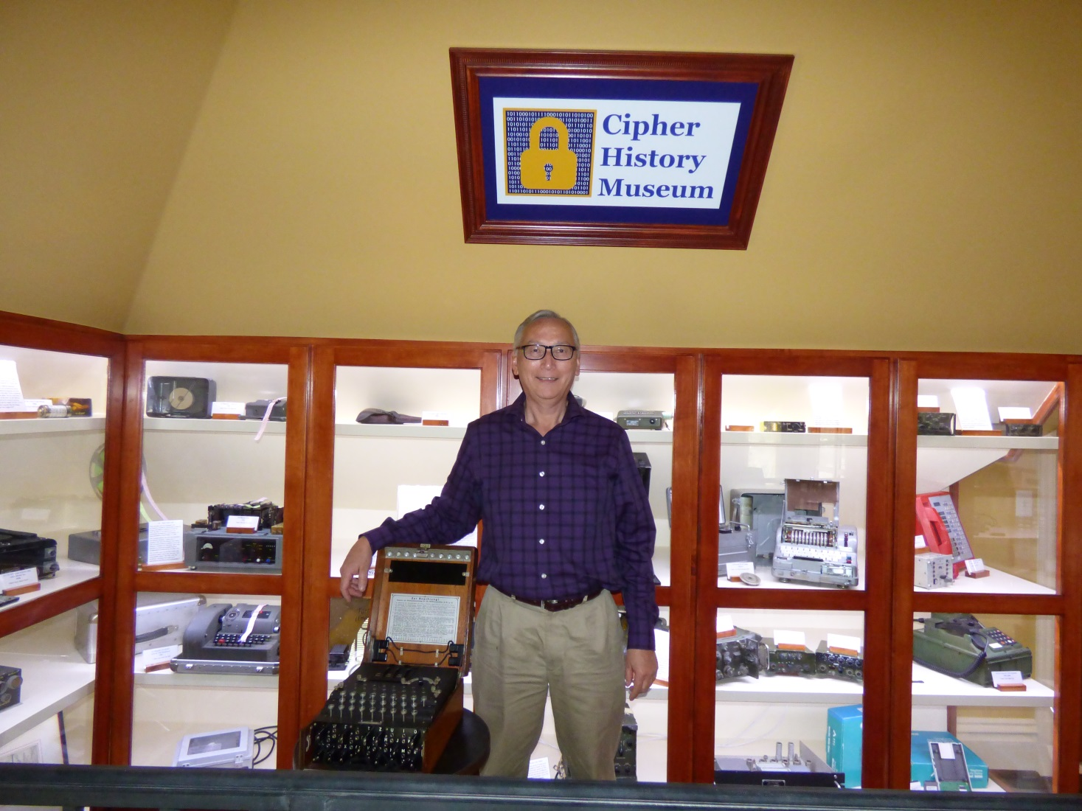
Download this presentation
CipherHistory.com / keyspaces
Cipher History Museum

Slide 72
Word Crunching
by Bill Bilston
I
wrote
a poem
on a page
but then each line grew
to the word sum of the previous two
until I began to worry about all these words coming with such frequency
because as you can see, it can be easy to run out of space when a poem gets all fibonacci sequency
I could have happily ended this small poem with the words above
because it was increasingly difficult to write each additional line
so in my struggle to add another couplet, the problem loomed cataclysmic
but then I found a solution to my space problem by something called word wrap
and also found solace in the fact I was set free to express myself
without the creative limitation of just a few words on a line
but still I am glad the sequence I chose was Fibonacci and not logarithmic

Slide 73
Word Crunching
I
wrote
a poem
on a page
but then each line grew
to the word sum of the previous two
until I began to worry about all these words coming with such frequency
because as you can see, it can be easy to run out of space when a poem gets all fibonacci sequency
I could have happily ended this small poem with the words above
because it was becoming a struggle to write each additional line
and by trying to add another couplet, the problem seemed existential
but then I found a solution to the space problem by a technique called word wrap
and also found solace in the fact I was much more free to express myself
without the limitation of a few words on a line
but still I am glad the sequence I chose was Fibonacci and not exponential

