Slide 1
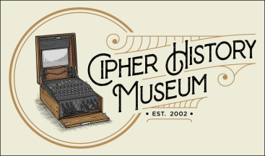
M-94 Cylinder Cipher
A Story of Innovation, Intrigue, and Deception
September 5, 2023
Copyright © 2023
CC Attribution 4.0 International
Ralph Simpson
Cipher History Museum
All images in this presentation are from the Cipher History Museum, unless otherwise noted
Notes:
M-94 Cylinder Cipher: A Story of Innovation, Intrigue, and Deception
This is the story of the invention and history of the cylinder cipher, starting with the c.1795 invention by Thomas Jefferson. This is a simple, user-friendly, and cryptographically strong cipher device for its time and was in use for over 160 years. We have evidence of the creative spark from Thomas Jefferson and Parker Hitt which brought about their independent inventions. The acceptance of the M-94 into the US military after WW1 is a story of deception involving the titans of early US cryptology; Joseph Mauborgne, William Friedman, and Herbert Yardley.

Slide 2
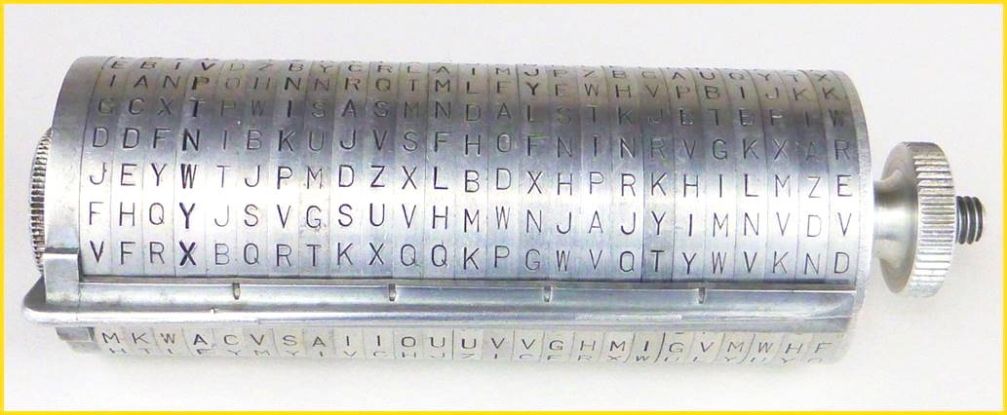
M-94 Cylinder Cipher
US Army M-94 Cipher Device
Main US battlefield cipher device, 1922- 43
Navy version named CSP- 488, issued 1927
Each of 25 wheels have a unique mixed alphabet
Key is the order of wheels on axle
  Labeled inside B-1, C-2, … to Z-25
  Labeled outside AB, AC, … to AZ (letter below “A”)
To encipher, plaintext arranged on ruler, any other row is ciphertext
To decipher, ciphertext is placed on ruler, user finds plaintext line

Slide 3
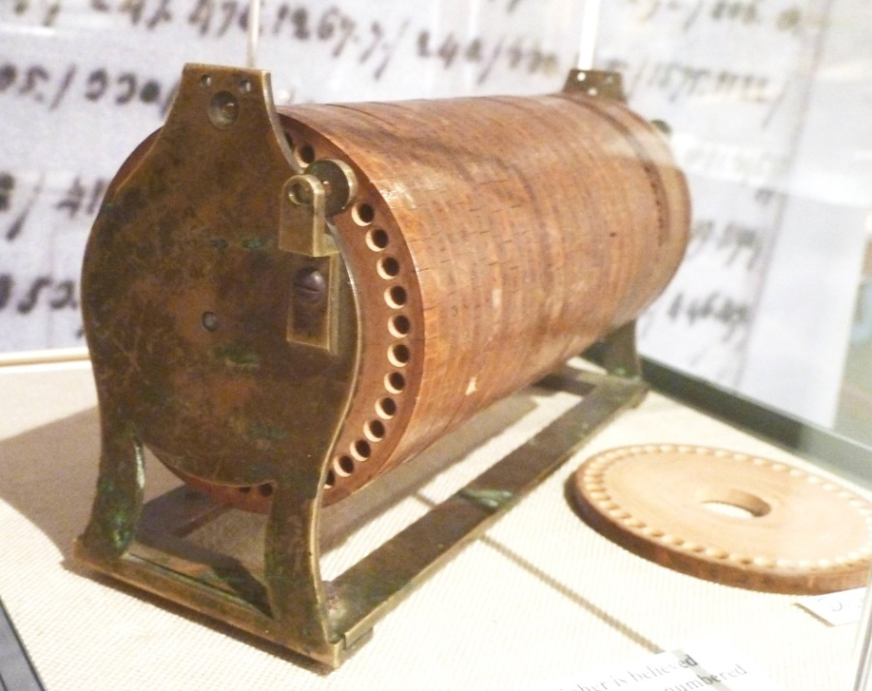
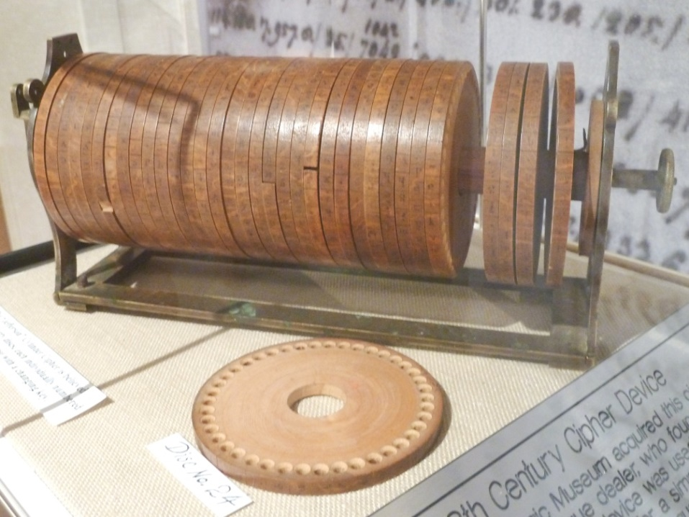
Invention of Cylinder Cipher
Original invention by Thomas Jefferson, third President of US!
Invented “Wheel Cypher” c.1795
Only one known to exist, in NSA Museum
36 wheels, Jefferson correctly calculated key space as, “372 with 39 cyphers [zeros] added to it”
  Wheel Cypher lost to history until discovered in Jefferson’s papers in Library of Congress in 1922, by Dr. John M. Manly
Jefferson Wheel Cypher
Photo credit: Ralph Simpson, device at NCM. Ft. Meade, MD

Slide 4
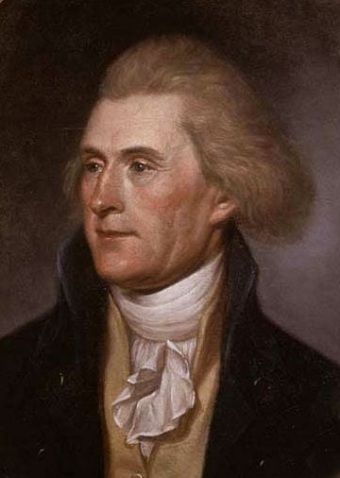
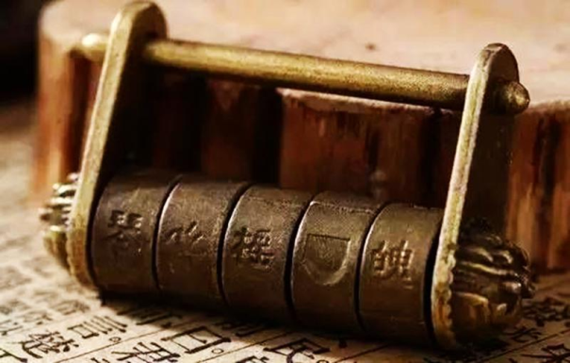
The Spark that Ignited the Wheel Cypher
Inspiration may have been Chinese letter locks, popular in France at the time
  Jefferson’s library had French magazines, “Encyclopedie Methodique,” with articles on Chinese letter locks
  Jefferson wrote letters to editor of this magazine and gave subscriptions to others, including B. Franklin & J. Madison
Jefferson had life-long interest in ciphers and message secrecy
  Wheel cypher was clearly superior to the
Thomas Jefferson, 1791
Photo credit: Public domain, from painting by Charles Willson Peale
  Vigenère disk or other manual methods of the time
  Inexplicably, after his invention, Jefferson advocated use of Vigenère table for the Lewis & Clark Expedition, and columnar transposition for the Secretary of State
Chinese letter lock
Photo credit: zhuanlan.zhihu.com

Slide 5
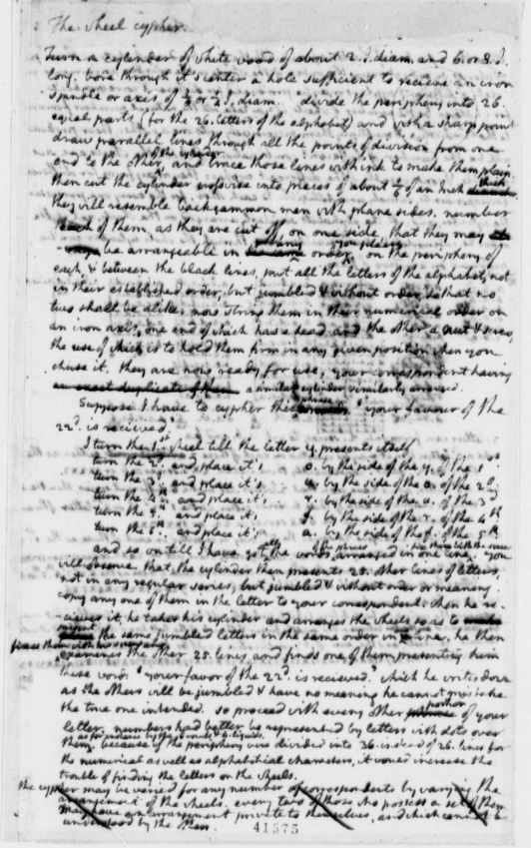
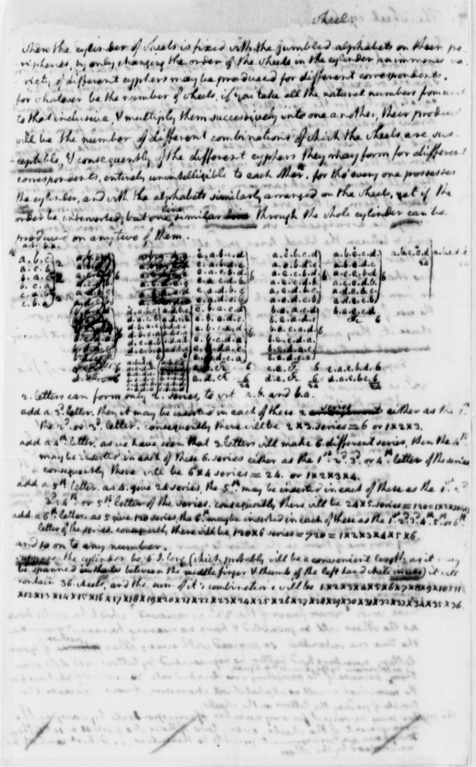
Jefferson Paper “The Wheel Cypher”
  Paper describes construction, usage instructions, key space proof
Paper transcribed here:
CipherHistory.com/jefferson3
Photo credit: US Library of Congress

Slide 6
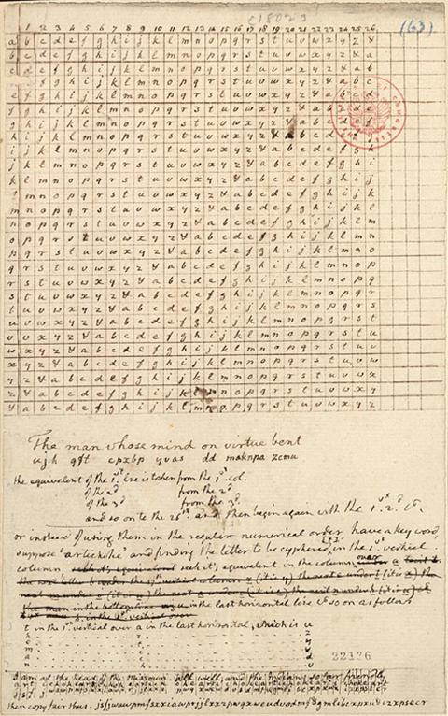
Jefferson Cipher for Lewis & Clark
  Very detailed instructions on using a Vigenère table for Lewis & Clark Expedition
  Written by Thomas Jefferson in 1803
  No evidence it was ever used
  Why wasn’t the Wheel Cypher recommended?
Photo credit:
Monticello.org

Slide 7
Independent Inventions of Cylinder Cipher
Cylinder and strip ciphers are cryptologically identical
William Friedman coined the term “multiplex cipher” to describe this type of device, since it uses multiple, simultaneous alphabets
Independent inventions spanned 120 years
Thomas Jefferson, c.1795
Charles Babbage, 1854
Étienne Bazeries, 1891
Arthur J. Hermann, strip version in 1893
Col. Oliver Ducros, 1900
George Lugagne, strip version in 1912
Capt. Parker Hitt, strip and cylinder versions in 1912
Lt. Russell Willson, strip version in 1916

Slide 8
2nd Invention of Cylinder Cipher
Charles Babbage describes cylinder cipher in letter to editor of “Journal of the Society of Arts” in 1854
He built a cylinder cipher with, “common centre, each circle having on its circumference the 26 letters of the alphabet”
His autobiography included a chapter on “Picking Locks and Deciphering” saying, “These two subjects are in truth more allied than might appear…”
Babbage left no evidence that his cylinder cipher was ever constructed

Slide 9
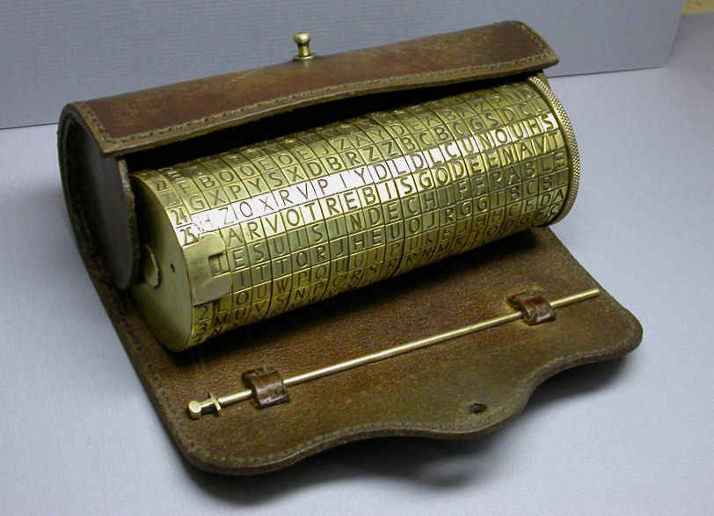
3nd Invention of Cylinder Cipher
Invented in 1891 by Major Étienne Bazeries, of French Army
First cylinder cipher to have public disclosure
20 wheel cipher
Independent invention, probably from the same letter lock idea as Thomas Jefferson
  Broken by the Marquis de Viaris in 1893, so it was never adopted by the French military
Bazeries Cylinder
Photo credit: Atelier Maquarthis, maquarthis.com
  Bazeries previously solved a de Viaris cipher, so there was a rivalry between these men

Slide 10
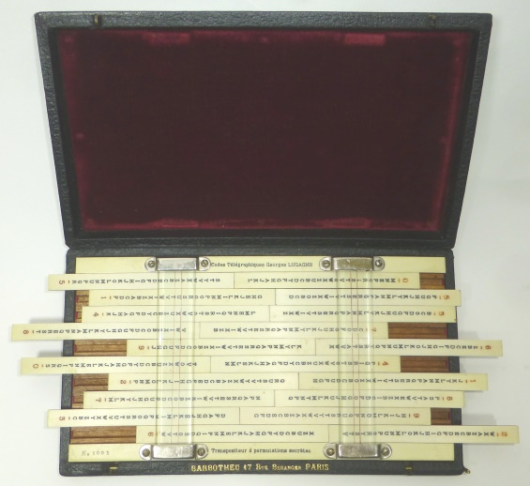
4th and 6th Inventions of Strip Cipher
Two French inventors came up with the idea of the first strip cipher devices
Arthur J. Hermann invented an 18 strip device in 1893
George Lugagne invented a 20 strip device in 1912, patented in 1913
Lugagne device used 10 strips on top and 10 different strips on bottom, which limits strength of cipher
Lugagne strip cipher device
In 1930, Lugagne designed a new strip cipher called Sphinx, which allowed all 20 strips to be used interchangeably

Slide 11
5th Invention of Cylinder Cipher
Col. Oliver Ducros of Italy invented the Ducros Scotograph in 1900
Scotograph is an instrument for writing in the dark
13 disk device similar to the Bazeries, but with embellishment
Not accepted by Italian military

Slide 12
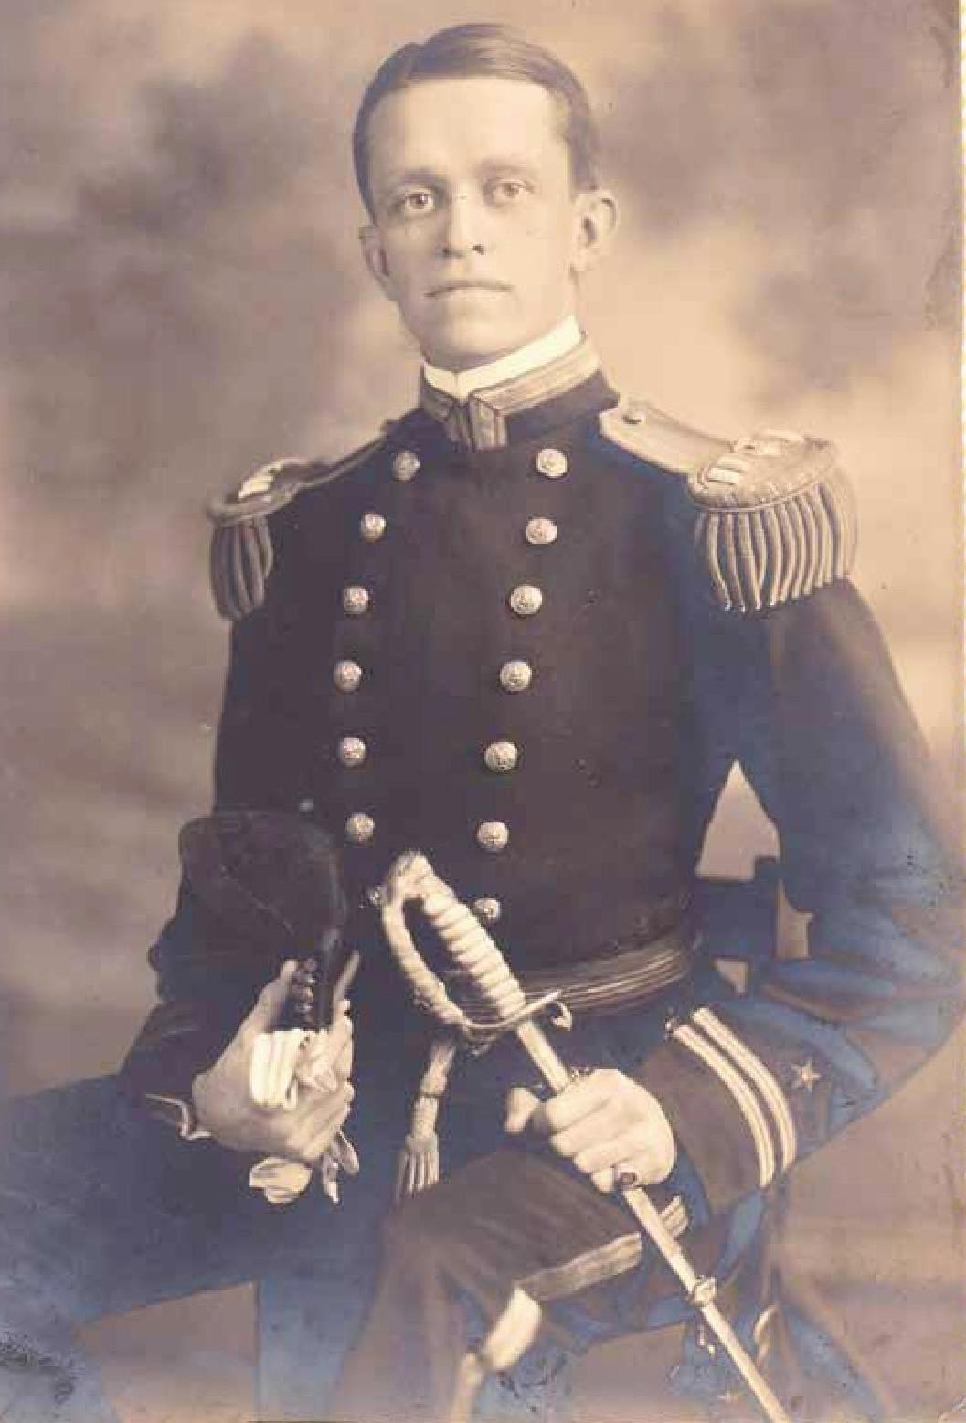
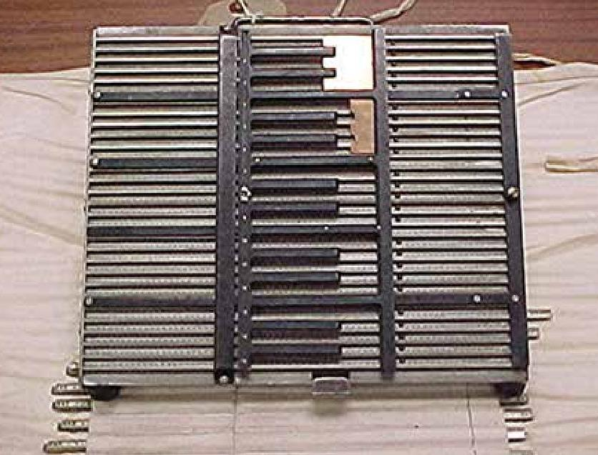
8th Invention of Strip Cipher
Lt. Russell Willson
Invented by Lt. Russell Willson in c.1916
Willson later became Vice Admiral in US Navy
25 strip Navy Cipher Box (NCB) first issued on June 12, 1917, made obsolete in 1935
NCB upgraded to Mark II in 1918, 1000 issued
Eight different sets of alphabets were issued for different naval networks
President Wilson used NCB, which he operated personally at the 1919 Paris Peace Conference
For his invention, Willson was awarded Navy Cross, second highest award
President Roosevelt signed Act of Congress, awarding Willson $15,000 in 1935 (about $300K in today’s dollars)
Photo credits: US National Archives
Navy Cipher Box

Slide 13
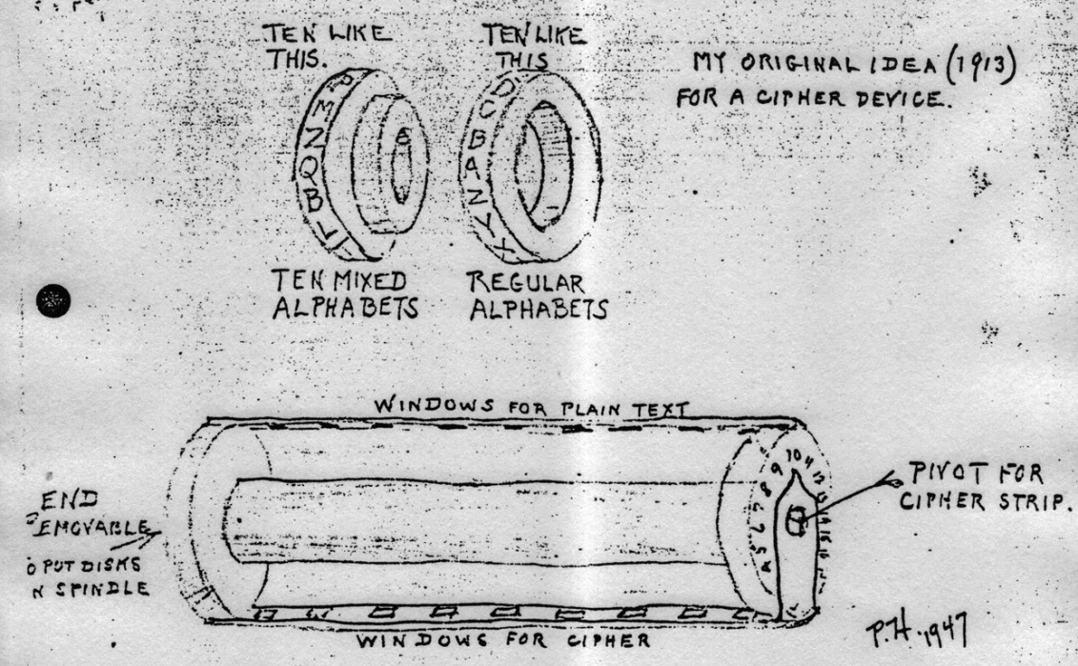
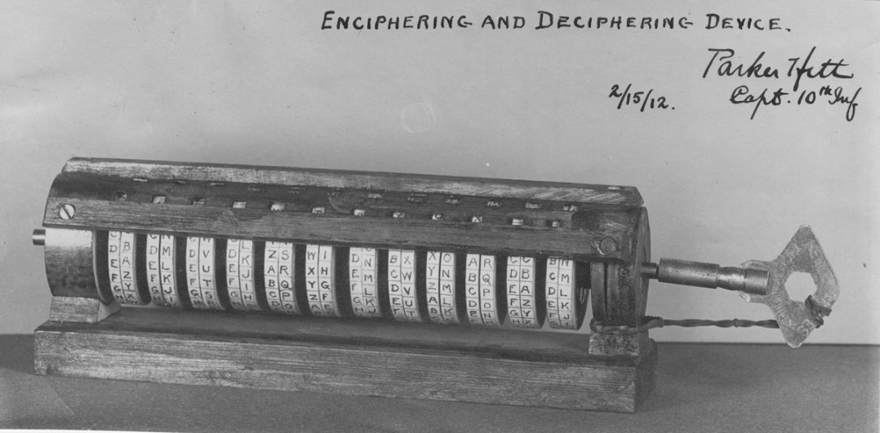
7rd Invention of Cylinder Cipher
US Army Capt. Parker Hitt invention in 1912
Hitt did not know of the Jefferson or Bazeries inventions
Lt. James G. Taylor, a classmate in 1911, made a cylinder and strip device to decipher the Army Cipher Disk
In Feb. 1912, Hitt developed his device for deciphering Army cipher disks, using 12 pairs of wheels
In 1947, Hitt sketched his invention and later found a picture of it
Parker Hitt’s 1947 drawing from memory
Parker Hitt’s first cylinder device, Feb. 1912

Slide 14
Hitt’s Inspiration for the Cylinder Cipher
In Aug. 1947, Hitt drew a picture of his cipher device, from memory
He mistakenly said the training class was in 1913
Since then, Hitt’s invention was incorrectly dated to 1913 or 1917, until Betsy Smoot verified that the actual class date was 1912 and the picture of Hitt’s first cipher cylinder was dated Feb. 1912 *
The device he made was for deciphering enemy Vigenère disks, and he describes his inspiration:
  “One day during the summer of 1913 [1912] I went into the lab shop to work… and picked up a rod on which I had strung ten mixed alphabet disks for safe keeping the day before. By pure accident, one line of the first two disks spelled TH and the idea came to me to discard the plain text disk and the reading stripe and to set plain text to any line of the mixed alphabet disks and to send any other line as the cipher message.”
Hitt pursued the strip version of his invention, leaving Mauborgne to design the M-94, sometime between Sept. 1916 to Aug. 1917
* ”Parker Hitt’s First Cylinder Cipher Device…”, Betsy Rohaly Smoots, “Cryptologia”, June 11, 2015

Slide 15
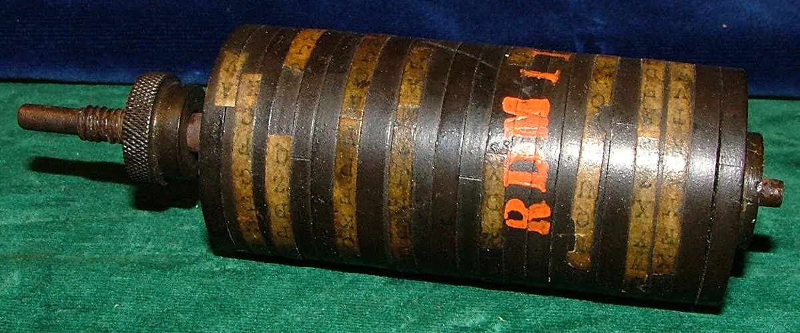
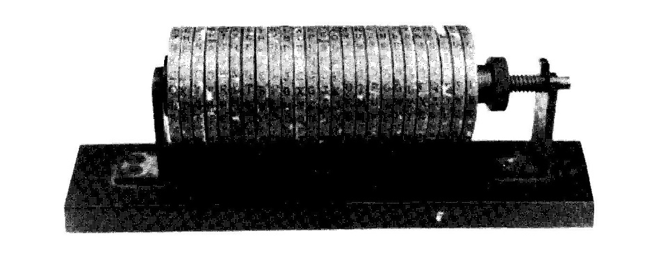
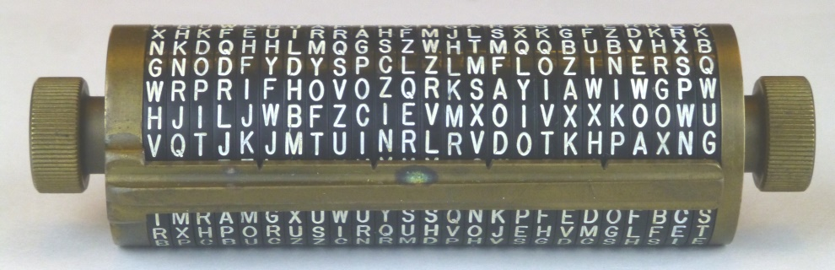
M-94 - A Plethora of Prototypes
M-94 designed by Mauborgne, from 1912 Hitt invention
First 2 prototypes in early 1917 made of red fiber and hard rubber (top), letters on paper
2 were made of all brass on wooden base (middle)
Later prototypes made of brass/Bakelite (bottom) or brass/solid aluminum
Betsy Smoot, NSA historian, say multiple prototypes are documented in NSA archives
William Friedman claims US Army Signal Corps adopted the M-94 in 1918 *
* https://www.nsa.gov/Portals/70/documents/news-features/declassified-documents/friedman-documents/lectures-speeches/FOLDER_163/41744749078395.pdf

Slide 16
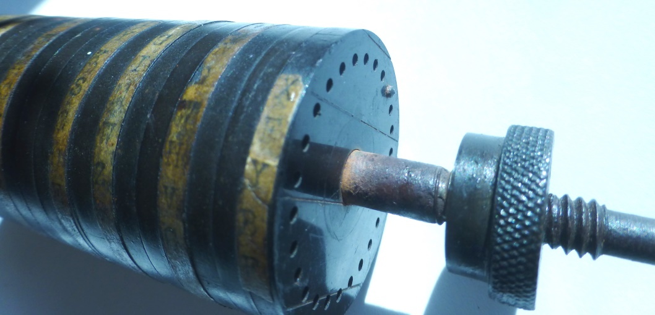
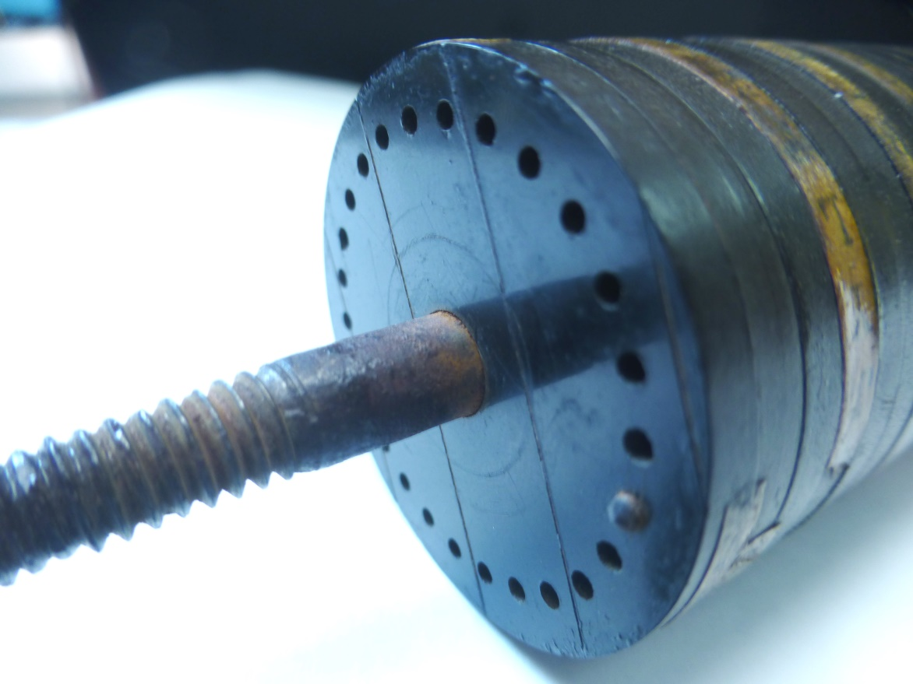
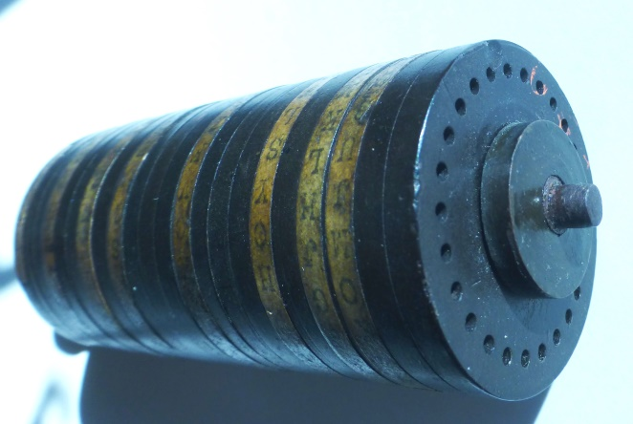
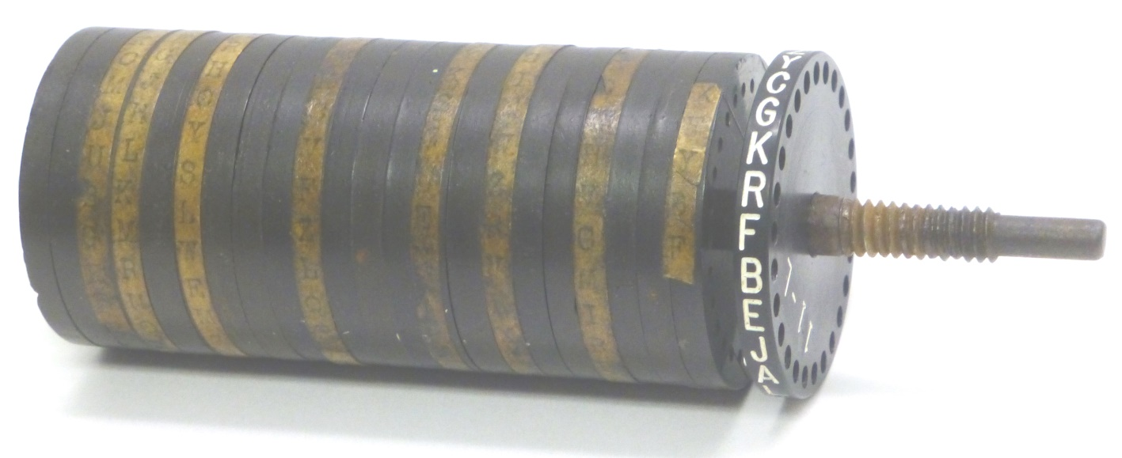
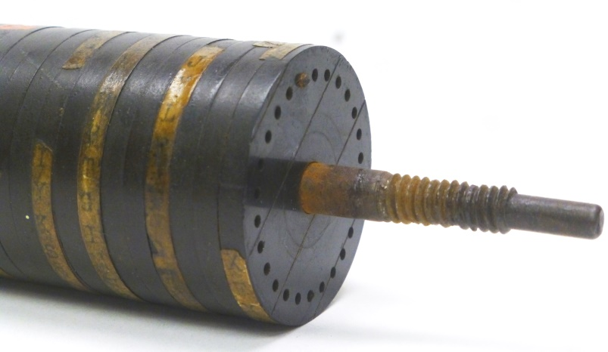
M-94 - A Picture Gallery
1st hard rubber prototype at NSA Museum – note letters on paper strips glued to disks
Wheel from
brass/Bakelite
prototype

Slide 17
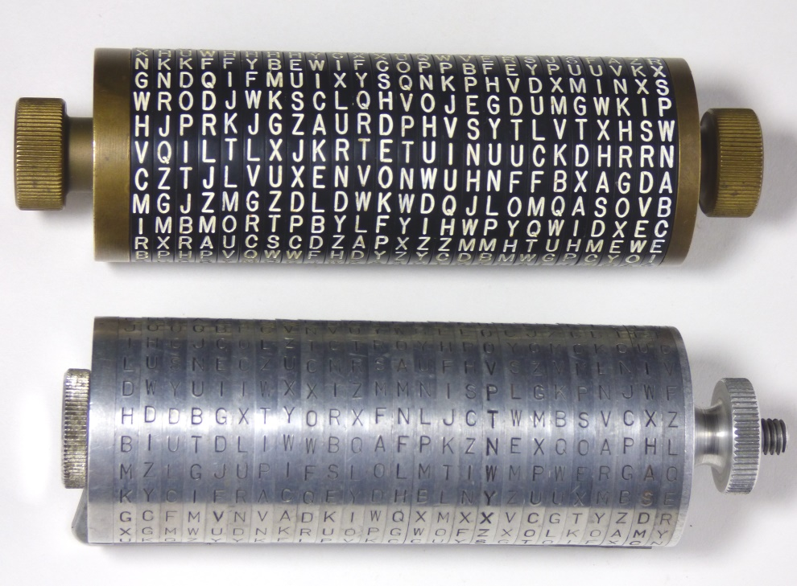
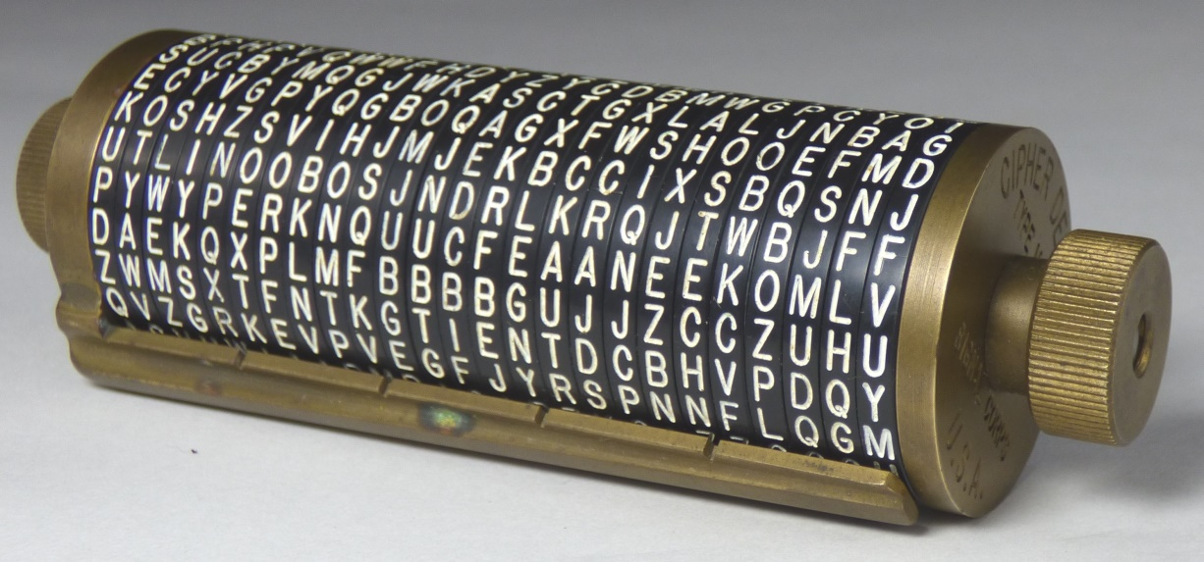
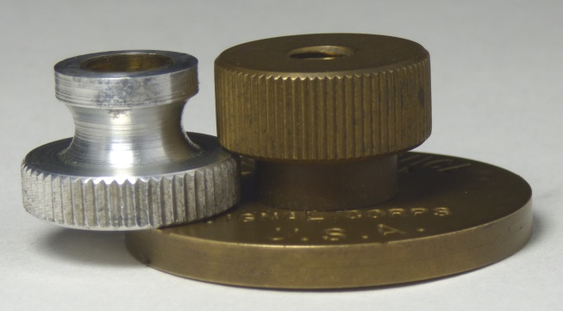
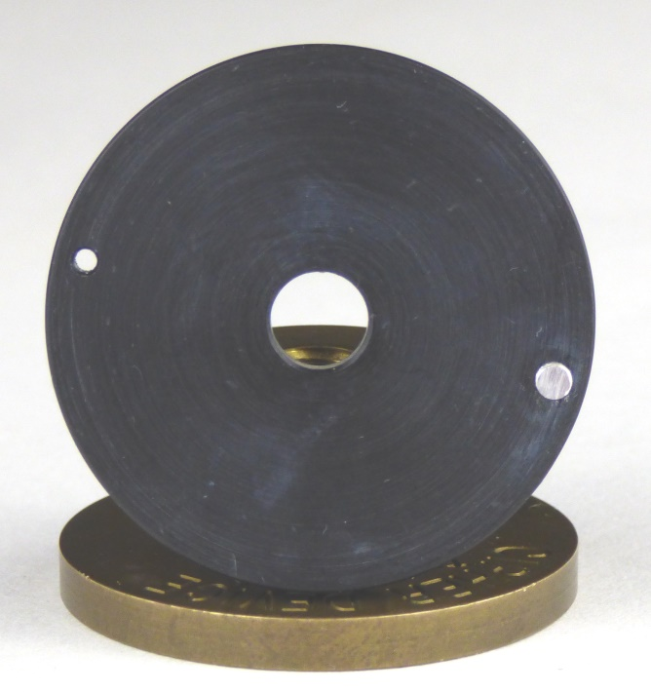
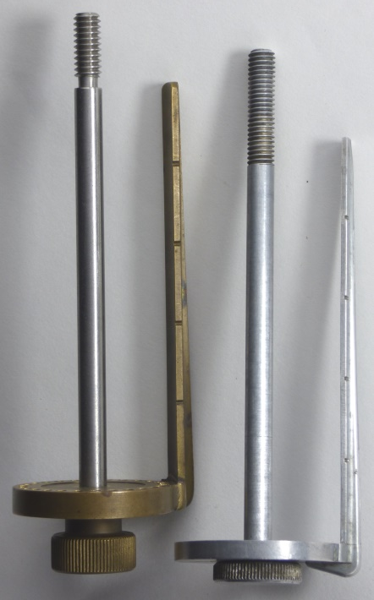
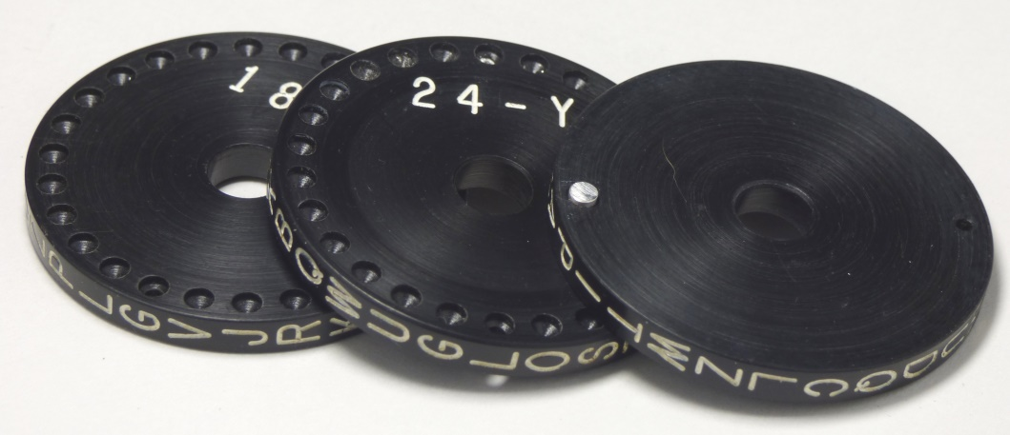
M-94 - A Picture Gallery
Brass/Bakelite
prototype compared to standard aluminum model

Slide 18
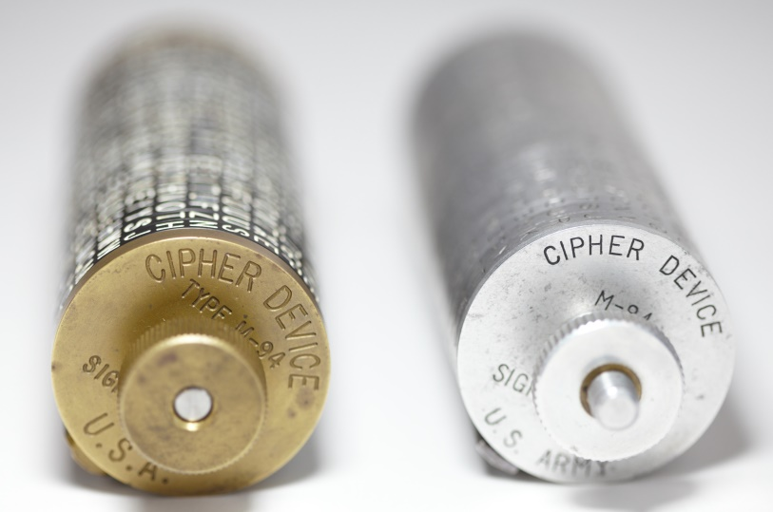
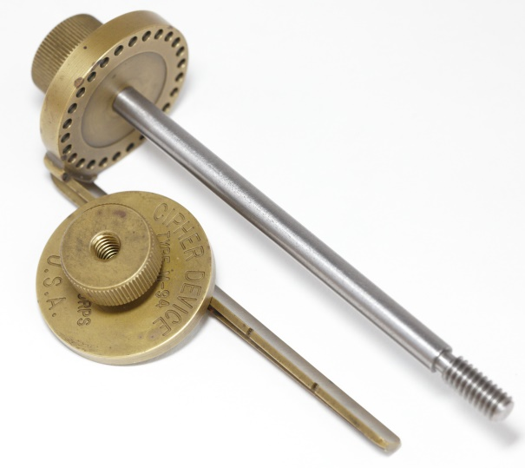
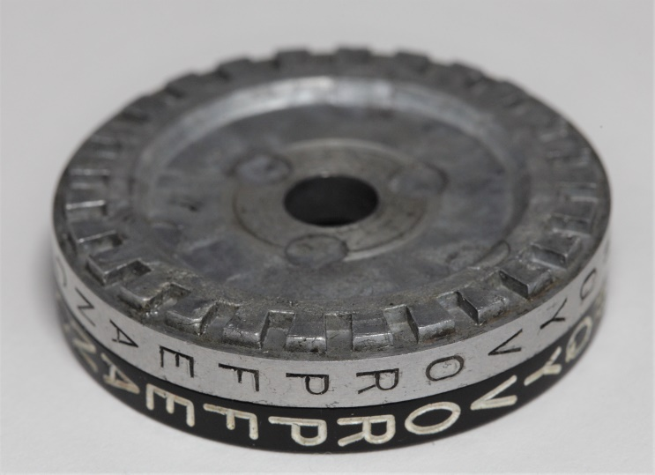
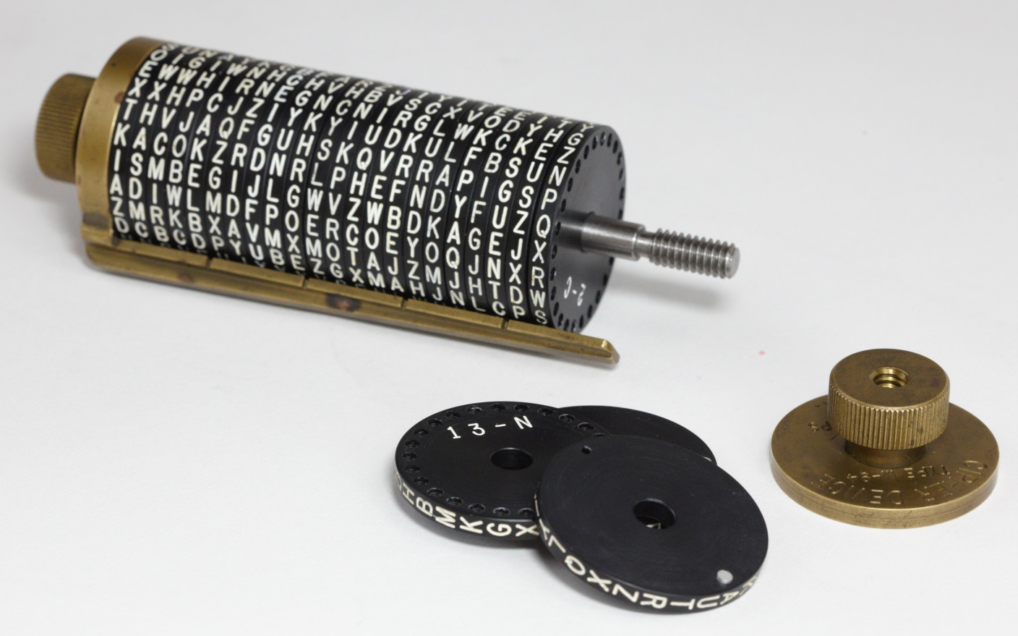
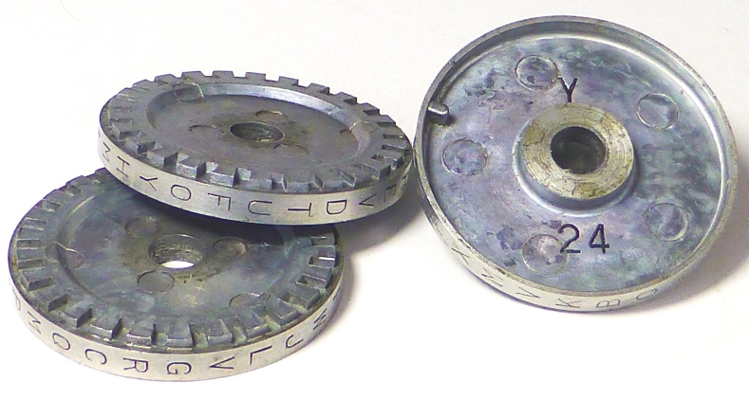
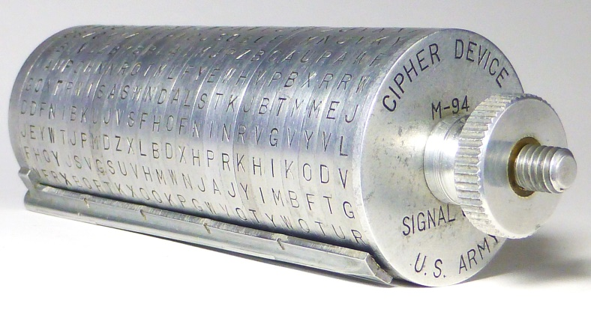
M-94 - A Picture Gallery
Brass/Bakelite prototype with aluminum M-94

Slide 19
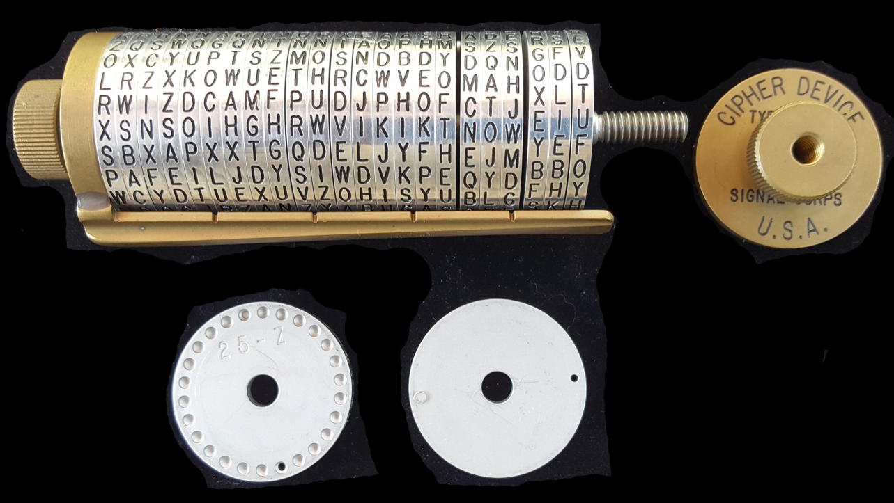
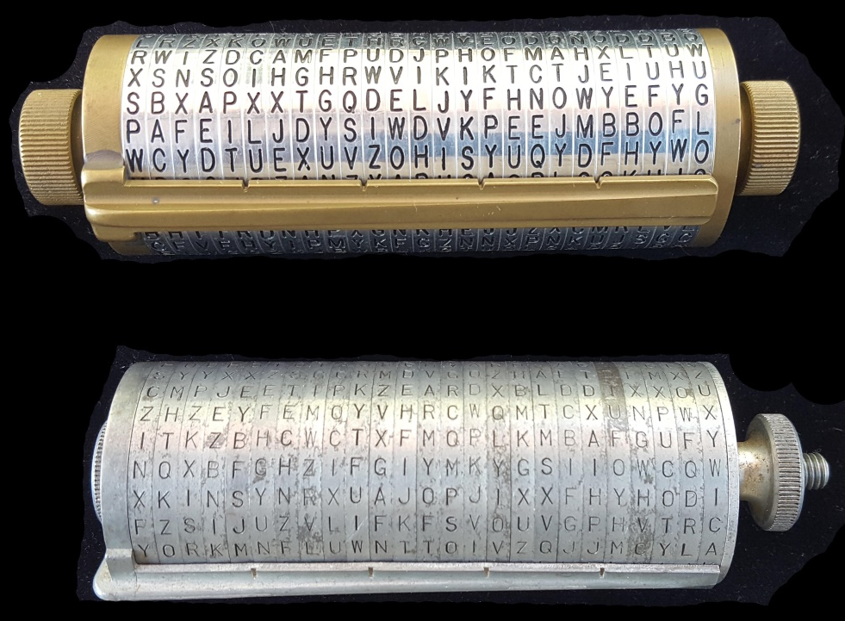
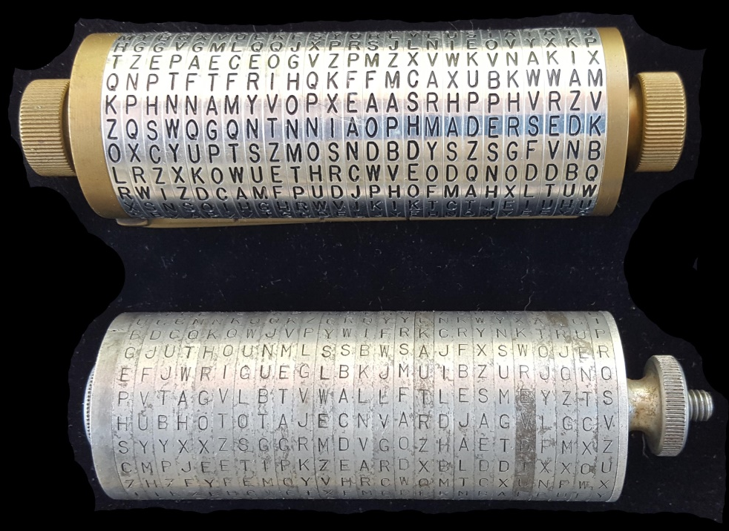

M-94 - A Picture Gallery
Copyright © 2020 Dr. Nicholas Gessler – all rights reserved
Brass/aluminum prototype from the collection of Dr. Nicholas Gessler. This prototype is an exact copy of the brass/Bakelite prototype. These pictures are copied by permission of Dr. Gessler and can only be used with his prior approval.
Brass/Bakelite prototype shown for comparison

Slide 20
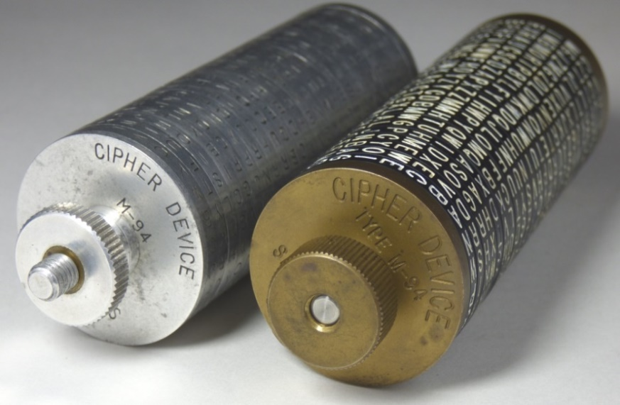
Last M-94 Prototype?
This M-94 prototype from the estate of Bill Lear, founder of Lear Jets, co-founder & inventor of Motorola
Lear enlisted in Navy at age 16, was radio operator and trainer, 1918-20
NSA claims, “In 1917, the Signal Corps widely adapted Colonel Hitt's cylindrical device” *
Aluminum production model
next to brass/Bakelite prototype
Hitt was Asst. Chief Signal Officer in France in 1917, CSO in 1918
“Prototype possibly used by military attachés in WW1” – Betsy Rohaly Smoot, NSA Historian
From NSA archives, Smoot says there were several prototypes developed, the brass/Bakelite version is so close to the final aluminum version, it is likely the last prototype
Two brass/solid aluminum M-94s are known to exist and about 7 brass/Bakelite versions
* https://nsa.gov/About-Us/Current-Leadership/Article-View/Article/1621575/colonel-parker-hitt/

Slide 21
M-94 Key Space
  Per Kerckhoffs’ Principle, assume enemy has your device, then key space = (#wheels)!
Key space first calculated by Thomas Jefferson
  36! = “372 with 39 cyphers [zeroes] added to it”
  138 bit key
  Did Jefferson beat Kerckhoffs to his principal?
  Probably not, Jefferson advised using different wheel settings with different correspondents
For M-94 key space = 25! = 2^83 (or an 83 bit key)
But, this key space has been incorrectly calculated for over 220 years!

Slide 22
M-94 Key Space
Key space has been incorrectly calculated for over 220 years!
Correct key space will now be disclosed
Key space is reported everywhere as #wheels!
But, key space is actually (#wheels)! X (# letters on wheels - 1)
(#letters on wheels - 1) is the offset, which in not sent and left as an exercise for user (find the message among the gibberish)
Key space was claimed to be 83 bits, but is really:
    25! X 25 = 88 bits
    Greater than Enigma (76 bits) or DES (56 bits) – (but easier to break)

Slide 23
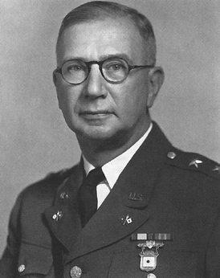
M-94 Acceptance by US Army
Mauborgne sent 25 messages to William F. Friedman at Riverbank Labs and Herbert O. Yardley at MI-8 on 4/23/18 for cryptanalysis
Alphabets not provided
Alphabets selected by Mauborgne to increase cryptologic strength, but could not resist making “R” disk say “armyoftheus” and “Y” disk say “Friday”
Messages were not solved after 6 months, even with a hint and despite Friedman’s 1918 book on a solution to cylinder ciphers
Joseph O. Mauborgne
M-94 was approved for use by the Army on 4/16/1921
Instructional manual published on Feb. 1922
Total of 9,432 devices were manufactured
8/9/1943 the M-94 was declared obsolete, replaced by M-209

Slide 24
Mauborgne’s Challenge Messages
25 messages of 25 characters, all used same key, different offset
Hint was given, one message contained “are you”
  Chlorine and oxygen have not b
  Where did you meet each other
  Drink this potion quickly for
  Well make me the same shape but
  Cyanogen is a colorless gas in
  Phenols are benzene derivati
  Xylonite and artificial ivor
  I went to a new theatre the Pala
  Picric acid is explosive and i
  Llangollen is a town in Wales a
  Yvette are you going shopping
  Orthophosphoric is a compo
  Caoutchouc is closely allied
  Olefiant gas ethene or ethyle
  See the terrible tank tackle a
  It is a thin limpid liquid that
  If it is insoluble in water it i
  Silver has been known from rem
  Hot concentrated sulfuric a
  Small coefficient of expansi
  Palladium possesses a power o
  Absorbing and condensing thi
  Compounds of platinum form tw
  Gold occurs widely distribut
  Oxydation caused by it probab

Slide 25
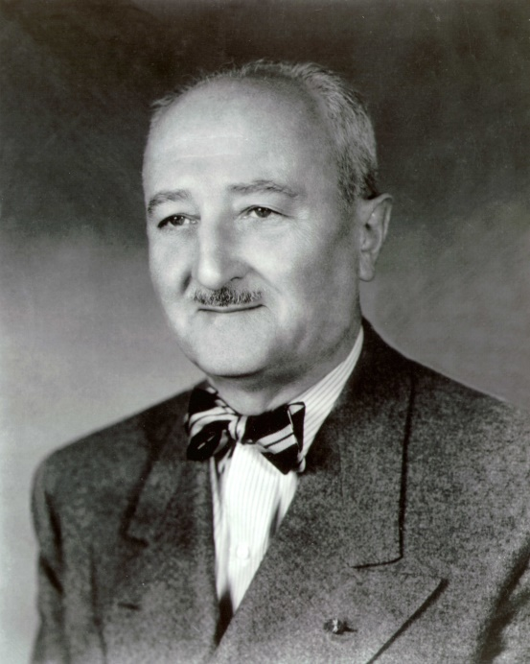
Was Mauborgne Deceptive?
In 1941, after Mauborgne retired, Friedman asked for solution to M-94 challenge messages
Friedman complained to Mauborgne, who blamed an assistant, a Major Fowler!
The M-94 was Mauborgne’s design, not likely he would have let an assistant decide the challenge messages without his approval
Col. Fabyan of Riverbank, said in a 1919 letter regarding a running-key challenge, “Our past
William F. Friedman
experience is that Colonel Mauborgne will do the same thing … to put one over on Riverbank and this is not our idea of co-operation”
In 1917, Yardley complained that a Mauborgne/Hitt “unbreakable” running-key cipher test of 6 messages, “3 started with proper names, only one conjunction, 2 infinitives, 2 adverbs,…we decoded a message about a shipment of bananas!”
But afterwards, Yardley said Mauborgne acted honorably and quickly had the running-key cipher discontinued (1918)

Slide 26
Was Mauborgne Deceptive?
Was Mauborgne deceptive in his test messages – Of Course!
Did Mauborgne’s deception have a good intent – Yes!
Before WW1, only ciphers in use were the Vigenère, Playfair, and codes – Mauborgne knew all were vulnerable
  “Vigenère can be deciphered faster than it can be enciphered”
  Playfair solution was published by Mauborgne in 1914
  Codes not appropriate for battlefield use, but were used anyway
Mauborgne knew the M-94 would be a stronger cipher than the Vigenère disk and wanted it approved by the Army
So, did Mauborgne use the prototype M-94s during WW1 by the Army attachés, or others before Army approval?
  We have no proof, but that may be disclosed in the future
  There are multiple prototypes in existence
  Friedman notes “unauthorized cipher methods were used in WW1” and “the M-94 was adopted by the Signal Corps in 1918”

Slide 27
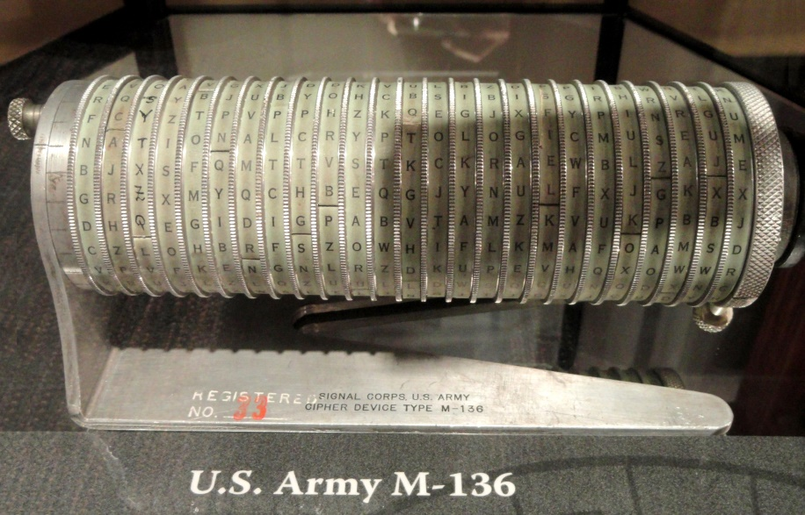
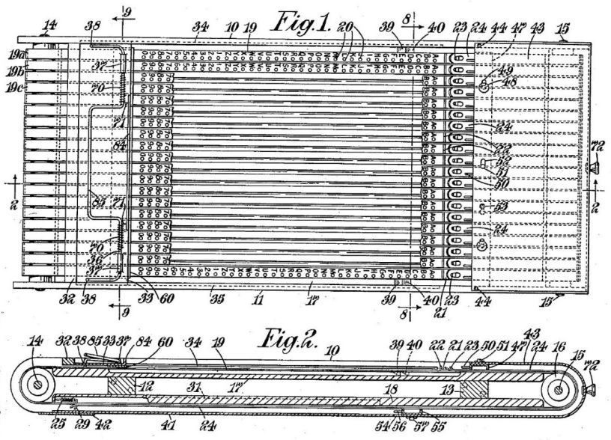
Prototypes with Changeable Alphabets
M-136 Cipher
M-137 Cipher
Late in 1933, prototypes were designed to allow a change of alphabets, to address the greatest cryptologic weakness
M-136, designed by Friedman, was never used
M-137, designed by Lt. Smellow of the Navy, was complex and unwieldy, and had limited use for only 3 years by the Navy
M-138, Hitt’s simpler design from 1915 became the model adopted for changeable alphabets in 1934

Slide 28
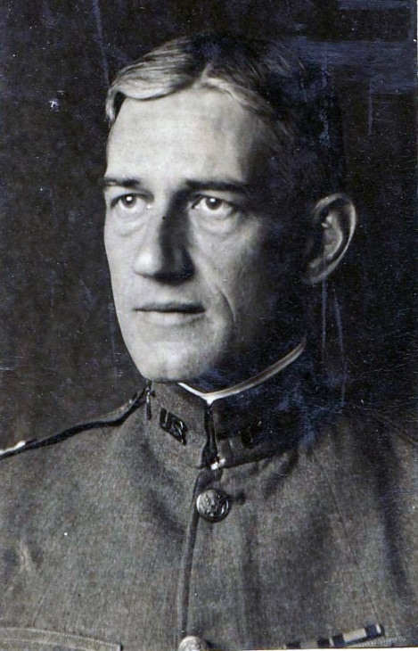
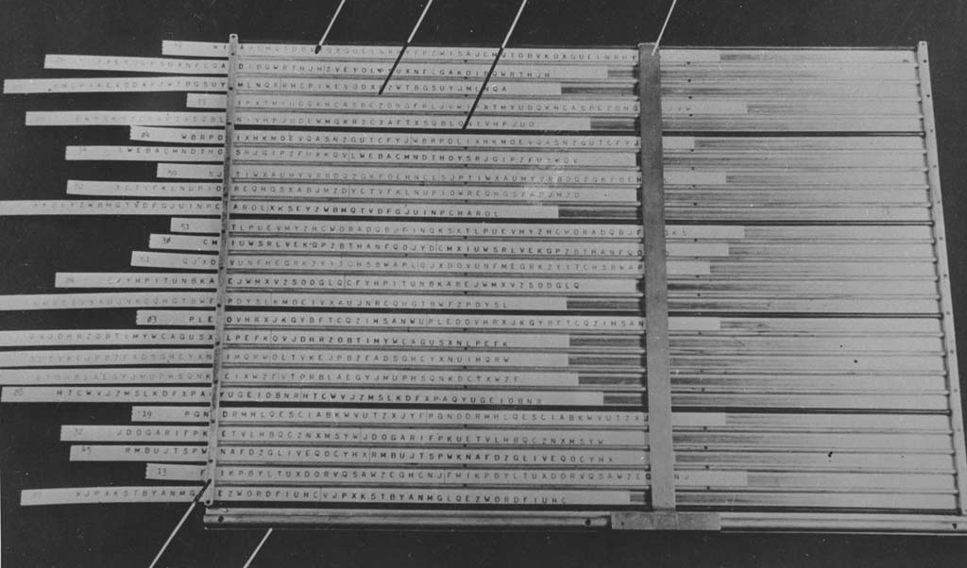
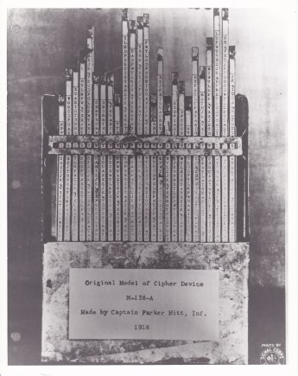
M-138 Strip Cipher
1934 M-138 Strip Cipher
Parker Hitt
1916 Hitt Strip Cipher
Parker Hitt pursued the strip cipher version, first deployed on July 9, 1934 (M-138), but used decades earlier for cryptanalysis
Used 25 strips of mixed alphabets, later M-138-A used 30 strips out of 100 available
Advantage over cylinder cipher is ease of having more/changeable alphabet strips

Slide 29
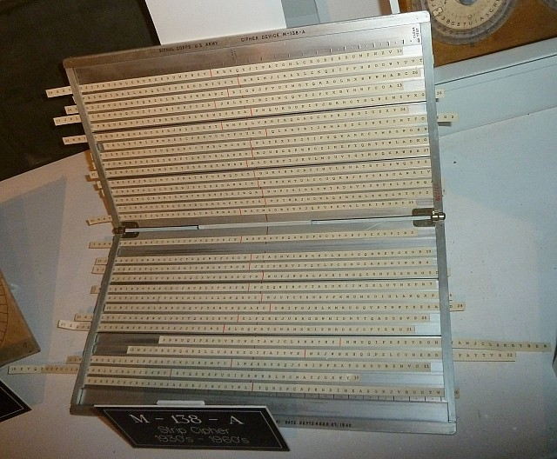
M-138-A Strip Cipher
M-138-A cipher first deployed on June 1938
Used 30 strips of mixed alphabets, instead of the 25 of the M-138
30 alphabets selected from 100
Advantage over cylinder cipher is ease of having more/changeable alphabet strips
US Army M-138-A Cipher Device
Methods to address the vulnerability of fixed repetition of 30 strips
  July 1939, a 5 strip group was omitted from each message, based on an elimination table
  Jan. 1942, a new procedure called for changing offset or “generatrix” every 15 characters
  Sept. 1944, 15 character offsets no longer used, omitting strips became variable

Slide 30
How to Break Strip Ciphers
Two critical weaknesses of strip ciphers
  Cycle of repeating alphabets, based on # wheels
  Fixed alphabets (especially for cylinder ciphers)
Selecting a row for encryption means all offsets are the same
A letter cannot encipher into itself, like the Enigma, so cribs can be used for breaking the strip cipher
After alphabet sequences are known, synoptic tables can aid in faster decryptions
  Friedman published a solution, with synoptic tables in 1918

Slide 31
Did the Germans Break Strip Ciphers in WW2?
Yes, both the M-94 and the M-138-A were broken
US entered WW2 in Dec. 1941 and by April 1942, M-94 messages were routinely decrypted by Germans until July 1943 when the M-94 was discontinued
Lower security messages were sent via M-94, while M-138-A was used for diplomatic and more strategic messages, which was more difficult to break
The M-138-A was first broken after a one year effort, in 1943
Germans used IBM punch card machines, specially made machines (Automaton, Tower Clock), and synoptic tables to break the M-94 & M-138-A *
In interviews after the war, one German cryptanalyst stated,
“The breaking of strip traffic was subject to time lags of two months before the reception of IBM machinery, but only two to four weeks afterwards.” *
* https://www.nsa.gov/Portals/70/documents/news-features/declassified-documents/european-axis-sigint/volume_2_notes_
on_german.pdf, pages 50-86

Slide 32
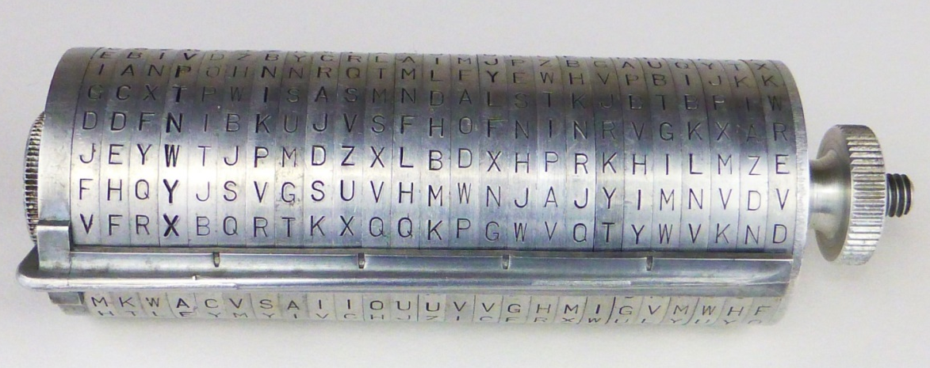
Cylinder and Strip Ciphers
US Army M-94 Cipher Device
US Army M-138-A
Cipher Device
Original invention by Thomas Jefferson, still used 160 years later
Parker Hitt’s inventions of the cylinder and strip devices used for 4 decades - from 1922 to the 1960s
9,432 M-94s and 17,872 M-138s were made, the major battlefield cipher of their time by the US

Slide 33
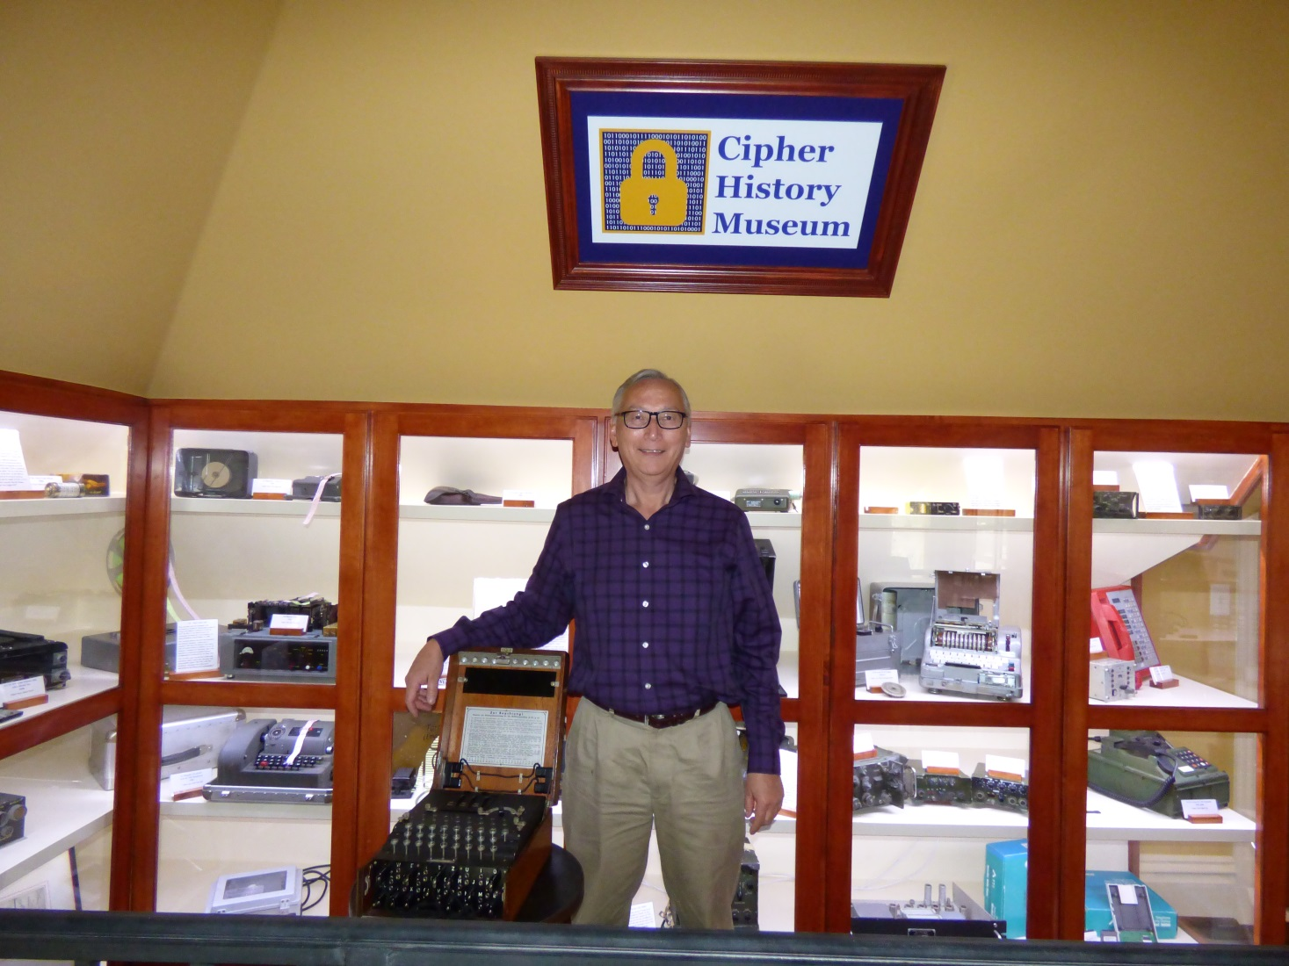
Download this Presentation
CipherHistory.com/slides/m-94.pptx

