Slide 1
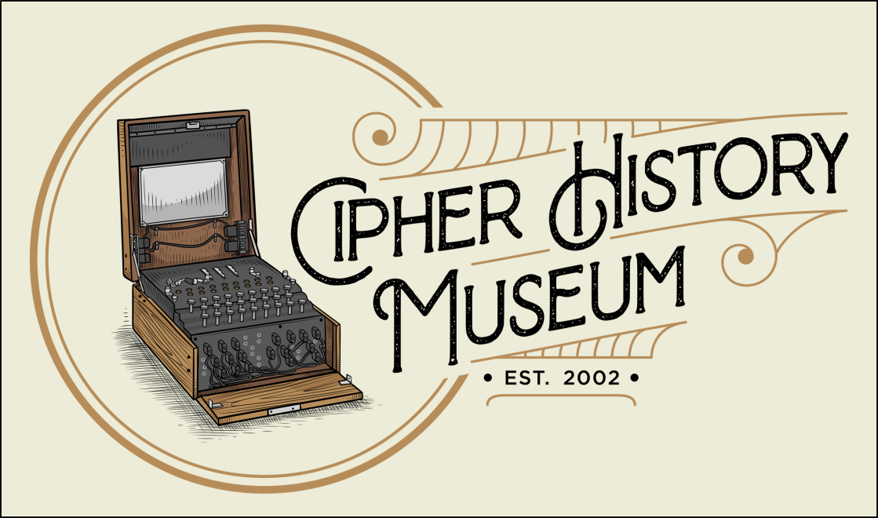

In Search of the World’s Oldest Surviving Cipher Devices
May 1, 2020
Copyright © 2022
CC Attribution 4.0 International
Ralph Simpson
Ralph@CipherHistory.com
All images and cipher devices in this presentation are from the collection of CipherHistory.com, unless otherwise noted

Slide 2
Definition
A “cipher device” will be defined as an apparatus, mechanism, tool, or instrument that performs a cryptographic function
  Popular and accepted use of the word “device”
  A Vigenère table, one-time pad, Playfair matrix, code book are not devices
  Vigenère disk, Cardano grille, skytale are considered cipher devices
Copyright © 2020 CipherHistory.com

Slide 3
The Quest…
A systematic and global search for the world’s oldest surviving cipher devices
  No previous searches have been found
  Seems like a fool’s errand
Copyright © 2020 CipherHistory.com

Slide 4
…and the Problem
Cryptologic tradition is to keep all devices & methods secret
  Only portion of one Japanese Purple cipher from WW2 exists
  360 out of 40,000 Enigma machines exist
  5 Confederate cipher disks exist
  1 Jefferson Wheel Cypher exists
  German WW1 invisible ink recipes finally disclosed by CIA in 2011
Old cipher devices may be mis-identified or discarded
Oldest devices saw limited use, by kings, military leaders, ambassadors, etc., so few were made and kept secret
Copyright © 2020 CipherHistory.com

Slide 5
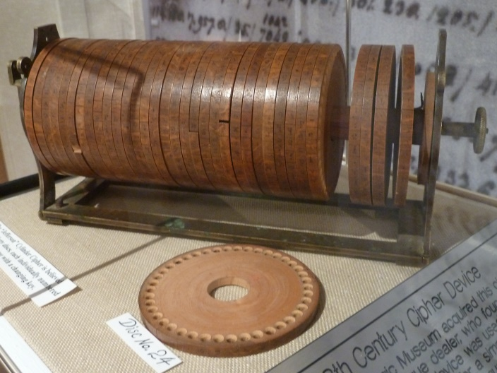
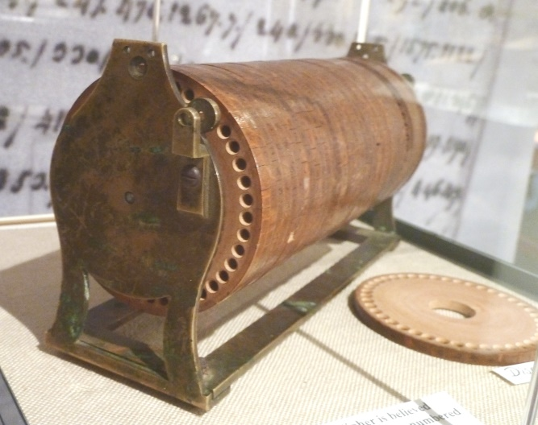
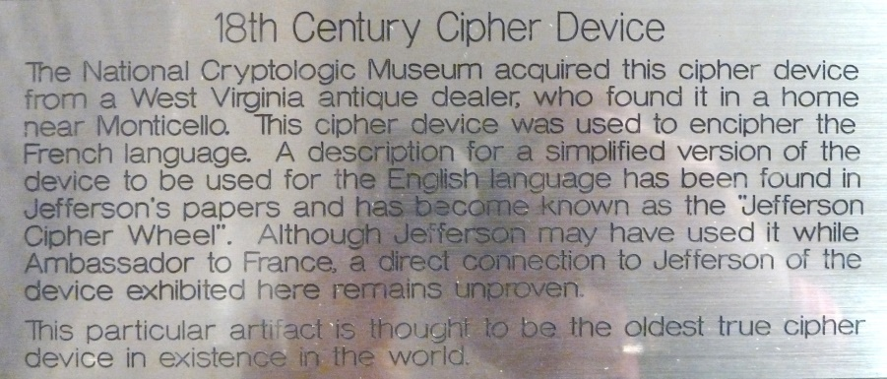
Oldest Device at NSA?
Thomas Jefferson invented his “Wheel Cypher” in about 1795
Reinvented twice, used by US until WW2
Only one existing example, in the NSA Museum in Ft. Meade, MD
NSA claim: "the oldest true cipher device in existence in the world"
Copyright © 2020 CipherHistory.com

Slide 6
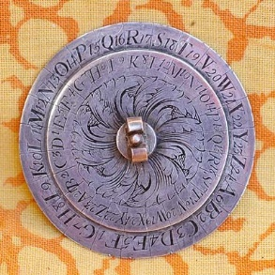
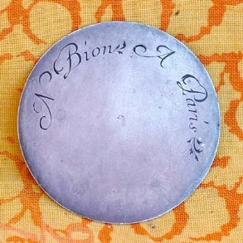
Nicholas Bion Cipher Disk
Found and owned by Nick Gessler
Vigenère cipher disk originally invented in 1466-7
Disk above made by Nicholas Bion (1652-1733) of France
Bion was instrument maker for King Louis XIV (1638-1715)
This device is likely from 1680-1715, 100 years older than NSA’s Jefferson Wheel Cypher
Copyright © 2020 CipherHistory.com

Slide 7
Systematic Search
What are the earliest types of cipher devices?
  Scytale
  Cardano grille
  Cipher disks
Global search
  China, Japan use thousands of characters, not compatible with cipher devices
  India used ciphers, transposition and steganography
  Arabic world discovered letter frequency analysis in 800s CE and used astrolabs, but no writings of early cipher disks
  Africa left no evidence of cryptology outside Egypt, Arabic areas
  Europe likely is the area of focus
Copyright © 2020 CipherHistory.com

Slide 8
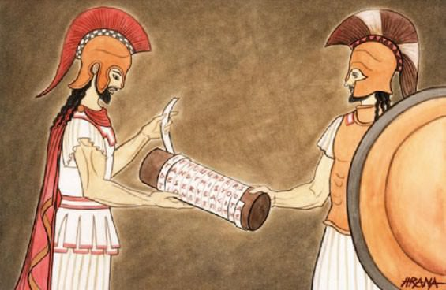
Scytale
Stick or cylinder with ribbon of parchment wrapped around it
Message written along length of stick in rows
Receiver needs same size stick to read the message
Transposition cipher
First mention of scytale from 7th century BCE in Greece
Since they would not appear to have significance, no early artifacts exist in our museums
Copyright © 2020 CipherHistory.com

Slide 9
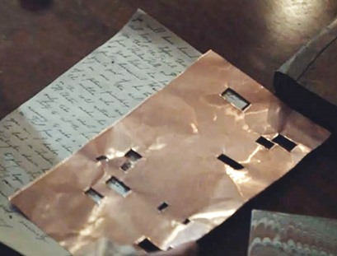
Cardano Grille
Invented by Girolamo Cardano (1501-1576) in 1550
Holes cut in metal or paper sheet to write in a secret message
Rest of page is filled in with ordinary looking letter
Combination of transposition cipher and steganography
Grilles carefully protected, no early examples known to exist
Copyright © 2020 CipherHistory.com

Slide 10
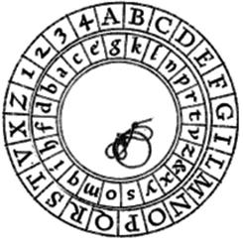
Cipher Disks
Astrolabes invented over 2000 years ago
Disks used to calculate motion of heavenly bodies
Antikythera mechanism has 30 meshed gears for calculating motion of sun, moon, planets c.250-100 BCE
Alberti disk from 1466 document
Ramón Llull (c.1232 - c.1316) introduced volvelle from Arabic world in 1274
First disk to have evidence of use as a cipher device was 1466 invention of Alberti disk
Copyright © 2020 CipherHistory.com

Slide 11
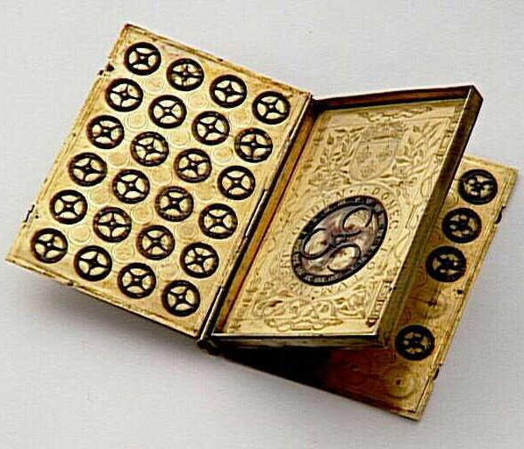
King Henry II Cipher Device
French King Henry II (1519-1559)
Engraved brass cipher device in shape of 4 page book with 50 cipher disks
Henry II reign 1547-59
Polyalphabetic cipher, but not of the Alberti style
In French museums for 180 years, but mis-identified as an astronomic device until 2014
Pages 1&2, similar to pages 3&4
Now identified as the world’s oldest cipher device!
Copyright © 2020 CipherHistory.com

Slide 12
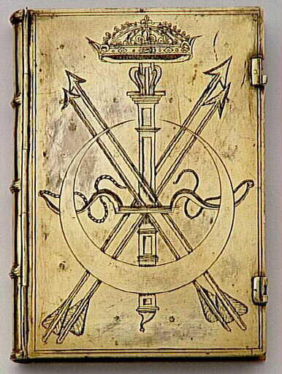
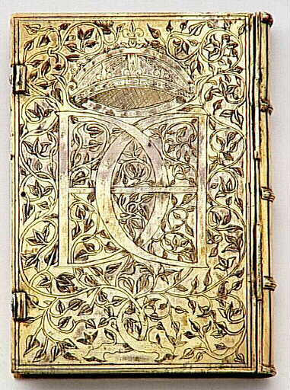
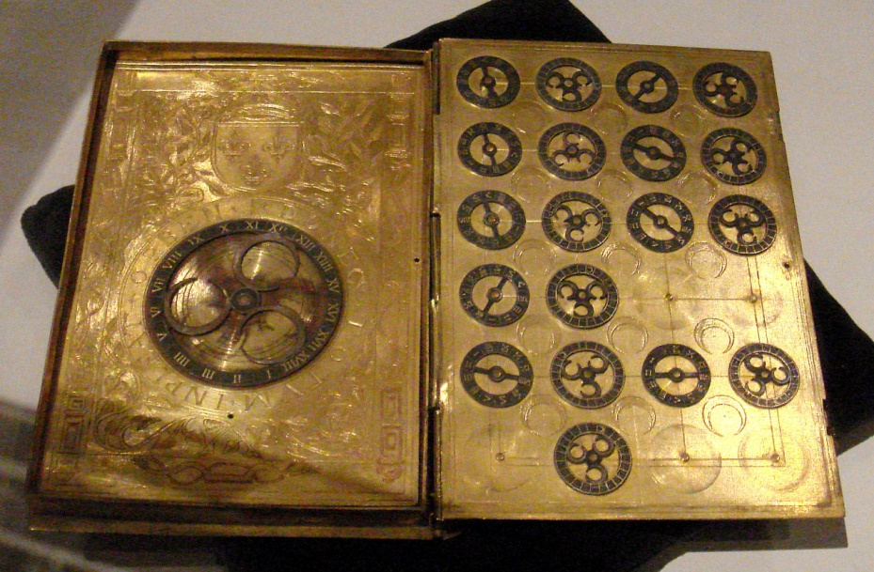
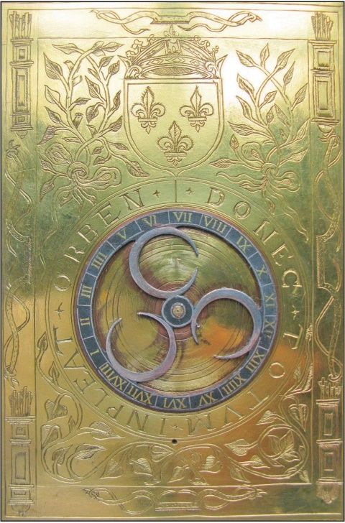
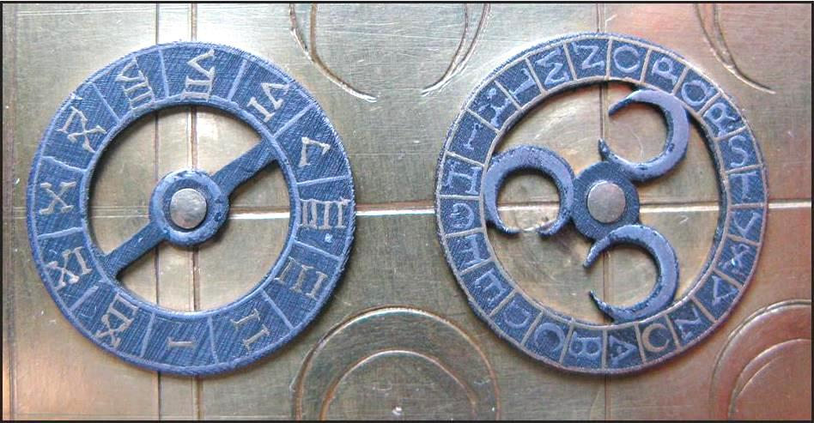
King Henry II Cipher Device
Pages 3&4
Front & back covers
Page 2 details, with larger wheel, numbered I-XVIII
Details of smaller wheels, alternate wheels numbered I-XII and A-Z plus ℧
Copyright © 2020 CipherHistory.com

Slide 13
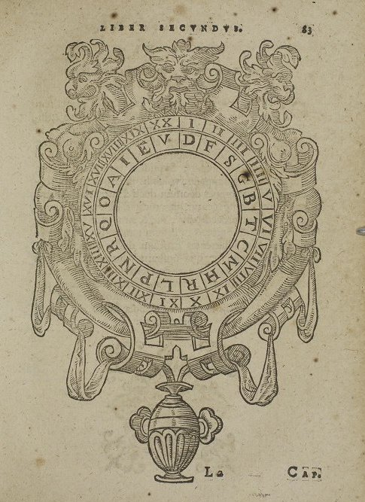
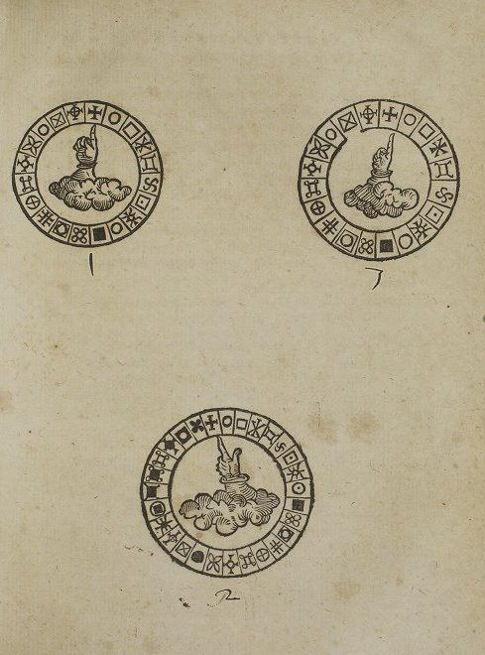
Volvelles
Paper volvelles were known to be printed in medieval books
Search through the first printed books on cryptography shows:
  “Polygraphia” by Johannes Trithemius in 1518
  “Opus Novum” by Jacopo Silvestri in 1526
  “De furtivis Literarum Notis” by Giambattista della Porta in 1563
della Porta’s book has 3 volvelles. The smaller disks would be cut out by the book owner and attached to larger disk by thread
Copyright © 2020 CipherHistory.com

Slide 14
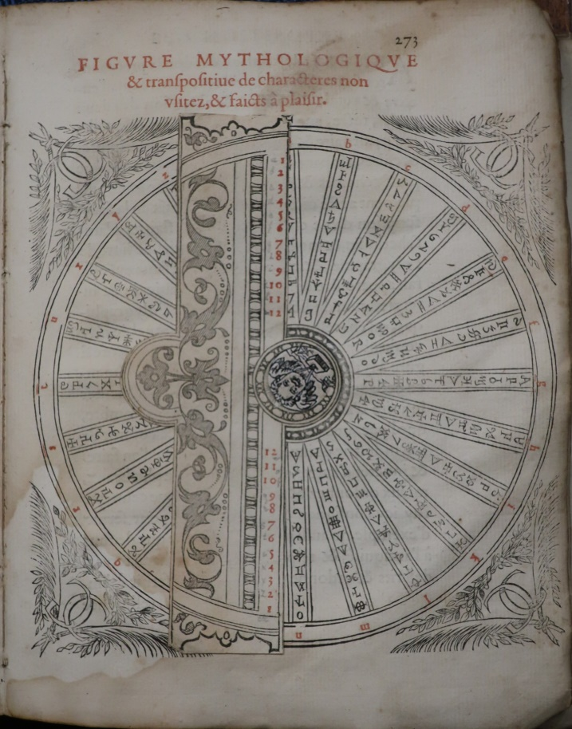
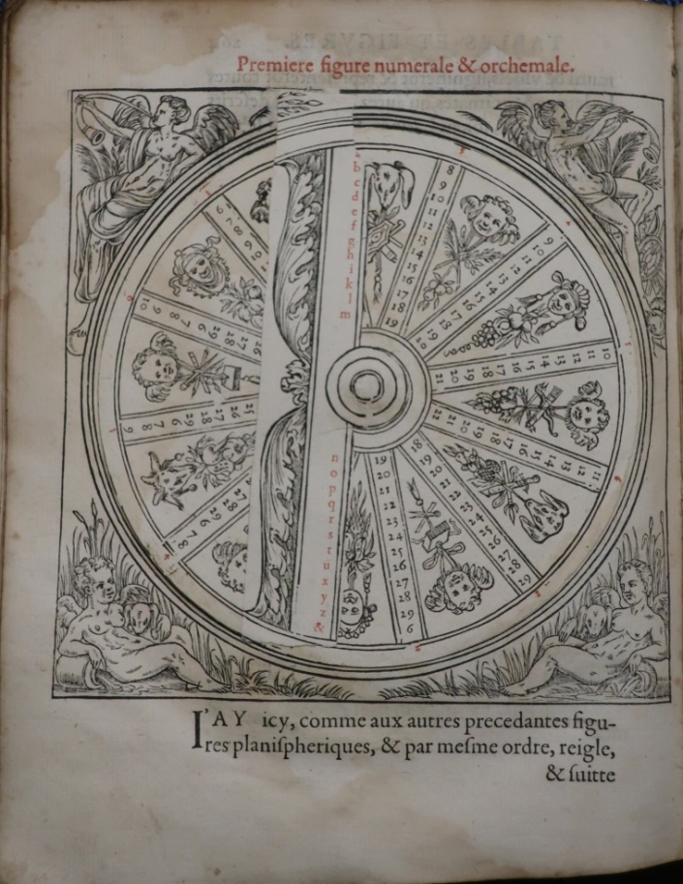
Polygraphia
“Polygraphia” was first printed book on cryptography, but did not contain volvelles
Gabriel Collange translated French edition in 1561, contained 13 volvelles, with spokes!
Later French editions printed in 1571, 1620, 1625
Copyright © 2020 CipherHistory.com

Slide 15
World’s Oldest Surviving Cipher Devices
1547-1559 - King Henry II brass cipher device
1561 - “Polygraphia” – 1st French translation
1563 - “De furtivis Literarum Notis”
1571 - “Polygraphia” – 2nd French edition
1591 - “De furtivis Literarum Notis” – pirated edition (false 1563 date)
1593 - “De furtivis Literarum Notis” 2nd edition
1602 - “De furtivis Literarum Notis” 3rd edition
1620 - “Polygraphia” – 3rd French edition
1625 - “Polygraphia” – 4th French edition
1680-1715 - Nicholas Bion silver cipher disk
c.1795 - Thomas Jefferson Wheel Cypher
Copyright © 2020 CipherHistory.com

Slide 16
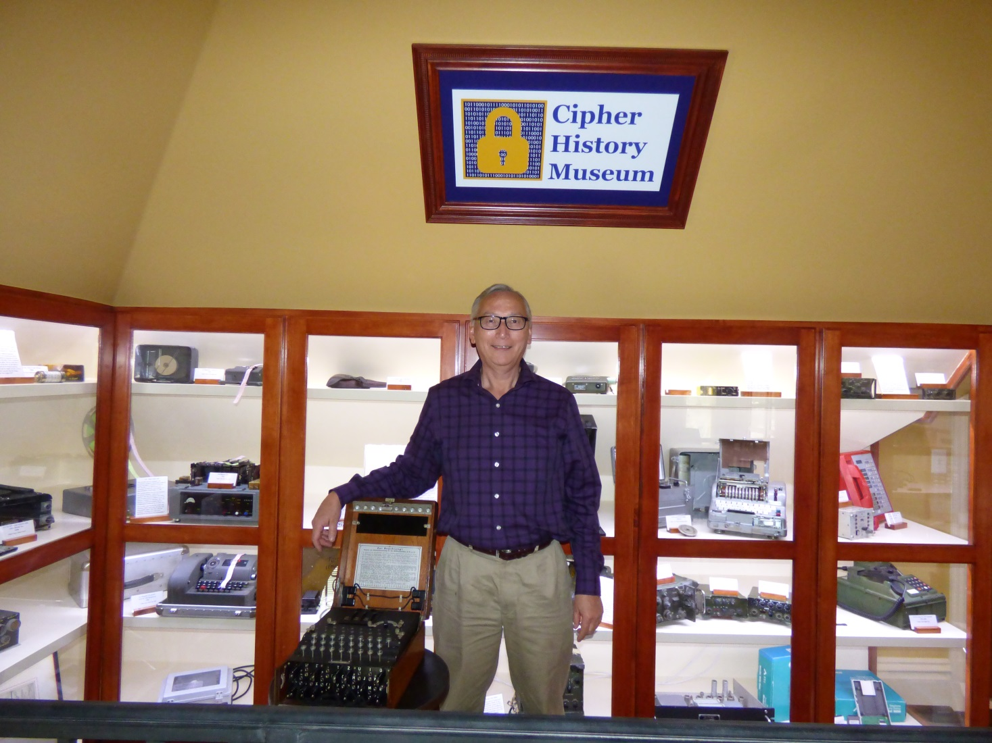
Download this Presentation
Slides: CipherHistory.com/slides/oldestciphers.pptx
Video: CipherHistory.com/video/oldestciphers.mp4
Article: CipherHistory.com/oldestciphers.html
Copyright © 2020 CipherHistory.com

