Slide 1
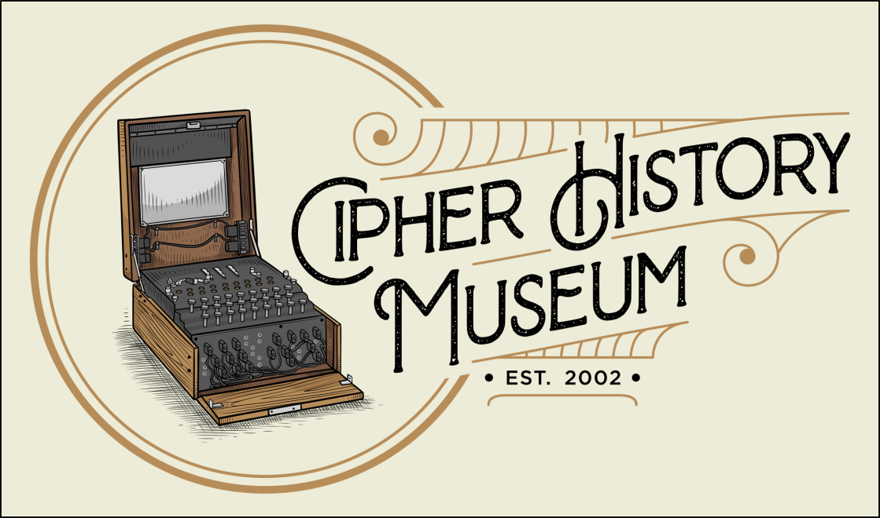

The One-Time Pad
Breaking the Unbreakable Cipher
January 9, 2021
Copyright © 2022
CC Attribution 4.0 International
Ralph Simpson
Cipher History Museum
All images in this presentation are from the Cipher History Museum, unless otherwise noted
Notes:
The invention of the one-time pad was incorrectly attributed to the wrong inventor for almost 100 years, until the original inventor was discovered in 2011. This follows a long tradition in cryptology of giving credit to the wrong inventor. Although the one-time pad is famous for being unbreakable, three historic examples will show three different ways in which this unbreakable cipher device was broken, with devastating results.

Slide 2
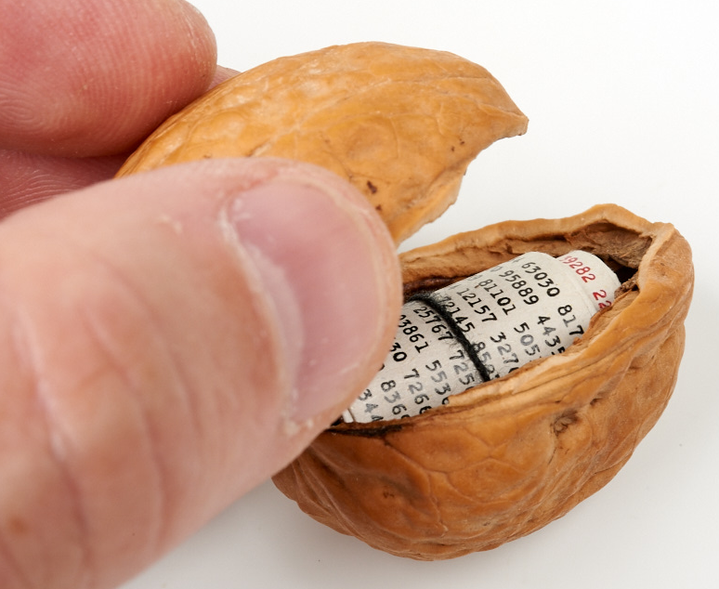
What is the One-Time Pad?
Cipher made by combining a random key to plaintext
Named for small pads of random characters, used only one time
The pad is the cipher device, nothing else is needed
OTP is unbreakable, and the only cipher that is unbreakable ^{*2}
One-Time Pad
OTP has only 3 deceptively simple requirements:
The key must be…
  Random
  Used once
  As long as the message
  Destroyed after use or kept secure

Slide 3
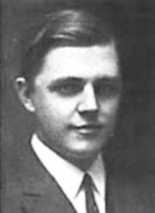
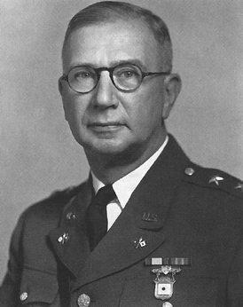
OTP Invention - the Classical Story
Gilbert Vernam AT&T
Joseph Mauborgne US Army
Gilbert Vernam of AT&T invented teletype OTP in Dec. 1917
Informed Navy in Feb., demonstrated to Army in Mar. 1918 ^{*3a}
Applied for patent in Sept. 1918, granted Jul. 1919 ^{*3b}
Vernam credited with inventing random key, as long as message
Co-credit given to Capt. Joseph Mauborgne (later Major General and Chief Signal Officer) for codifying one-time use of key ^{*3c}

Slide 4
How Vernam Teletype Cipher Works
Teletype characters represented in 5 bit Baudot code
Plaintext and random key XORed by relays (before computers)
Example of XOR function (from Vernam patent): ^{*4}
Automatic, reciprocal, and elegant!
Giant leap in technology compared to the common ciphering systems at the time: code books and Vigenère disks
1 1 0 0 0 Plaintext letter A
1 0 0 1 1 Random key letter B
0 1 0 1 1 Result of XOR, ciphertext letter G is sent
0 1 0 1 1 Ciphertext letter G received
1 0 0 1 1 Random key letter B
1 1 0 0 0 Result of XOR, original plaintext letter A
Sender
Receiver

Slide 5
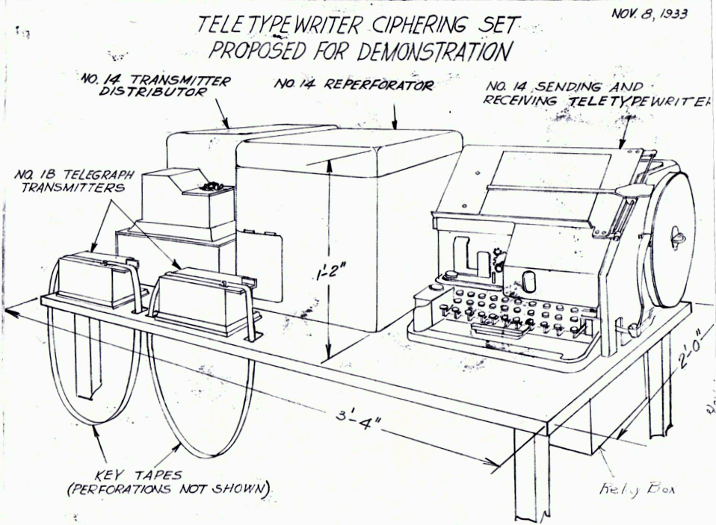
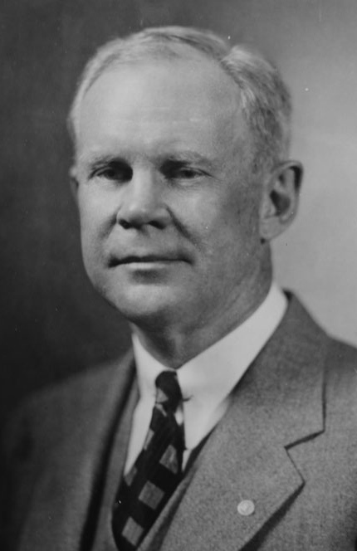
Morehouse 2-Tape System ^{*5a}
Lyman Morehouse
AT&T colleague of Gilbert Vernam
Diagram of 2-tape system - AT&T Archives
Problem: Each location needs 100,000 character random tape daily = 833 feet
Morehouse used 2 loops of 1000 and 999
characters (two 32” diameter loops) to represent 999,000 characters
Two Morehouse loops equivalent to 10 reels random tape
Morehouse 1918 patent may be the first patent of an algorithm
  Paper tape, electrical, mechanical… or no “discernable form” ^{*5b}

Slide 6
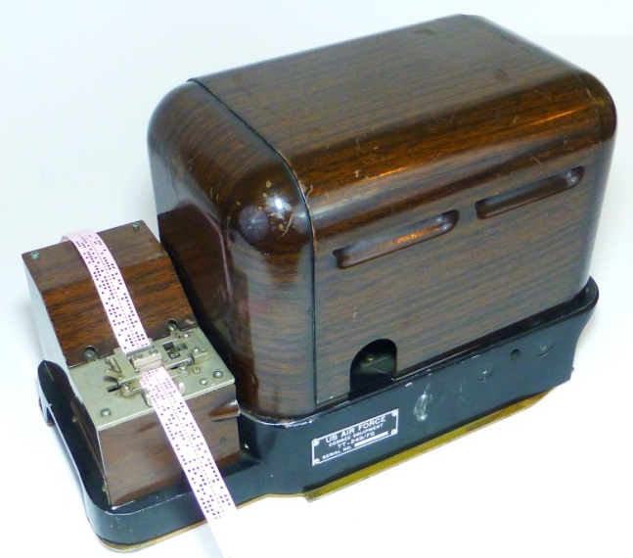
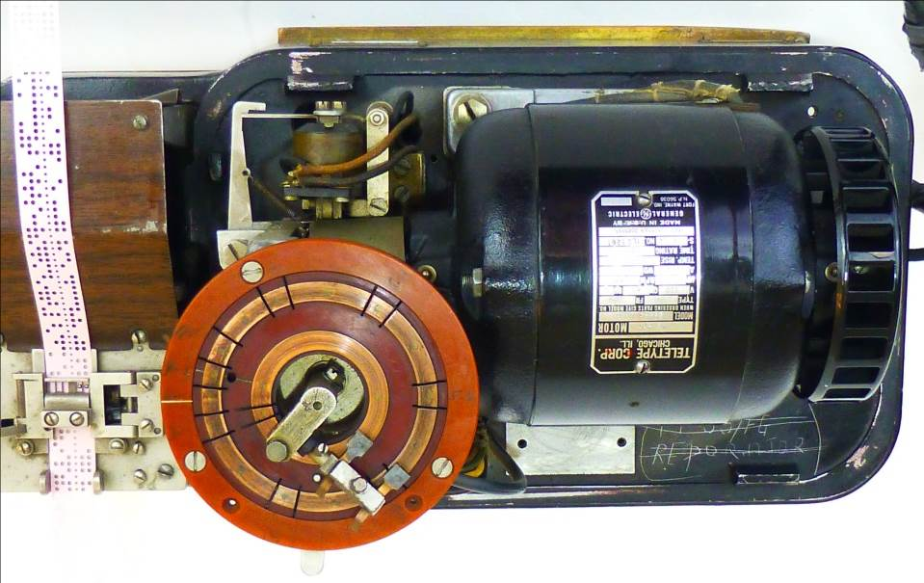
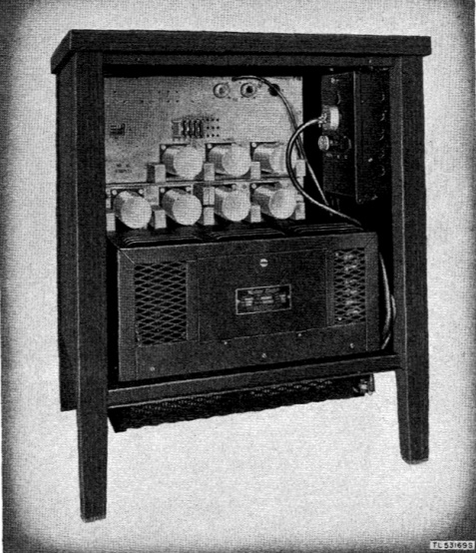
SIGTOT One-Time Tape
Receiving Transmitter / Distributor reads random tape
Vernam’s OTT used as early as 1918 ^{*6}
Standard teletype plus “receiving TD” to
read random tape and mixer table to perform XOR function
First used with 2 tape loops, 1000 and 999 characters, combined to give random key
SIGTOT was first official product of Vernam patent, used by US military from 1925 to 1959
B1 Mixer Table - XORs plain and random tapes

Slide 7
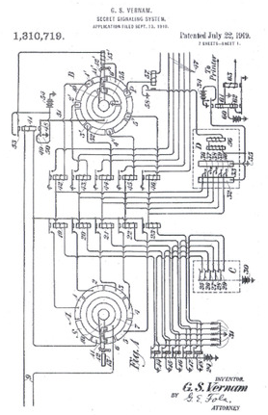
Importance of OTP
The one-time teletype was the first automated, online, and immediate cipher device
All previous ciphers were offline and manual, subject to human delays and errors
The NSA call this patent:
“perhaps one of the most important in the history of cryptography” ^{*7a}
SIGTOT used in White House and FDR’s airplane (now in the NCM)
During WW2, President Truman personally typed on SIGTOT ^{*7b}
Vernam 1919 patent

Slide 8

OTP History Rewritten
In 2011, Steven Bellovin, a Columbia University professor, discovered a prior invention of the one-time pad ^{*8}
In 1882, Frank Miller, a Sacramento CA bank president, wrote a telegraphic code book
Miller’s code book also described a one-time pad!
How did this bank president invent OTP 35 years before Vernam?
Dr. Steven Bellovin
During Civil War, Miller was injured in 1st Battle of Bull Run, then worked for Col. Henry Steel Olcott
Col. Olcott investigated fraud and corruption (and Lincoln assassination), some conspirators used ciphers

Slide 9
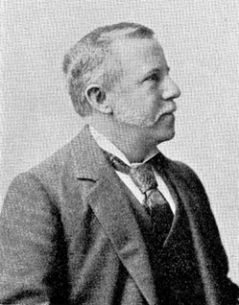
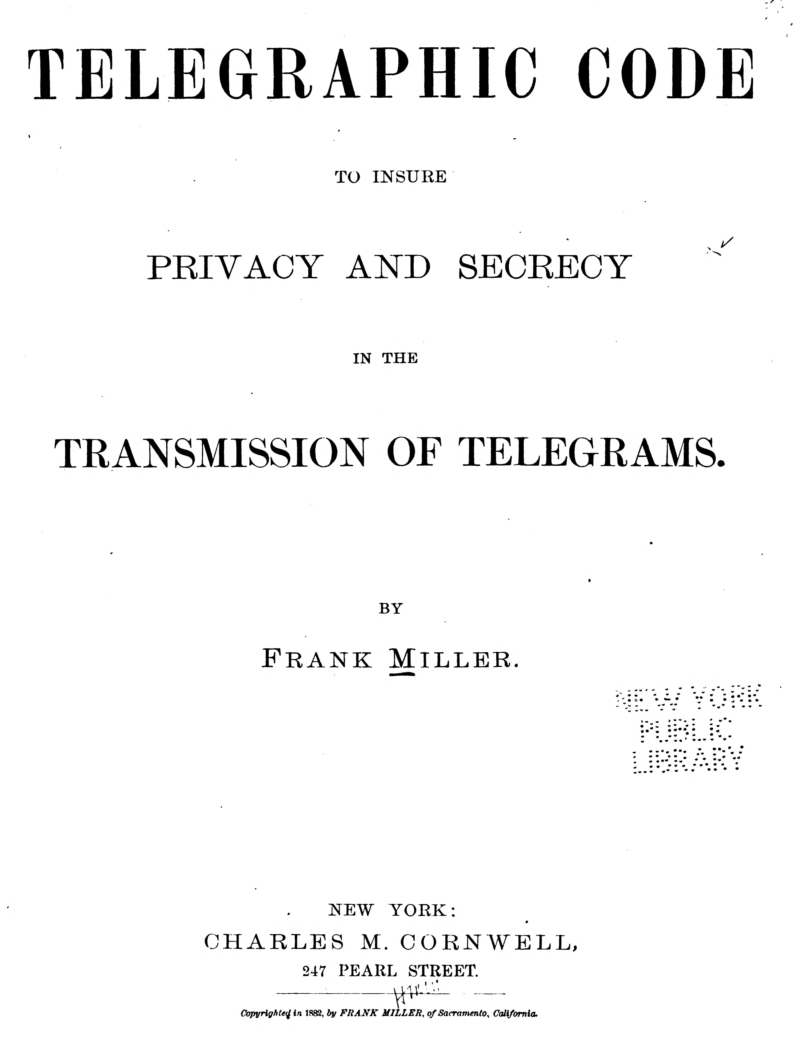
Frank Miller, Banker & Inventor of OTP
Miller’s book was a typical telegraphic code book…
But with “Privacy and Secrecy” in title
Privacy = plain cipher Secrecy = shift cipher
Explanation of his shift cipher was a OTP:
Frank Miller
Title page of Miller’s book
  “A banker in the West should prepare a list of irregular numbers to be called 'shift numbers', such as 483, 281, 175, 892, &c. The differences between such numbers must not be regular. When a shift-number has been applied, or used, it must be erased from the list and not be used again.” ^{*9}

Slide 10
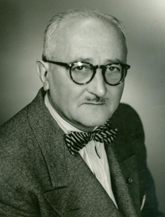
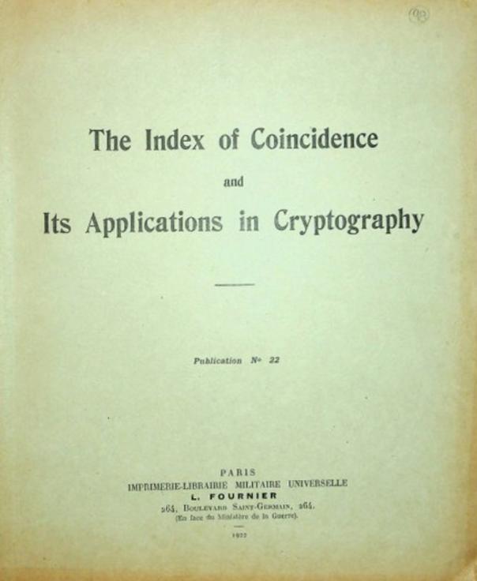
History Rewritten a Second Time?
In 2013, Dr. Bellovin argues the one-time tape teletype was invented solely by Vernam ^{*10a}
Mauborgne later codified the requirements for non-repetition, with collaboration from Parker Hitt and William Friedman
William Friedman’s break of the two-tape system in 1920 likely led to his groundbreaking invention, “Index of Coincidence”
William Friedman
David Kahn:
“the most important single publication in cryptology. It took
the science into a new world.” ^{*10b}

Slide 11
Did Vernam Understand OTP is Unbreakable? ^{*11}
Vernam’s original invention in 1917 specified a random key
Challenge messages sent to Friedman and Yardley included a “truly random” message, some with reuse of key, and some with the Morehouse loops - the reused key messages were expected to be broken
Lyman Morehouse, AT&T engineer, patented system using 2 tapes vs random tape, pat. filed Dec. 4, 1918 (#1,356,546)
2 tape system may have originated from Mauborgne
This 2 tape system was an accommodation to avoid the need for management of random tapes
Vernam’s manager and a colleague claim Vernam understood need for random AND non-repetition of key

Slide 12
Bellovin Timeline of OTP Invention^{*12}
“The problem of who invented the unbreakable cipher. . . was the most difficult I faced in my research.” - David Kahn 1963
Dec. 1917, Vernam invented one-time, random tape system
Vernam’s writings and his AT&T manager, Ralzeman Parker, show he knew the importance of a random, one-time, non-repeating key
1918, Mauborgne collaborated with Lyman Morehouse to develop 2 tape system
US Signal Corp started using 2 tape system in 1918
Mauborgne then collaborated with William Friedman, Parker Hitt, and Herbert Yardley on strength of 2 tape system
Yardley signed off on strength of 2 tape system
William Friedman broke 2 tape system, sent letter to Mauborgne on Dec. 9, 1919

Slide 13
Bellovin Timeline of OTP Invention (continued)
1920, William Friedman and Parker Hitt helped Mauborgne codify need for random, non-repeating key
Summer of 1920, Friedman wrote “Index of Coincidence”
1963, Mauborgne wrote to David Kahn claiming he invented non-repeating key requirement ^{*13}
1966, Friedman wrote “not true” on paragraph in his copy of Scientific American article that gave part-credit to Mauborgne
Friedman left letter verifying Vernam claim unsigned, “because NSA wanted to stay out of the controversy”

Slide 14
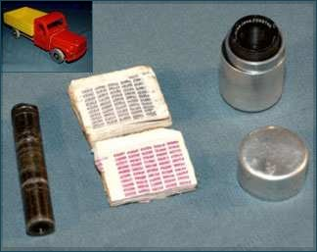
OTP Popular with Spies
First known use of paper pads - German Foreign Office in 1923
Favored by spies because the pads were easily concealed, the cipher was unbreakable, and no other device is needed
Pads were often shrunk to a very small size and made of flammable or water soluble material
In WW2 the SOE used silk scarves, lines of letters unraveled after use
Spies still use OTP today
One-time pad, microdot reader concealed in toy, found on spy entering Canada

Slide 15
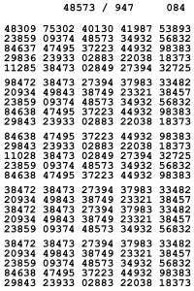
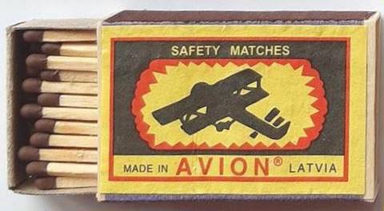
NSA Calypso OTP
NSA Calypso OTP
(shown to scale)
Small pads called
“Mickey Mouse” pads
Calypso used a key of numbers only
Each pad has 625 numbers, yielding 312 cipher characters
Because of the small size, called “Mickey Mouse” pads
Small pads, but slow and error-prone to use
  Plaintext converted to numbers (ex. A-Z converted to 0-25)
  Key is added without carrying
  Result is the ciphertext

Slide 16
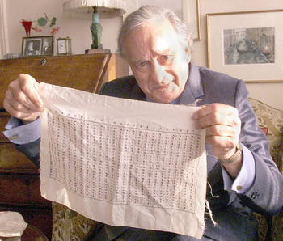
OTP used by SOE
At the beginning of WW2, SOE used poems, songs, and books for double transposition ciphers
Leo Marks, only cryptologist in SOE, independently invented “letter OTP”
Letter OTP uses algorithms instead of changing letters to numbers, then adding a key
Leo Marks with letter OTP algorithm on silk
Algorithms and random letters were written on silk scarves, random letters unraveled after use
Marks later learned BP already knew about letter OTP
Dudley Smith of BP explained that Mark’s plans to have different algorithms for each agent was not necessary ^{*16}

Slide 17
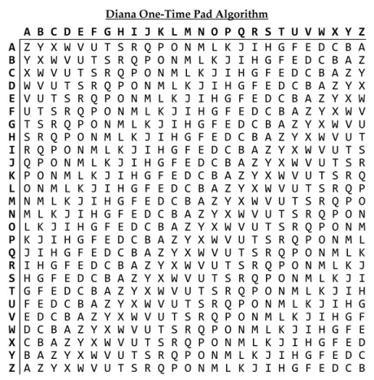
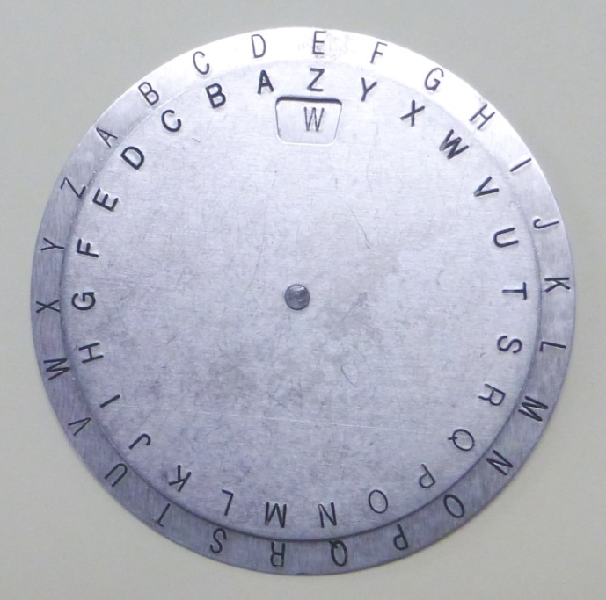
NSA Diana Algorithm
One-time pad calculator with NSA Diana algorithm
NSA Diana algorithm
NSA replaced Calypso with a user-friendly, reciprocal letter OTP, code-named Diana ^{*17}
Letter OTP much easier than converting letters to numbers and adding or subtracting modulo 26
Each small “Mickey Mouse” pad yields 625 cipher characters
Diana still used by spies today

Slide 18
NSA Orion OTP
Orion was developed to provide faster, simpler OTP
Orion 3X faster than Diana *¹⁸
50 lines of A-Z on one side of pad, random key on back
By circling plaintext, with carbon paper underneath, ciphertext is circled on back
Requires precise alignment of printing
NSA Orion pad – front and back
Also, Orion pads could not be reduced to “Mickey Mouse” size
  Larger Orion sheet only yields 50 characters vs 625 for Diana

Slide 19
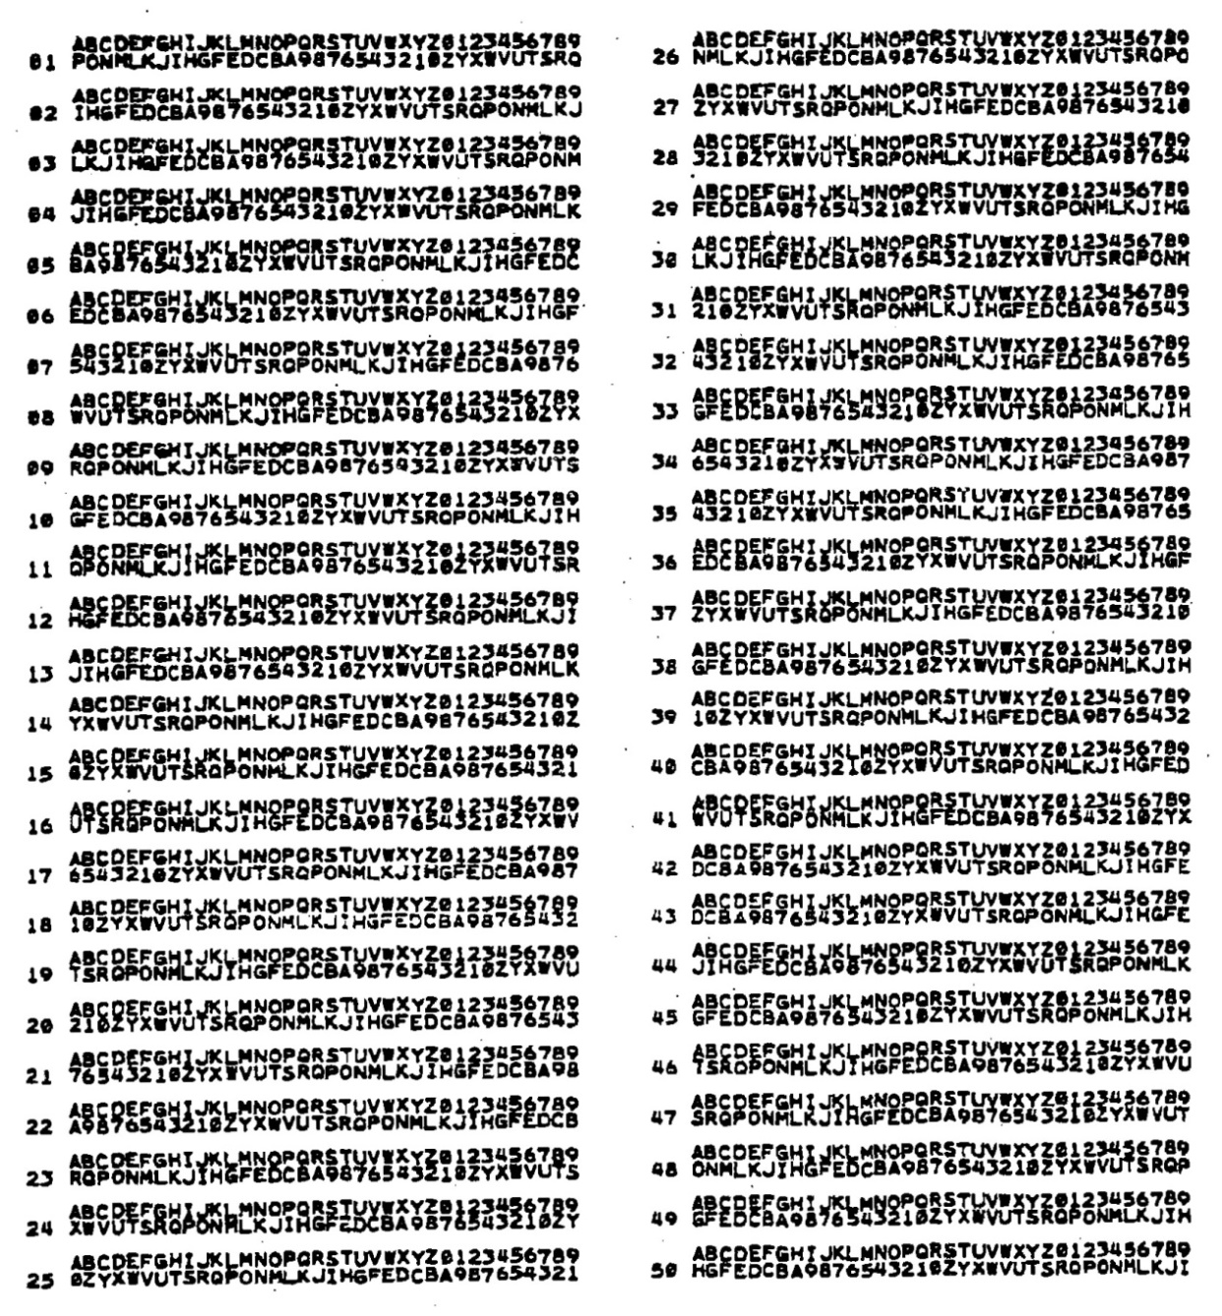
NSA Medea OTP
Medea replaced Orion to avoid carbon paper and precise alignment of printing
Medea is as fast as Orion
Pad has normal alphabet plus 10 digits over random alphabet / digits
72 (2 X 36) characters on 2 lines = one plaintext letter
50 characters per page
In 1972, NSA printed 86,000 Medea pads *¹⁹
NSA Medea pad

Slide 20
Other One-Time Tape Machines
Examples of teletype one-time cipher machines:
  US SIGTOT
  Norway ETCRRM
  Hagelin T-55
  German T-37 ICA
  E. German T-304
  British BID-590
  Dutch ECOLEX
  Canadian Rockex
  Russian M100
  Czech SD1
Examples of manual one-time cipher machines:
  Hagelin C-446-RT
  Hagelin CX-52-RT
  Hagelin CD-57-RT
  German Hell STG-61

Slide 21
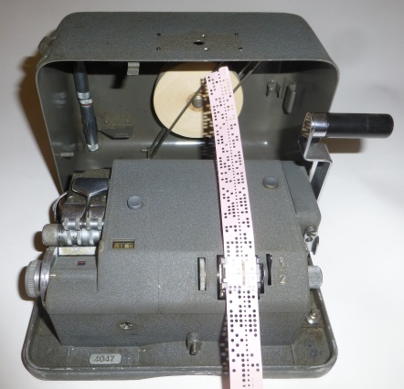
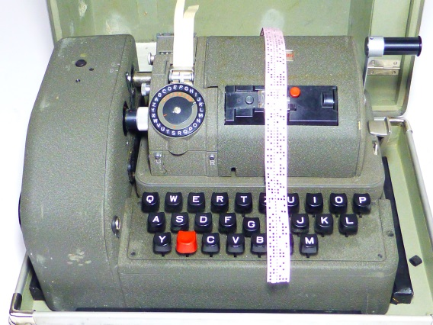
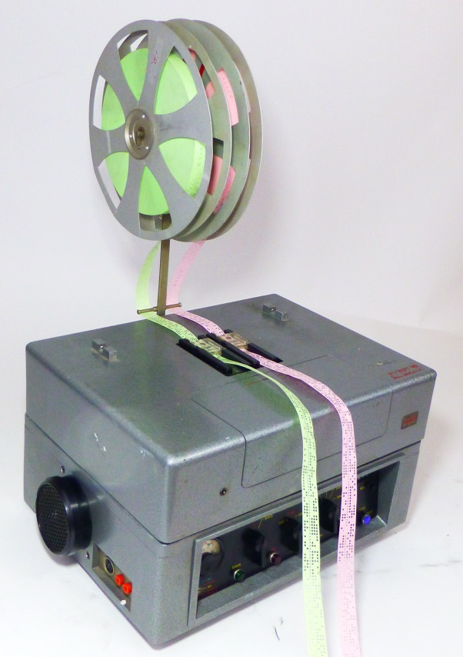
Hagelin One-Time Devices
Hagelin C-446-RT
Hagelin CX-52-RT
Hagelin replaced pin and lug cipher with one-time tape readers in C-446-RT, CX-52-RT, and handheld CD-57-RT
Hagelin also sold a traditional teletype one-time tape machine, the T-55
Hagelin T-55
Some T-55’s included CX-52 or M-209 pin and lug options, which is not a random one-time function, so it is breakable

Slide 22
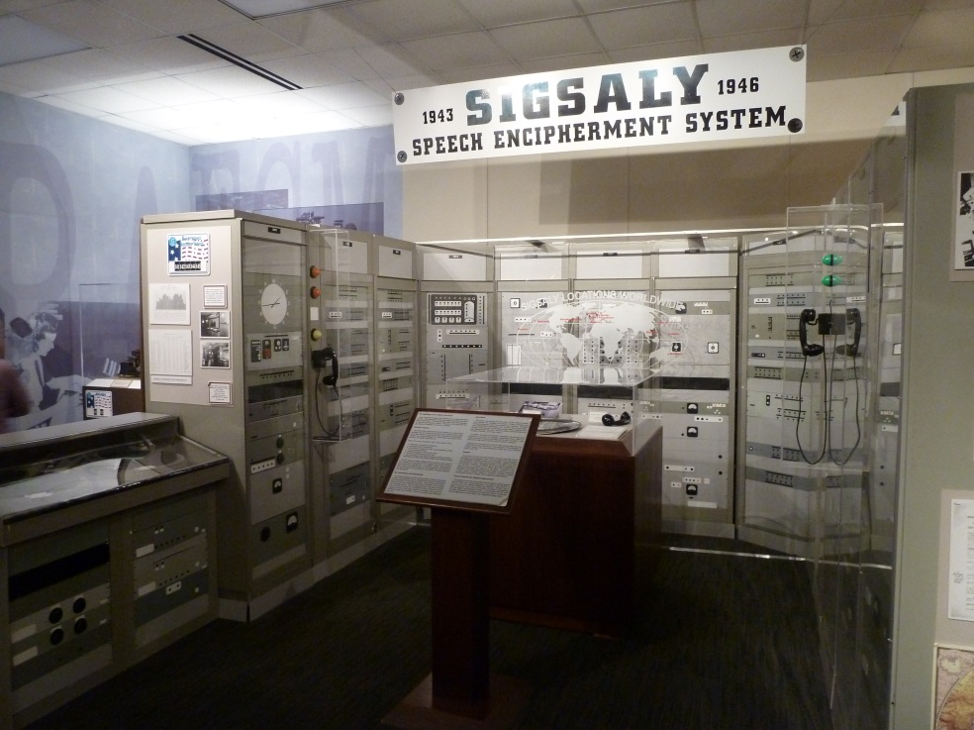
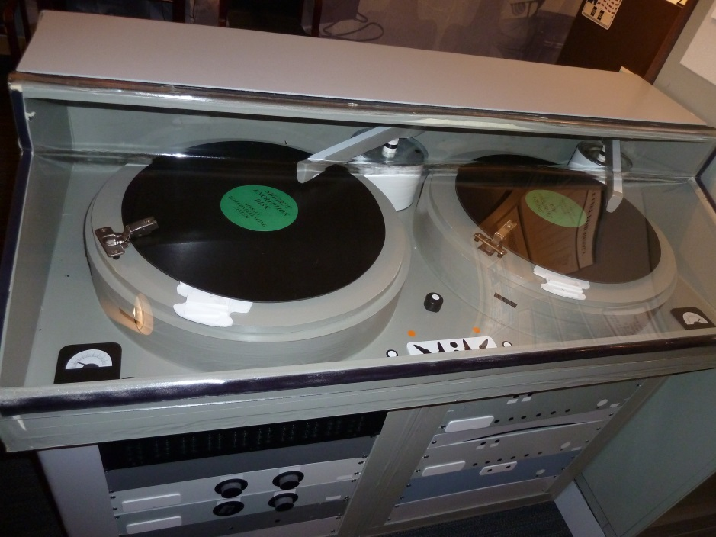
Other One-Time Ciphers
Invented in 1943, US SIGSALY voice encryption was the first digital voice cipher, using noise on records as random data *²²
Since a record was used, some writers erroneously report this as an analog cipher
Used by Churchill and Roosevelt and Allied military leaders in 12 locations, and never broken
SIGSALY in NCM
Random noise on records

Slide 23
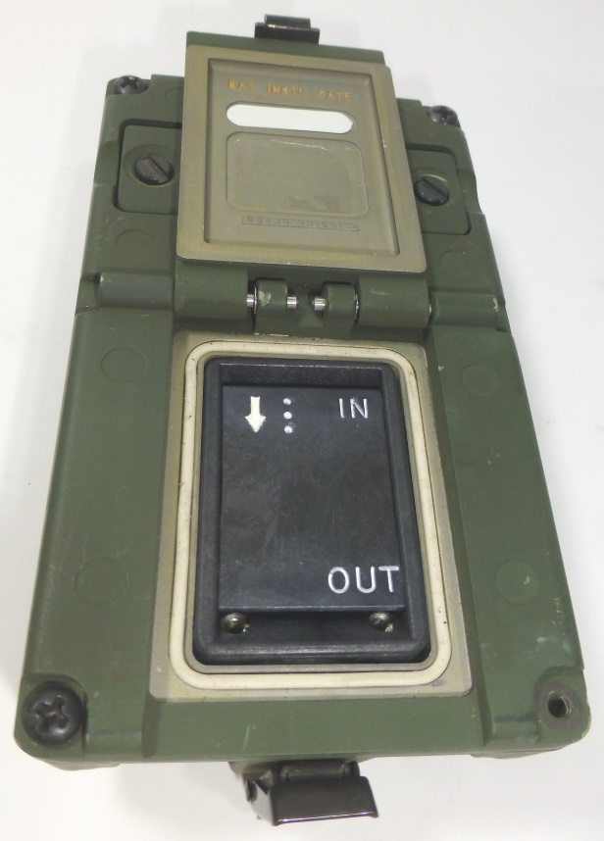
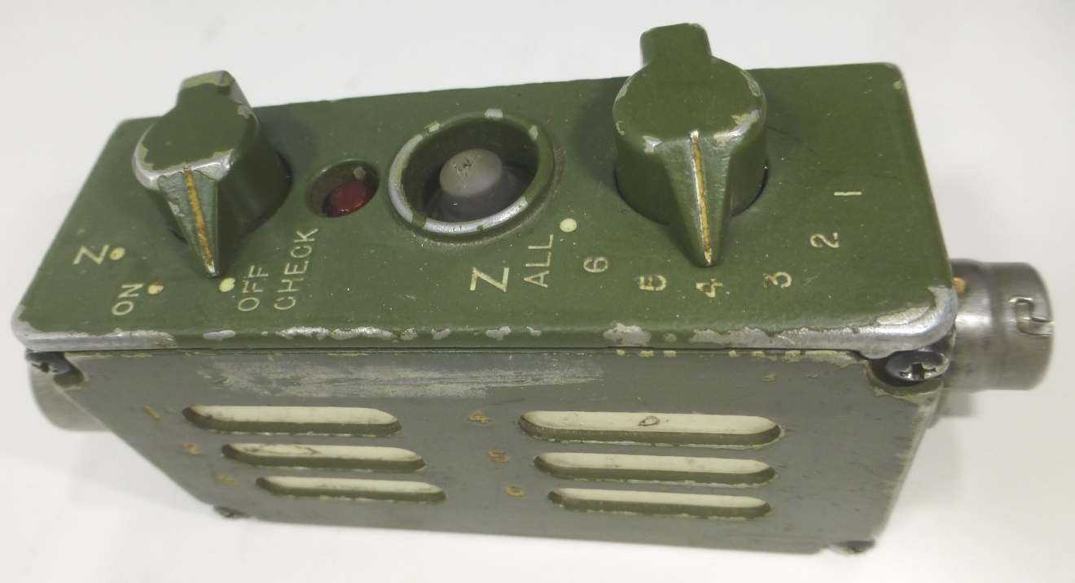
Other One-Time Ciphers
OTP also can be used as a key for a password to another cipher
KOI-18 is a manual OTT device which connects to a key fill device, such as the KYK-13
KYK-13 is then used to load a radio or secure phone, and still used today!
KOI-18 manual tape reader
KYK-13 fill device

Slide 24
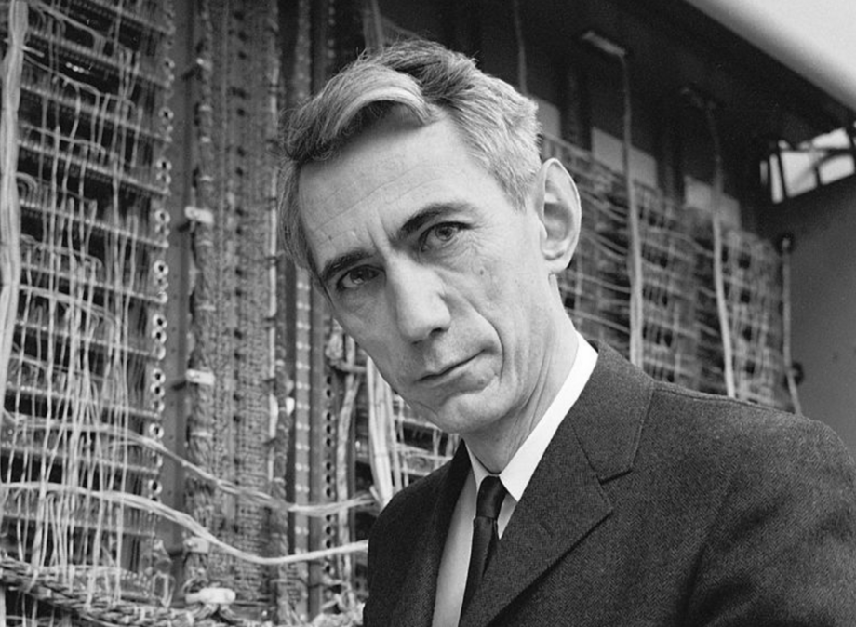
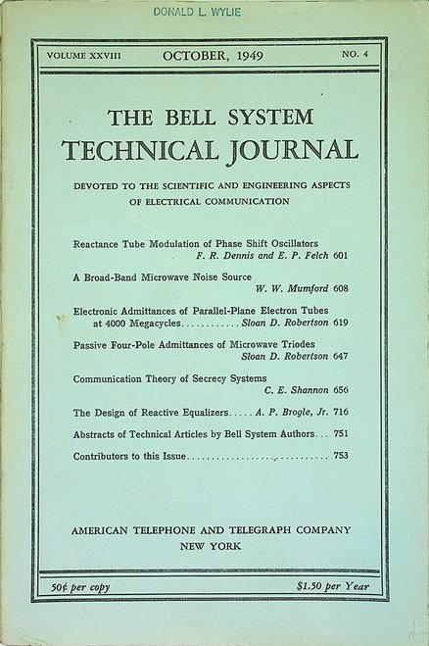
Is the OTP Unbreakable?
Claude Shannon “Father of
Information Theory”
In 1945, Claude Shannon proved the OTP is mathematically unbreakable *²⁴
Shannon’s proof made public in Oct. 1949 issue of Bell Technical Journal
Brings information theory into world of cryptology
Shannon also proved OTP is the only unbreakable cipher:
  If key is random, used once, as long as message, that is “necessary and sufficient” for perfect secrecy

Slide 25
Proof OTP is Unbreakable
Here is my “non-math” translation of Shannon’s proof:
  Take any cipher message of N characters (below left)
  OTP can change that message to EVERY possible plaintext of N characters or less (below right)
  Because of random key, all possible messages are equally likely, so there is no way to know which message is correct
  Result is perfect secrecy
Possible solutions
Attack at dawn
Cipher message
XUIXP DKEGA SBTQL RBPTS CNWPW LSEIG PZWCQ EBXIU VSOOU
Retreat at noon
Bring home milk and eggs

Slide 26
Is OTP CPA-Secure?
“CPA-secure” means secure from a “chosen plaintext attack”
If a codebreaker has known plaintext from OTP, can she break another message using that same key?
  Of course, but that other message would be a two-time pad
  The rest of the message would be secure
  Conclusion: one-time pad does not fit model and cannot be categorized as CPA-secure or not CPA-secure
But… CPA-secure highlights a shortcoming of OTP
  If a codebreaker has known plaintext, she could alter the message, or have a woman-in-the-middle attack
  OTP does not have message authentication

Slide 27
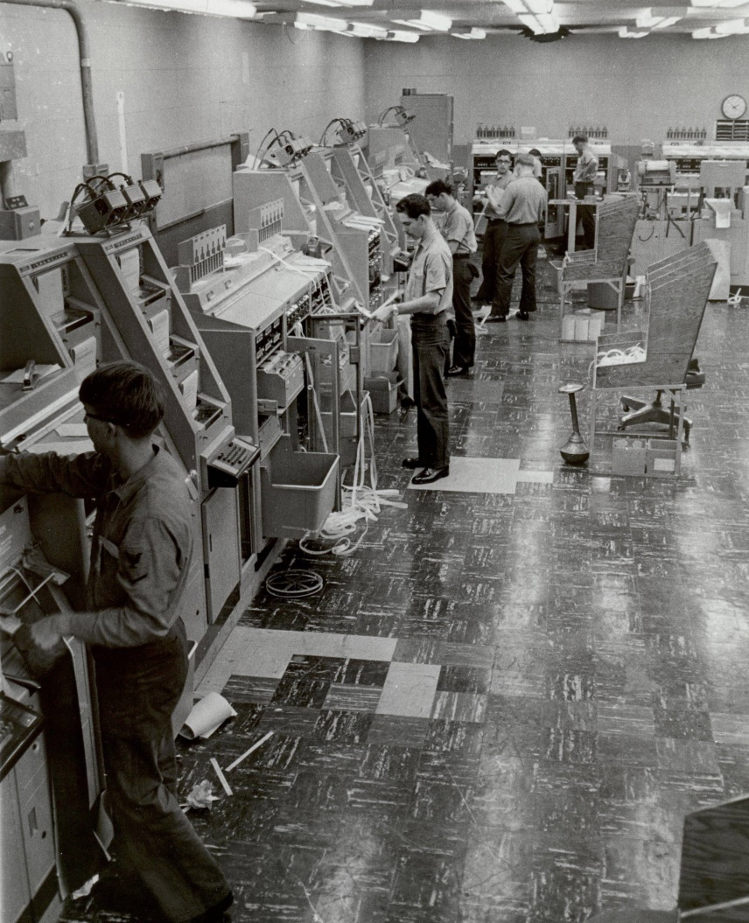
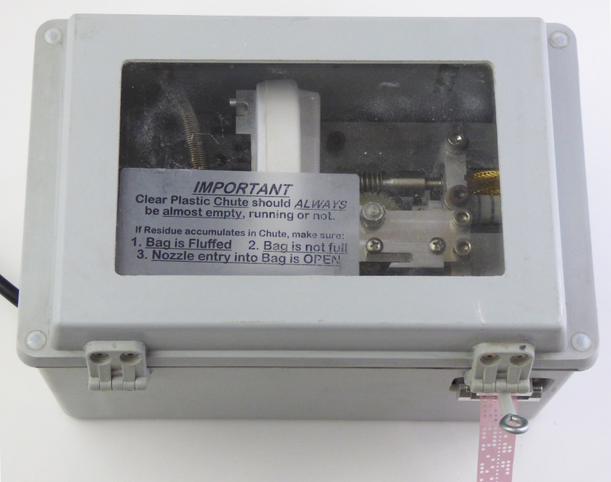
Limitations of One-Time Tape
Tape disintegrator, turns tape to dust
No message authentication
Creating random tape not trivial
Not suitable for broadcast to many
Tape management
Producing, distributing, managing, and destroying tapes is a burden and security risk

Slide 28
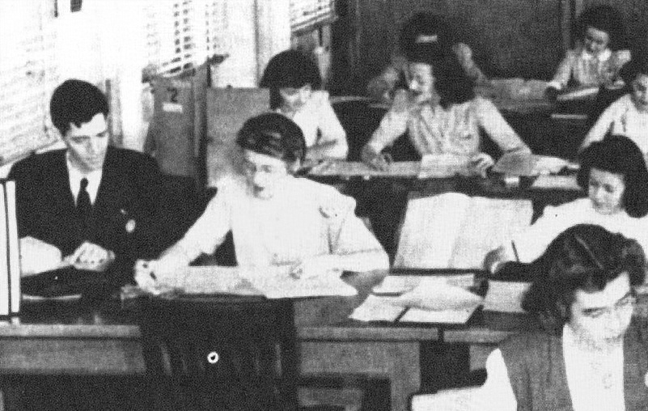
Three Vulnerabilities of OTP
Reuse of one-time pads, ex. Venona Project
  In 1942, Russians had so many spies, they carbon-copied 35,000 pads *²⁸
  During 1942-48, 1.5M total OTP messages were sent,
  1M intercepted, 30,000
  used duplicate pads, 2,900 partially decrypted
  US decryption of Russian spying on Manhattan Project, spies in almost every major military and diplomatic organization, including White House, OSS, MI6, etc.
  349 Americans mentioned, about half identified
  Venona Project closed in 1980, declassified in 1995
Most Venona code beakers were women

Slide 29
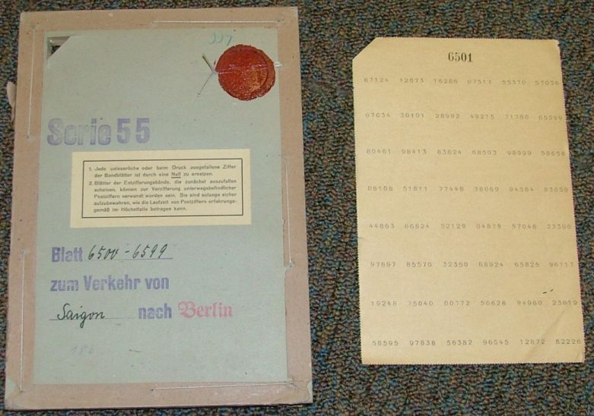
Three Vulnerabilities of OTP
Pseudo-random pads, ex. German Foreign Office in WW2
  German Foreign Office used machine generated, pseudo-random keys, for a system codenamed GEE *²⁹
  Used for high-level diplomatic messages
GEE codebook
  Random numbers added to codes from code book
  The US solved this cipher in 1944, Germans continued to use GEE until 1955

Slide 30
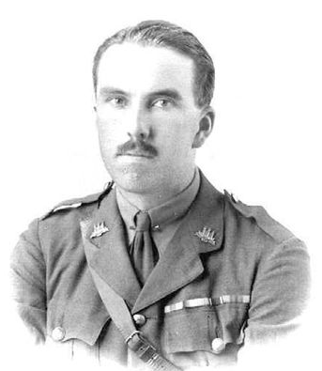
Three Vulnerabilities of OTP
  John Tiltman call the break of GEE:
  “ entirely the work of the US cryptanalysts and perhaps one of the greatest US cryptologic accomplishments of WW2… led to the solution to a large part of the material passing between Berlin and Tokyo.” *³⁰
  14,000 GEE one-time pads were broken for Berlin – Tokyo traffic
  Earliest intercepted message solved from 1925, so 30 years of diplomatic messages were broken
Brigadier John Tiltman,
Deputy Director GCHQ

Slide 31
Three Vulnerabilities of OTP
Electronic emissions, ex. NSA code named Tempest
  First discovered by AT&T in 1943, electronic emissions from teletype relays, keyboards, printers, etc. can be detected before encryption takes place *^{31a}
  Faint artifacts of plaintext travels through the air, signal wires, electric wires, plumbing and can be tapped for up to 20 miles
  US exploited this capability to capture messages in the Berlin hub in 1955, tunneling under the Berlin wall to tap phone and teletype lines *^{31b}
Vulnerabilities #1 and #2 were improper use of OTP, but #3 shows how the OTP can be exploited, even when used correctly

Slide 32
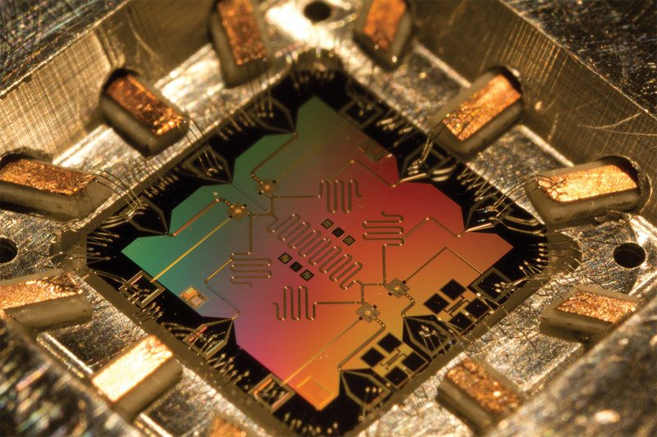
Is There a Future for OTP?
Burden of managing pads or tapes limits use of OTP
OTP also limited to one-to-one communications
Today, two main uses of OTP remain:
  Allows countries to safely exchange messages without revealing their own cipher secrets
  Spies, ambassadors, other high-value messages
But, OTP may return to prominence when quantum computers are available
  Quantum entanglement eliminates problem of managing random tapes and also gives message authentication *³²
Quantum chip

Slide 33
Works Cited
*2 Shannon, Claude. "Communication Theory of Secrecy Systems.“ The Bell System Technical Journal, Bell Labs, NJ, Vol:28, Issue:4, Oct. 1949, pp.679-83.
*3a Kahn, David. The Codebreakers: The Story of Secret Writing. Macmillan, NY, 1967, p.397.
*3b Vernam, Gilbert. “Secret Signaling System.” US Patent #1310719, filed 13 Sept. 1918, granted 22 Jul. 1919.
*3c Kahn. The Codebreakers. p.398.
*4 Vernam. “Secret Signaling System.”
*5a Morehouse, Lyman. “Ciphering System.” US Patent #1356546, filed 4 Dec. 1918, granted 26 Oct. 1920.
*5b Bellovin, Steven. “The Oldest Algorithmic Patent?” Columbia University, NY, 21 May 2013, accessed 17 Dec. 2020, www.cs.columbia.edu/~smb/blog/2013-05/2013-05-21.html.
*6 Bellovin, Steven. “Vernam, Mauborgne, and Friedman: The One-Time Pad and the Index of Coincidence.” Columbia University, NY, 2013, accessed 3 Dec. 2020, mice.cs.columbia.edu/getTechreport.php?techreportID=1576#:~:text=It%20is%20most
%20likely%20that,of%20the%20two-tape%20variant.&text=The%20one-time%20pad%20as,Mauborgne%20%5B22%5D.
*7a Klein, Melvin. Securing Record Communications: The TSEC/KW-26. NSA, Ft. Meade, MD, 2003, p.3.
*7b Mehl, Donald. Top Secret Communications of World War II. Published by Donald Mehl, Raymore, MO, 2002, p.157.
*8 Bellovin, Steven. “Frank Miller: Inventor of the One-Time Pad.” Columbia University, NY, 2011, accessed 3 Dec. 2020, www.cs.columbia.edu/~CS4HS/talks/FrankMillerOneTimePad.pdf.
*9 Miller, Frank. Telegraphic Code to Insure Privacy and Secrecy in the Transmission of Telegrams. Charles M. Cornwell, NY, 1882, p.4.
*10a Bellovin. “Vernam, Mauborgne, and Friedman.” p.
*10b Kahn. The Codebreakers. p.376.
*11 Bellovin. “Vernam, Mauborgne, and Friedman.” p.
*12 Bellovin. “Vernam, Mauborgne, and Friedman.” p.

Slide 34
Works Cited
*13 Kahn. The Codebreakers. pp.1044-5.
*16 Marks, Leo. Between Silk and Cyanide: A Codemaker’s Story, 1941-1945. The Free Press, NY, 1998, pp.246-53.
*17 Boak, David G. “A History of US Communications Security (Volumes I and II).” NSA, Ft. Meade, MD, 1973, p.22.
*18 Ibid. p.23.
*19 Ibid. p.24.
*22 Mehl. Top Secret Communications of World War II. pp.1-123.
*24 Shannon. "Communication Theory of Secrecy Systems.” pp.679-83.
*28 Benson, Robert L. The Venona Story. Center for Cryptologic History, NSA, Ft. Meade, MD, 2001.
*29 Waggoner, T.A. and Jache, R. “The GEE System - V,” NSA Technical Journal. NSA, Ft. Meade, MD, Fall 1962, Vol.VII: No.4, declassified 29 Sept. 2008, accessed 19 Dec. 2020, www.nsa.gov/Portals/70/documents/news-features/declassified-documents/tech-journals/gee-system-v.pdf.
*30 Tiltman, John. “The GEE System - Introduction.” NSA Technical Journal. NSA, Ft. Meade, MD, Fall 1961, Vol.IV: No.4, declassified 29 Sept. 2008, accessed 19 Dec. 2020, www.nsa.gov/Portals/70/documents/news-features/declassified-documents/tech-journals/gee-system-i.pdf, p.1.
*31a NSA. “TEMPEST: A Signal Problem,” Cryptologic Spectrum. NSA, Ft. Meade, MD, 1972, declassified 27 Sep. 2007, accessed 16 Dec. 2020, www.nsa.gov/Portals/70/documents/news-features/declassified-documents/cryptologic- spectrum/tempest.pdf.
*31b Easter, David. “The impact of ‘Tempest’ on Anglo-American communications security and intelligence, 1943–1970,” Intelligence and National Security. Taylor & Francis, UK, 26 Jul. 2020, accessed 17 Dec. 2020, www.cryptome.org/2020/08/tempest-impact-uk-us-comms.pdf, p.8.
*32 Cai, Qing-yu. “An one-time-pad key communication protocol with entanglement.” Cornell University, NY, 7 Jun. 2004, accessed 17 Dec. 2020, www.arxiv.org/abs/quant-ph/0309108.

Slide 35
References
Kahn, David. The Codebreakers: The Story of Secret Writing. Macmillan, NY, 1967.
Shannon, Claude. “Communication Theory of Secrecy Systems.” The Bell System Technical Journal, Bell Labs, NJ, Vol:28, Issue:4, Oct. 1949.
Vernam, Gilbert. “Secret Signaling System.” US Patent #1310719, filed 13 Sept. 1918, granted 22 Oct. 1919.
Morehouse, Lyman. “Ciphering System.” US Patent #1356546, filed 4 Dec.1918, granted 26 Oct. 1920.
Friedman, William. The Index of Coincidence and Its Applications in Cryptanalysis. Riverbank Labs, IL, 1922.
Miller, Frank. Telegraphic Code to Insure Privacy and Secrecy in the Transmission of Telegrams. Charles M. Cornwell, NY, 1882.
Klein, Melvin. Securing Record Communications: The TSEC/KW-26. NSA, Ft. Meade, MD, 2003.
Mehl, Donald. Top Secret Communications of World War II. Published by Donald Mehl, Raymore, MO, 2002.
Bellovin, Steven. “Frank Miller: Inventor of the One-Time Pad.” Columbia University, NY, 2011, accessed 3 Dec. 2020, www.cs.columbia.edu/~CS4HS/talks/FrankMillerOneTimePad.pdf.
Bellovin, Steven. “Vernam, Mauborgne, Friedman: The One-Time Pad and the Index of Coincidence.” Columbia University, NY, 10 Oct. 2013, accessed 3 Dec. 2020, www.cs.columbia.edu/~smb/talks/VernamMauborgneFriedman.pdf.
Bellovin, Steven. “Vernam, Mauborgne, and Friedman: The One-Time Pad and the Index of Coincidence.” Columbia University, NY, 2013, accessed 3 Dec. 2020, mice.cs.columbia.edu/getTechreport.php?techreportID=1576#:~:text=It%20is%20most%
20likely%20that,of%20the%20two-tape%20variant.&text=The%20one-time%20pad%20as,Mauborgne%20%5B22%5D.
Boak, David G. “A History of US Communications Security (Volumes I and II).” NSA, Ft. Meade, MD, 1973.
Marks, Leo. Between Silk and Cyanide: A Codemaker’s Story, 1941-1945. The Free Press, NY, 1998.
Cai, Qing-yu. “An one-time-pad key communication protocol with entanglement.” Cornell University, NY, 7 Jun. 2004, accessed 17 Dec. 2020, www.arxiv.org/abs/quant-ph/0309108.
NSA. “TEMPEST: A Signal Problem,” Cryptologic Spectrum. NSA, Ft. Meade, MD, 1972, declassified 27 Sep. 2007, accessed 16 Dec. 2020, www.nsa.gov/Portals/70/documents/news-features/declassified-documents/cryptologic- spectrum/tempest.pdf.

Slide 36
References
Easter, David. “The impact of ‘Tempest’ on Anglo-American communications security and intelligence, 1943–1970,” Intelligence and National Security. Taylor & Francis, UK, 26 Jul. 2020, accessed 17 Dec. 2020, www.cryptome.org/2020/08/tempest- impact-uk-us-comms.pdf.
Tiltman, John. “The GEE System – I, Introduction.” NSA Technical Journal. NSA, Ft. Meade, MD, Fall 1961, Vol.IV: No.4, declassified 29 Sept. 2008, accessed 19 Dec. 2020, www.nsa.gov/Portals/70/documents/news-features/declassified- documents/tech-journals/gee-system-i.pdf.
Waggoner, T.A. and Jache, R. “The GEE System - V,” NSA Technical Journal. NSA, Ft. Meade, MD, Fall 1962, Vol.VII: No.4, declassified 29 Sept. 2008, accessed 19 Dec. 2020, www.nsa.gov/Portals/70/documents/news-features/declassified- documents/tech-journals/gee-system-v.pdf.
Benson, Robert L. The Venona Story. Center for Cryptologic History, NSA, Ft. Meade MD, 2001.

Slide 37
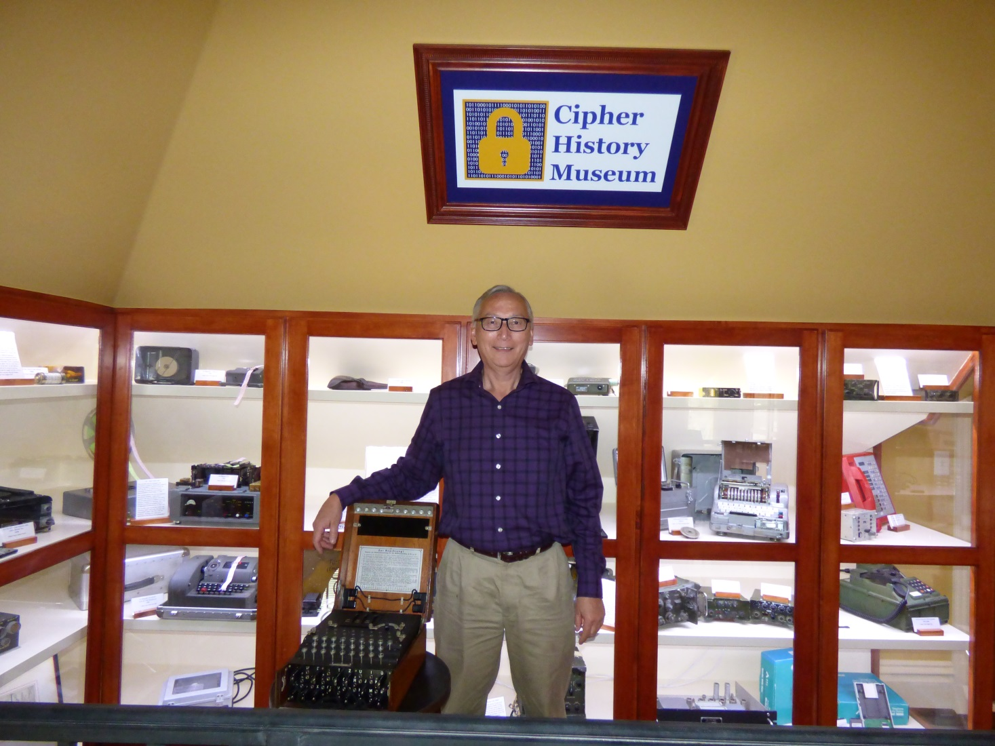
Download this Presentation
  CipherHistory.com/slides/otp.pptx

Slide 38
